Slide 1

Thrival Festival: Big Data & You
September 22, 2015
Erik Arneson, Executive Director
@ErikOpenRecords
@OpenRecordsPA
earneson@pa.gov
(717) 346-9903

Slide 2
Gov’t Collects a LOT of Data
Non-Personal:
Video: Dashcams, Bodycams, Drones
GIS Data
Economic Data, incl. Gov’t Budgets
Aggregated Data (e.g., voter participation)
Air Monitoring Test Results
More: e.g., OpenDataPhilly.org

Slide 3
Gov’t Collects a LOT of Data
Personal:
Driver’s License & Voter Registration
Property Deeds
Marriage License & Divorce Records
Birth Certificates
Court Records (Criminal & Civil)
School Transcripts

Slide 4
Some Gov’t Data is Public
Public access is governed by:
Pennsylvania Right-to-Know Law (RTKL)
Federal Freedom of Information Act (FOIA)
Other Statutes, Regulations & Court Orders

Slide 5
Big Data Can Benefit Gov’t
Benefits seen across agencies:
Law enforcement analyzing petabytes of data to investigate crimes against children
Drones sent in after disasters to compare landscape with pre-disaster mapping data
Monitoring complex transportation systems w/ real-time analysis to anticipate problems
NOTE: 1 petabyte = 1,000,000 gigabytes

Slide 6
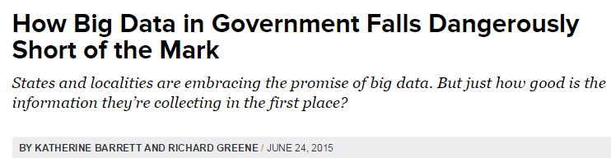
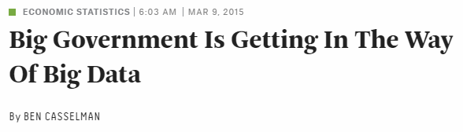
Big Gov’t vs. Big Data
GovTech.com:
FiveThirtyEight.com:

Slide 7
Big Gov’t vs. Big Data
FiveThirtyEight.com:
“Big data” may have revolutionized industries from advertising to transportation, but many of our most vital economic statistics are still based on methods that are decidedly, well, small.

Slide 8
Big Gov’t vs. Big Data
FiveThirtyEight.com found that:
Unemployment rate calculated via phone polls
Retail sales calculated via paper forms
Inflation calculated via on-site inspections
Agencies often don’t share data w/ each other
Other countries offer easier access to data

Slide 9
Examples of Gov’t Open Data
Open Data Websites:
data.gov (federal gov’t)
data.hawaii.gov (Hawaii)
data.illinois.gov (Illinois)
data.maryland.gov (Maryland)
data.ny.gov (New York)
data.ok.gov (Oklahoma)
opendata.utah.gov (Utah)
These six states ranked highest in an August 2014 report published by the Center for Data Innovation: datainnovation.org

Slide 10
THANK YOU
Erik Arneson, Executive Director
@ErikOpenRecords
@OpenRecordsPA
earneson@pa.gov
(717) 346-9903

