Slide 1

County Commissioners Association
November 23, 2015
Erik Arneson, Executive Director
http://openrecords.pa.gov
@ErikOpenRecords
@OpenRecordsPA
earneson@pa.gov
(717) 346-9903

Slide 2
Don’t Fear Transparency
Embracing transparency is the best policy
The goal of the Right-to-Know Law (as said by the Supreme Court) is “to empower citizens by affording them access to information concerning the activities of their government”
Constituents expect transparency

Slide 3
Cut RTK Requests Up Front
Many records can/should be instantly available
Constituents want information online
  Meeting minutes
  Budget documents, including spending
  RFPs and contracts
  Election results
  Job openings
  Park maps

Slide 4
Look at Other County Websites
No need to reinvent the wheel
Counties with very good websites include:
  Lancaster County
  Montgomery County
Think like a constituent, not an official
  “How do I… ?” section on website

Slide 5
Have a Good AORO
AORO = Agency Open Records Officer
Sometimes called “Right-to-Know Officer”
A good AORO is absolutely vital
Job responsibilities:
  Communicating with requesters
  Understanding agency record-keeping
  Meeting tight, inflexible deadlines

Slide 6
Understand the Right-to-Know Law
All gov’t records are presumed to be public
Exceptions
  30 exceptions in RTKL itself
  Other state statutes
  Federal law
  Court orders

Slide 7
Exceptions to the RTKL
Exceptions in the RTKL include:
Public safety & personal safety
Social Security #s, driver’s license #s
Employee performance reviews
Medical records
Internal, predecisional deliberations
Certain investigative records

Slide 8
How the RTKL Applies to You
A record is…
“information, regardless of physical form or characteristics, that documents a transaction or activity of an agency and that is created, received or retained pursuant to law or in connection with a transaction, business or activity of the agency”

Slide 9
How the RTKL Applies to You
The Right-to-Know Law…
Doesn’t distinguish between emails & paper
Doesn’t distinguish between agency devices & personal devices
It only cares if the document / email / whatever is a “record” – and then if that record is a “public record”

Slide 10
Best Practice
Whenever possible:
Use agency devices for agency work
Dramatically simplifies process of responding to RTK requests – and the process of gathering documents for any other purpose

Slide 11
Record Retention
The RTKL does not address record retention
Goal is a strong, effective retention policy
Must balance agency needs & transparency
  Can’t simply say “0 days for everything”
PHMC has a County Records Manual
  Fantastic starting point
  PHMC staff can be a great resource

Slide 12
Sunshine Act
Complementary to the Right-to-Know Law
RTKL = Open Records Act
Sunshine Act = Open Meetings Act
When agencies must hold public meetings
OOR website’s Sunshine Act page offers practical tips about the law

Slide 13
Training from the OOR
Training on the RTKL & Sunshine Act
OOR website filled with information
  www.openrecords.pa.gov
OOR also provides on-site training
  Details on OOR website
  Or call George Spiess, 717-346-9903

Slide 14
Don’t Feel Overwhelmed
It can be a lot, but it’s manageable
In 2014, OOR heard 2,017 appeals
  Total appeals, not total requests
Nearly 60% involved local agencies
Only 13.4% (271) involved counties
On average, each county had ~4 appeals to the OOR in 2014

Slide 15
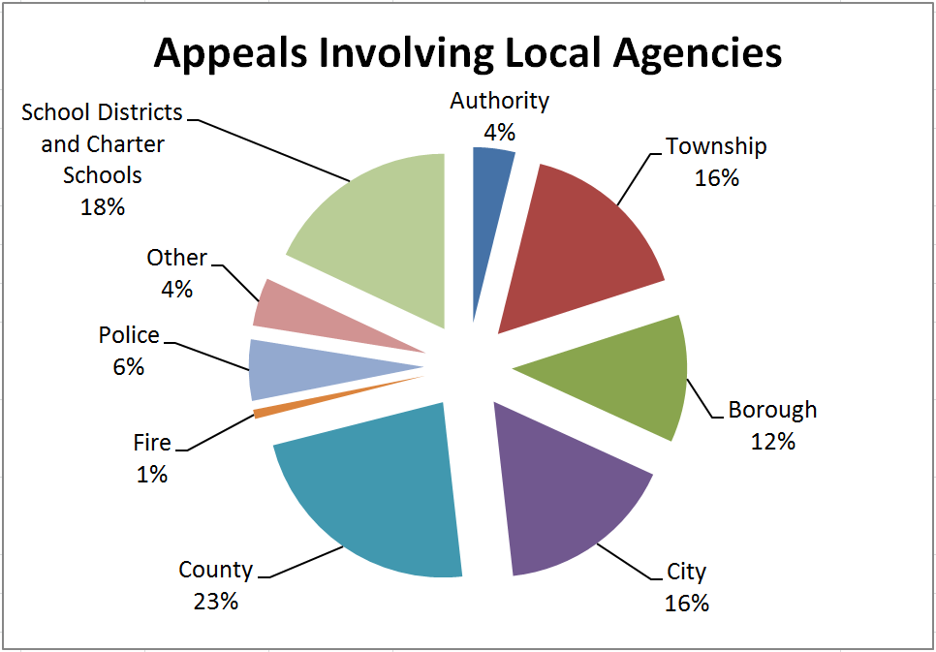
Don’t Feel Overwhelmed

Slide 16
The Office of Open Records
One of my goals is to simplify the RTK process for agencies & requesters
http://openrecords.pa.gov
Constantly updating content
  New AORO Guidebook for agencies
  Sample affidavit forms for agencies
Suggestions welcome

Slide 17
Open Records in PA Blog
Discussing RTKL & other transparency issues
http://OpenRecordsPA.wordpress.com
Significant OOR Final Determinations
Significant court decisions
OOR statistics and data
“Open Records in Pennsylvania” podcast
@ErikOpenRecords & @OpenRecordsPA

Slide 18
Mediation
Goal: Resolve more cases informally
OOR authorized to establish mediation
Limited resources made this difficult in past
Resources still limited, but moving forward
No harm in agreeing to mediation
  Worst-case scenario: FD is slightly delayed

Slide 19
Who Files Appeals?
In 2014, appeals were filed by:
45.1% average citizens
38.8% inmates (likely >40% in 2015)
8.4% companies
7.2% reporters / media
0.5% government officials

Slide 20
Senate Bill 411
Significant amendments to the RTKL
Separate fees for commercial requesters
Limits on inmate requests
OOR procedural improvements
Numerous clarifications
State-related universities: online databases
Supported by CCAP

Slide 21
THANK YOU
Erik Arneson, Executive Director
http://openrecords.pa.gov
@ErikOpenRecords
@OpenRecordsPA
earneson@pa.gov
(717) 346-9903

