Slide 1

NFIB Pennsylvania
March 15, 2016
Erik Arneson, Executive Director
http://openrecords.pa.gov
@ErikOpenRecords
@OpenRecordsPA
earneson@pa.gov
(717) 346-9903

Slide 2
Right-to-Know (Open Records) Law
Completely rewritten in 2007-08
SB1 (Pileggi) of 2007-08, Act 3 of 2008
All gov’t records presumed to be available
  30 exceptions in RTKL
  Other laws can make records non-public
Gov’t agencies have burden of proof
Created the Office of Open Records
PA now one of the most open states

Slide 3
Office of Open Records
Simple for requesters & agencies
A requester denied access can appeal to OOR
No lawyer necessary for requester
OOR assigns Appeals Officer to oversee case
Both sides can present evidence & argument
OOR has 30 days to issue Final Determination

Slide 4

Appeals Filed in 2015
2,926 Appeals Filed w/ OOR in 2015

Slide 5
Who Files Appeals?
In 2015, appeals were filed by…
48% inmates
39% average citizens
8% companies
5% reporters / media
0.3% government officials

Slide 6
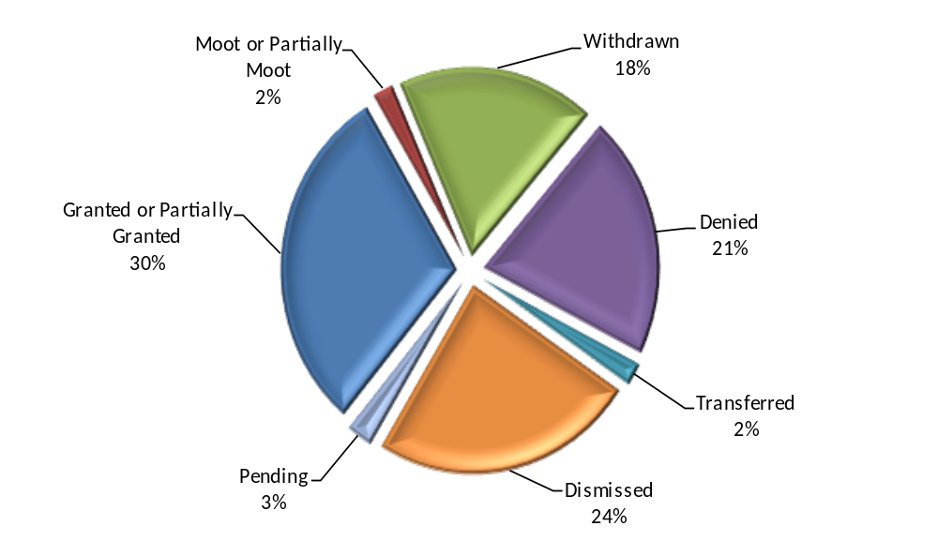
Appeals: Requester Gets Records
873 Appeals Granted / Withdrawn / Moot
This chart shows the results of non-inmate appeals.

Slide 7

Appeals w/ State Agencies
1,132 Appeals Involving State Agencies in 2015

Slide 8
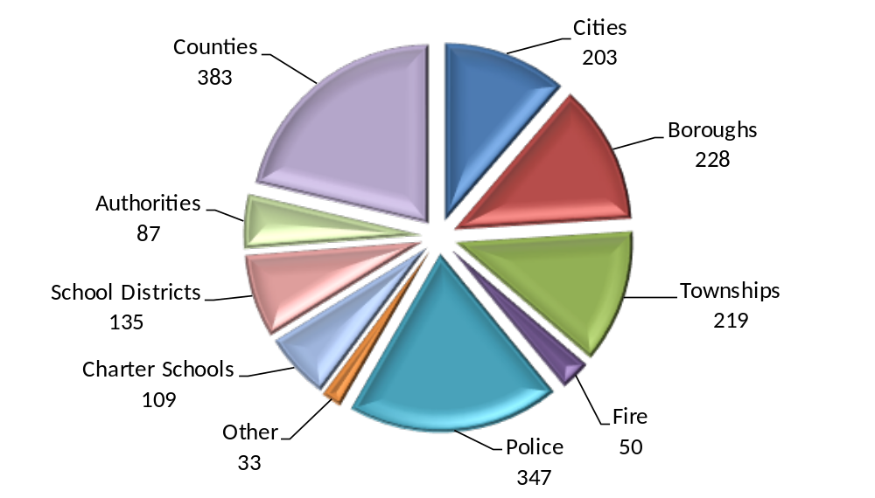
Appeals w/ Local Agencies
1,794 Appeals Involving Local Agencies in 2015

Slide 9
Mediation
Goal: Resolve more cases informally
OOR required to provide mediation
Limited resources made this difficult in past
Resources still limited, but moving forward
Successful mediation = no further appeals
No harm in agreeing to mediation
  Worst-case scenario: FD is slightly delayed

Slide 10
RTKL Provisions of
Interest to Businesses
Online State Contract Database
All state agency contracts > $5,000
http://contracts.patreasury.gov/
Local contracts are also available
Make a request under the RTKL
Some redactions may be made
Can appeal denials to the OOR

Slide 11
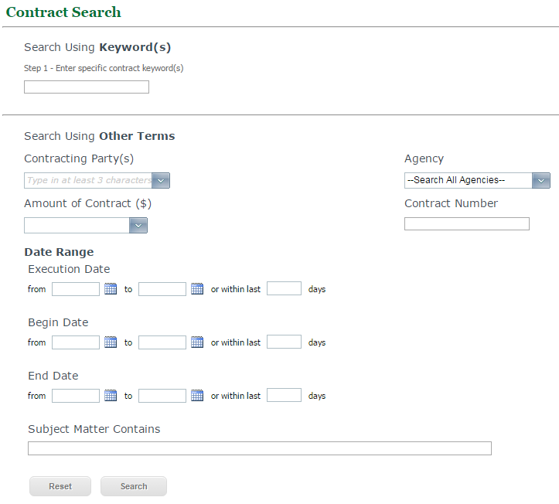

Slide 12
RTKL Provisions of
Interest to Businesses
Procurement Provisions
Records related to agency procurement or disposal of supplies, services or construction are available under RTKL…
  After a contract is awarded, or
  All bids are rejected

Slide 13
RTKL Provisions of
Interest to Businesses
Contract & procurement provisions are good for taxpayers
Providing access to those kinds of records helps businesses compete for gov’t contracts
Increased competition reduces taxpayer cost

Slide 14
Open Data Portals
Some agencies posting large datasets
Open Data Philly
  https://www.opendataphilly.org/
Western PA Regional Data Center
  https://www.wprdc.org/
Good statewide example: New York
  https://data.ny.gov/

Slide 15
Other Provisions of RTKL
Some third-party vendor records are public
Public records in possession of a third-party vendor contracted to perform a governmental function are available
Requests must go to agencies, who respond
Trade secrets
Agencies required to provide notification before releasing *IF* aware of the issue

Slide 16
RTKL Training by the OOR
54 Training Sessions Across PA in 2015
Right-to-Know Law
Sunshine Act
Agency training, also requester groups
Call the OOR to discuss training ideas

Slide 17
THANK YOU
Erik Arneson, Executive Director
http://openrecords.pa.gov
@ErikOpenRecords
@OpenRecordsPA
earneson@pa.gov
(717) 346-9903

