Slide 1

PNA Sunshine Week Panel Discussion
March 15, 2016
Erik Arneson, Executive Director
http://openrecords.pa.gov
@ErikOpenRecords
@OpenRecordsPA
earneson@pa.gov
(717) 346-9903

Slide 2

Appeals Filed in 2015
2,926 Appeals Filed w/ OOR in 2015

Slide 3
Appeals Filed in 2015
2,926 Appeals Filed w/ OOR in 2015
Requesters & agencies more sophisticated
Complexity of cases increasing
Issues are more nuanced
Going forward:
  More in camera, likely more hearings

Slide 4
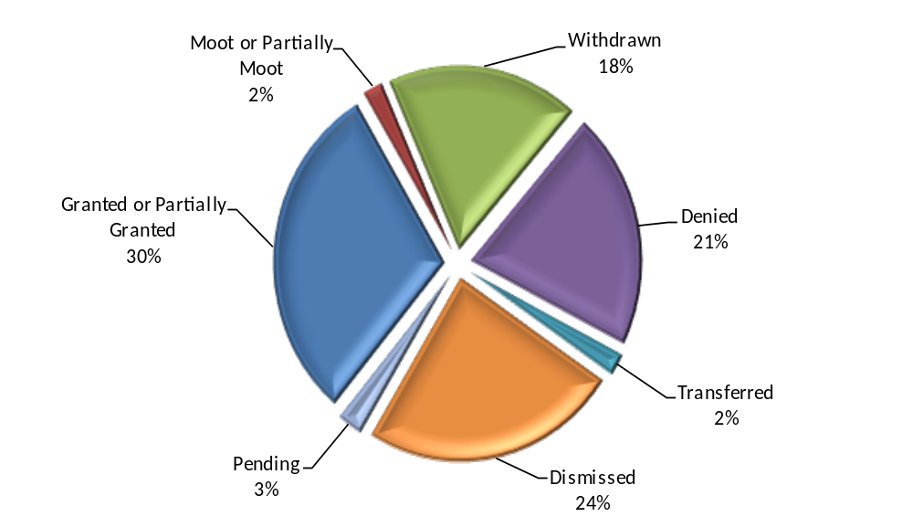
Appeals: Requester Gets Records
873 Appeals Granted / Withdrawn / Moot
Pie chart shows results of non-inmate appeals.

Slide 5

Appeals w/ State Agencies
1,132 Appeals Involving State Agencies in 2015

Slide 6
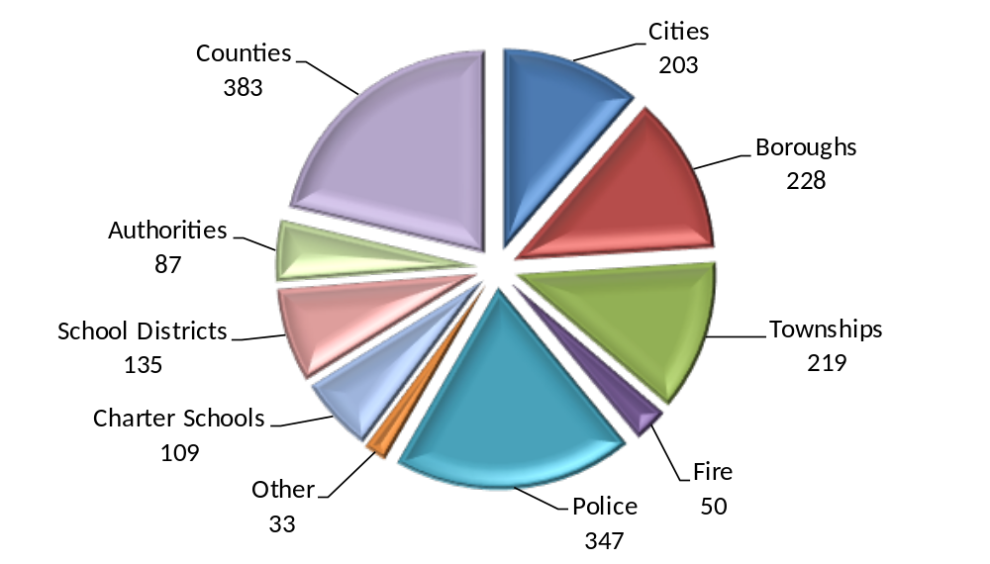
Appeals w/ Local Agencies
1,794 Appeals Involving Local Agencies in 2015

Slide 7
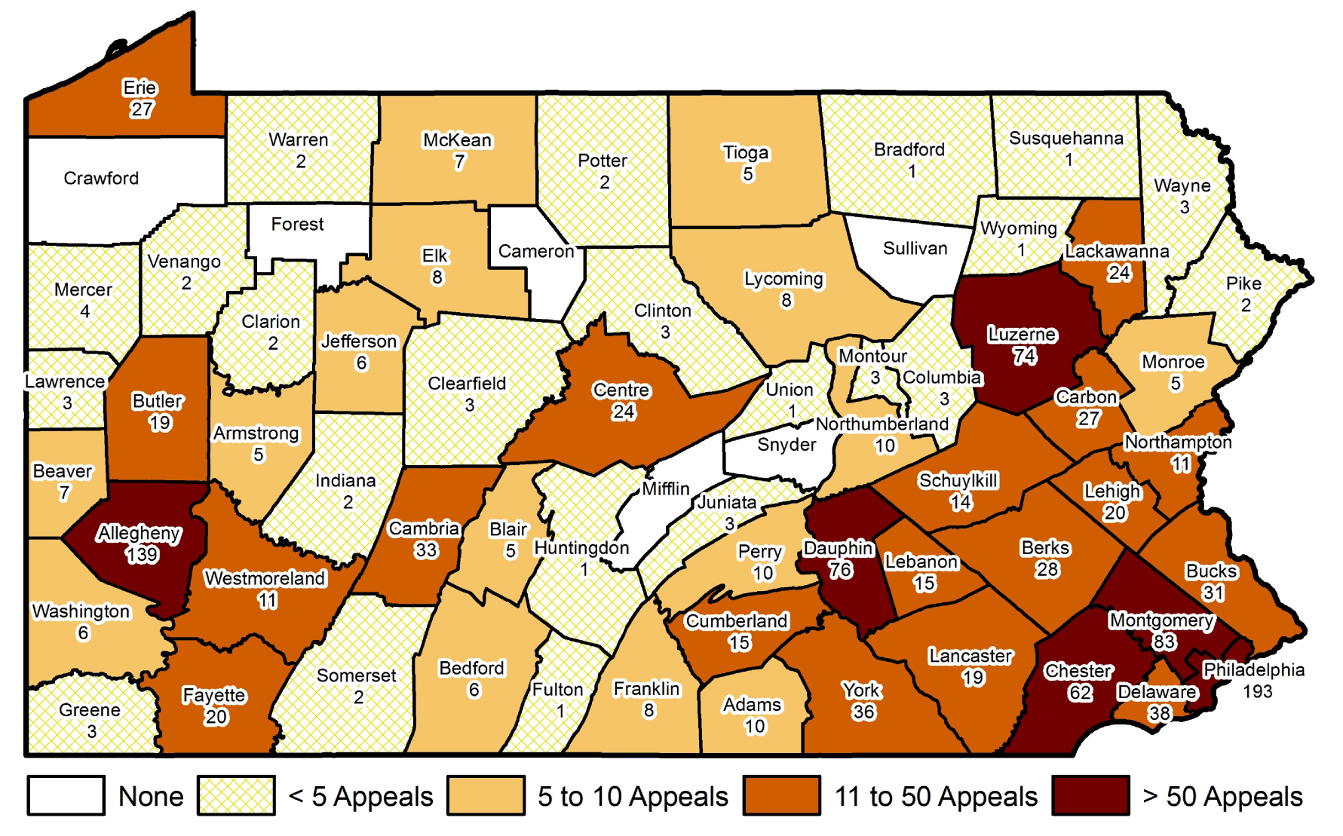
Appeals by County
(all Local Agencies)
193 Appeals Involving Agencies in Philadelphia

Slide 8
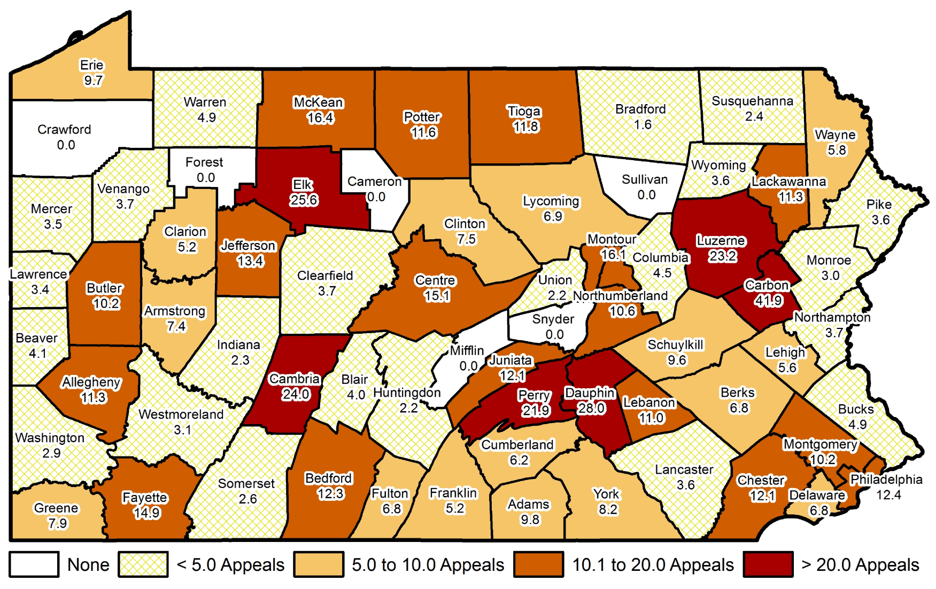
Appeals by County
(all Local Agencies)
41.9 Appeals Per Capita (per 100k) in Carbon County

Slide 9
Appellate Court Decisions
5 of the Top Appellate RTKL Decisions in 2015
Three-part balancing test for specificity
What emails are “records” under the RTKL
Searching for “deleted” email records
Mobile video recordings (MVRs) / dashcams
Providing evidence to the OOR, not waiting

Slide 10
Training
54 Training Sessions Across PA in 2015
Right-to-Know Law
Sunshine Act
Agency training, also requester groups
Call the OOR to discuss training ideas
  717-346-9903 (George Spiess)

Slide 11
Mediation
Goal: Resolve more cases informally
OOR required to provide mediation
Limited resources made this difficult in past
Resources still limited, but moving forward
Successful mediation = no further appeals
No harm in agreeing to mediation
  Worst-case scenario: FD is slightly delayed

Slide 12
2016 & Beyond
What the future holds for transparency
RTKL amendments (SB 411)
Increase in Sunshine Act inquiries
Video records
Social media records (Politwoops)
Metadata
Something entirely unpredictable

Slide 13
THANK YOU
Erik Arneson, Executive Director
http://openrecords.pa.gov
@ErikOpenRecords
@OpenRecordsPA
earneson@pa.gov
(717) 346-9903

