Slide 1

Right to Know Law/Sunshine Act 2016 Annual Training
Erik Arneson, Executive Director
Phone Number: 717.346.9903
http: //openrecords.pa.gov

Slide 2
Agency obligations:
Must appoint an Agency Open Records Officer (“AORO”).
May promulgate regulations and
policies necessary for the agency
to implement the RTKL.
May create your own Request Form, but must accept the Uniform Request Form developed by the OOR.
Should provide the OOR with the name and contact information for your AORO

Slide 3

Postings
On your bulletin boards and if you have a website:
  Contact information for the AORO.
  Contact information for the applicable appeals office.
  A form to file a Request.
  Regulations, policies and
  procedures of the agency
  related to the RTKL.

Slide 4
Prohibitions – Section 1308
An agency may not adopt a policy or regulation which:
  Limits the number of records which may be requested or made available for inspection or duplication; or
  Requires disclosure of the
  purpose or motive in requesting
  access to records.

Slide 5
What is a “Good” Request?
It is addressed to the Open Records Officer
It seeks a record
It is Sufficiently Specific

Slide 6
Definition of a Record:
  “Any information regardless of its physical form or character that documents a transaction or activity of an agency AND is created, received, or retained pursuant to law OR in connection with a transaction, business or activity of an agency.”

Slide 7
Sufficiently Specific
Subject – must identify a transaction or activity of the agency for which the record is sought
Scope – must identify a discreet group of documents either by type or recipient
Timeframe – needs to be finite

Slide 8
Receiving a Request
Upon receipt, AORO shall:
  note the date of receipt on the written request;
  Compute the date on which the five (5) day response period will expire and note that date on the written request;
  Maintain a copy of the Request until it is fulfilled;
    If denied, Request must be kept for 30 days or, if appealed, until the OOR issues the Final Determination.
  Commonwealth agencies must retain all Request related correspondence.

Slide 9
Agency Response
Agency must SEND the written response to a request within 5 business days.
  “Your business days”
  A mailed response is not required to be RECEIVED within five (5) business days; however, it must be placed in outgoing mail within that time frame.

Slide 10
Extensions
Agencies may unilaterally invoke a 30 Calendar Day Extension if:
  It is done within the initial 5 business day window
  It is done in writing to the requestor
  A reason is provided consistent with Section 902
  A date is provided that the requestor can expect a response
  An estimate of costs is given.
  5 + 30 application per Section 902(b)(2)

Slide 11
Payment Issues
Agency is only required to provide the record in the current medium
Cannot charge for electronic records
Must allow Requester to use their own equipment to make copies
Cannot charge for labor/redaction/legal review
Can only charge the actual cost/pass-through costs

Slide 12
More Payment Issues !
No surprises. Contact the requestor with an estimate before the work starts.
Mutual exchange, but payment is due first
An Agency may require pre-payment if the fees are expected to exceed $100.
Hold responses for 60 days before discard if not picked up.
Denial for non-payment of previous requests

Slide 13
Denying Access
A denial must include:
  A description of the requested record
  The legal and factual grounds for denial
  Name, title, signature, business
  address and phone number of AORO
  Date of response
  The procedure to file an appeal with the applicable appeals office.

Slide 14
The RTKL is not a confidentiality law
Records can be released outside of the RTKL.
An agency may exercise its discretion to make any otherwise exempt record accessible if:
Disclosure is not prohibited by Federal or State law or regulation; and
The record is not protected by privilege; and
The agency head determines that public interest favoring access outweighs any interest favoring withholding.

Slide 15
Filing an Appeal
If the agency denies or deem denies a Request, an appeal may be filed within OOR 15 business days of the mailing date of the Agency’s response or date of the deemed denial (whichever first).

Slide 16
A Complete Appeal…
Includes the original Request
Includes the Agency Response, if one is provided
Includes your statement about why the requested records are public
Includes a statement addressing any grounds cited by the agency for denying your request

Slide 17
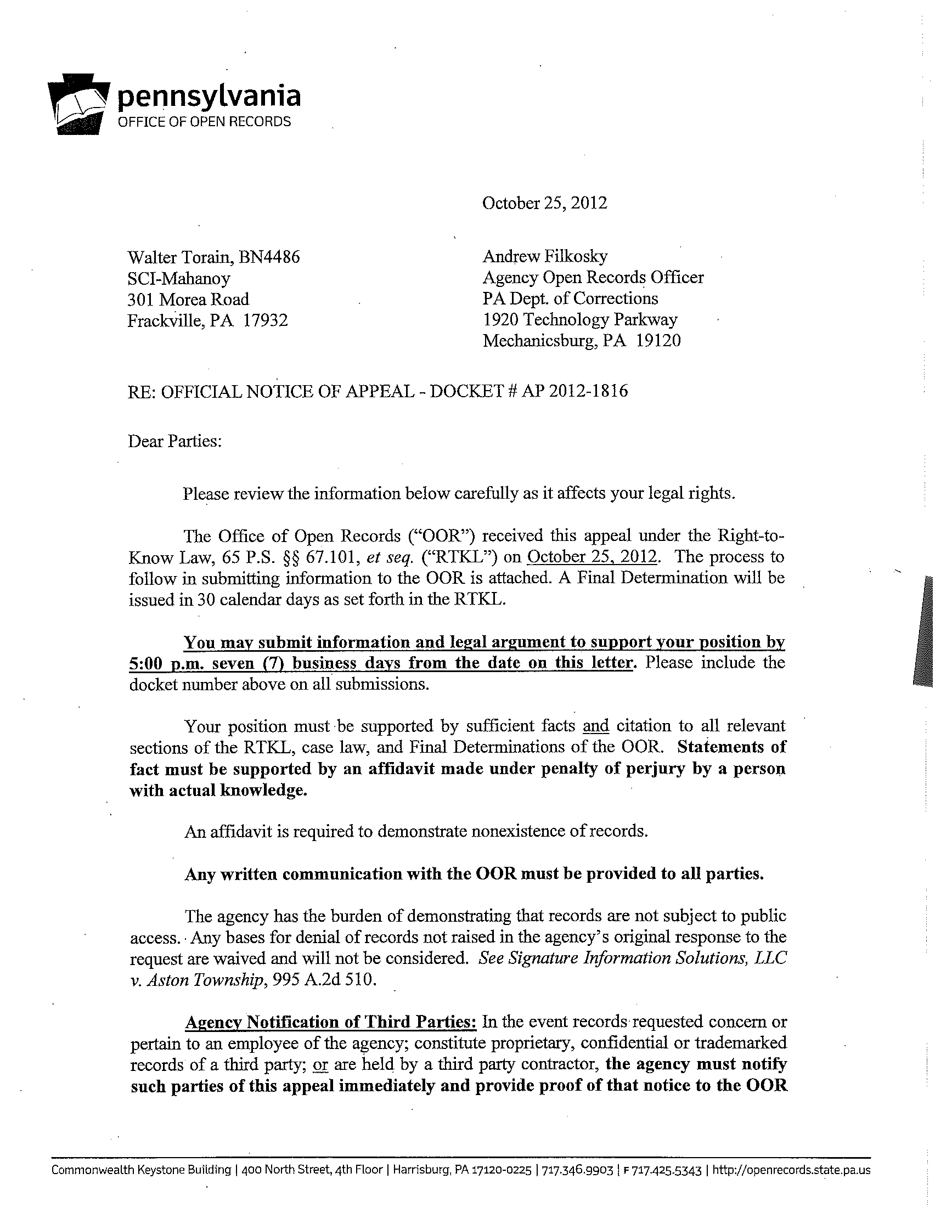
OOR Docketing Letter
h
Use mailing date of letter to calculate 7 business day submission period.
Affidavit is required to support facts.
Communication to OOR must include the other party.
Provide notice of appeal to relevant third parties.

Slide 18
Final Determinations
Are issued within 30 days of receipt of an appeal unless Requester agrees to an extension.
Are legally binding final orders.
Available for review on OOR website, Lexis, and Westlaw

Slide 19
Judicial Review
Within thirty (30) days of the mailing date of an OOR Final Determination, any party may file a judicial appeal. 65 P.S. § 67.1302(a).
  Local agency appeals are to be filed with Court of Common Pleas in the agency’s county.
  Commonwealth agency appeals are to be filed with the Commonwealth Court.
The OOR must be served notice of the appeal, but the OOR is not a party and should not be named in the caption.

Slide 20
PA Sunshine Act Primer for Government Officials
Erik Arneson, Executive Director
Phone Number: 717.346.9903
http: //openrecords.pa.gov

Slide 21
Who is Covered?
Applies to any state or local government body
and all committees
that perform an essential government function
and exercises authority to take official action.
Making recommendations = official action

Slide 22
Public Notice
Three days in advance of the first regular meeting of the year, along with all of the remaining meetings
Printed in a newspaper of general circulation
Posted at the meeting site
Special meetings = 24 hour notice

Slide 23
Public Comment
Commenters can be limited to residents and taxpayers
Right to comment on issues that are or may be before the board
Board may establish reasonable rules for public comment

Slide 24
Executive Sessions
Can be held before, during, or after an open meeting
Complete reason must be announced during the open meeting
No official action can be taken during an Executive Session

Slide 25
Executive Sessions II
Allowable Reasons for Executive Sessions:
Personnel matters (hiring, firing, discipline)
Discussing labor negotiations
Considering purchasing or leasing property
Consulting with counsel about litigation
Avoiding violating privilege or confidentiality
Discussing university admission standards

Slide 26
Miscellaneous
Must produce meeting minutes recording board attendance and who voted for and against
No requirement for an agenda
The public can record public meetings
Agency recordings and minutes are public records
Agencies can “cure” violations

Slide 27
Additional Resources
www.OpenRecords.pa.gov
  Citizens Guide
  Agency Guides
  Final Determinations and Key Court Decisions
Open Records Officer Guidebook
On Site Training = RA-DCOORTRAINING@pa.gov
Twitter Feed = @OpenRecordsPa
OOR Phone = 717.346.9903

