Slide 1

Office of Open Records Mediation
November 16, 2016
Erik Arneson, Executive Director
http://openrecords.pa.gov
@ErikOpenRecords
@OpenRecordsPA
earneson@pa.gov
(717) 346-9903

Slide 2
Office of Open Records
Created by RTKL: Independent & quasi-judicial
Decide appeals filed by people denied access to records by government agencies
18 total staff
  Executive Director & Deputy Director
  12 Attorneys
  Chief of Training & Outreach
  3 Administrative

Slide 3
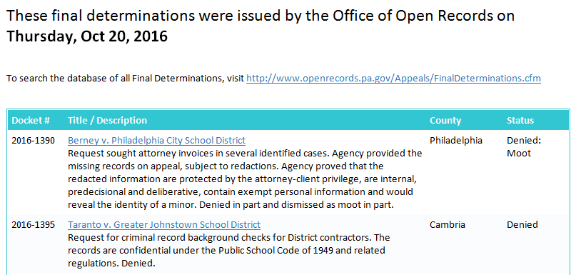
OOR Initiatives in 2016
Making more information public more quickly
Email subscriptions – sign up at website
  2 Lists: daily digest of FDs & general updates

Slide 4
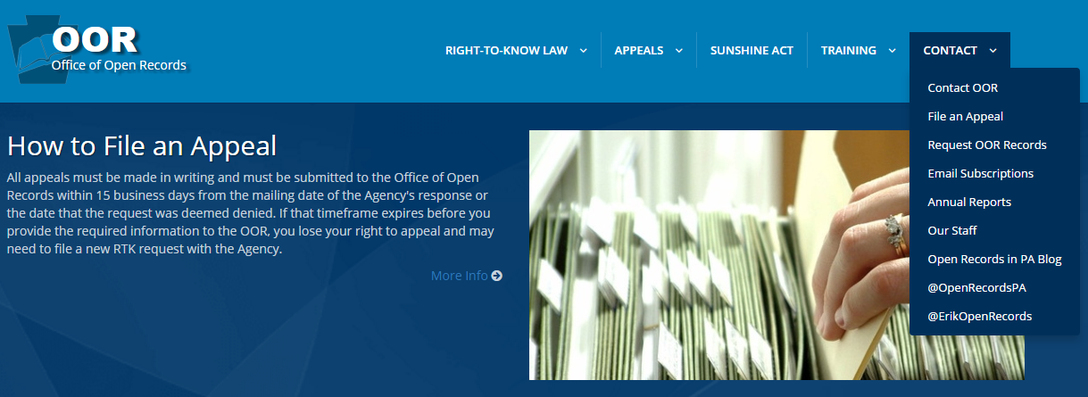
OOR Initiatives in 2016
Where to sign up for email updates
“Contact” tab at OOR website

Slide 5
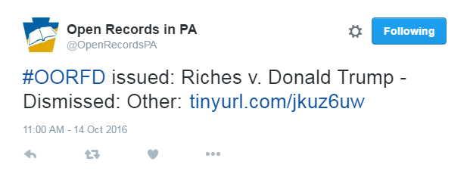
OOR Initiatives in 2016
Making more information public more quickly
@OpenRecordsPA – Twitter
  New FDs and court updates – automatic tweets

Slide 6
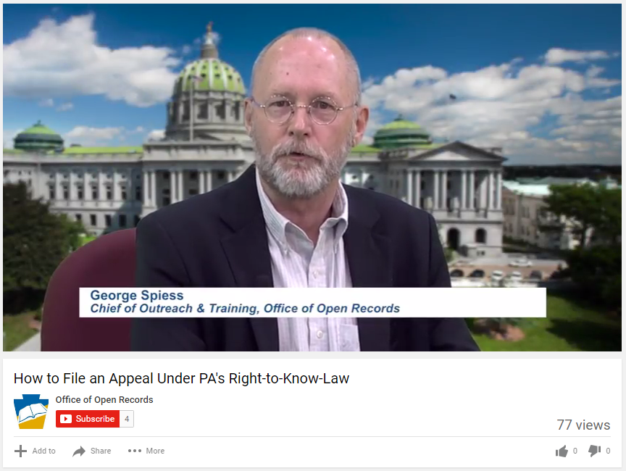
OOR Initiatives in 2016
Making more information public more quickly
Fee structure review used email & Twitter
YouTube Channel – Office of Open Records

Slide 7
Office of Open Records
One of my goals is to simplify the RTK process for agencies & requesters.
http://openrecords.pa.gov
Constantly updating content
  Citizens’ Guide to the RTKL
  AORO Guidebook for agencies
  Sample affidavits for agencies

Slide 8
OOR Mediation
Goal: Resolve more cases informally
62 cases referred to mediation so far in 2016
Both sides agree to confidentiality
OOR provides trained mediator
If mediation successful, appeal is withdrawn
There’s no harm in agreeing to mediation
  Worst-case scenario: FD is slightly delayed

Slide 9
OOR Mediation
How to request mediation
When filing an appeal, a requester can check a box: “I’m interested in mediation”
  This stays the initial OOR deadline for the issuance of the FD. If mediation is unsuccessful, the OOR has 30 days from end of mediation process to issue the FD.
If requester is interested, OOR contacts agency
Both parties must agree, in writing
Mediation can also be requested at any point during an appeal

Slide 10
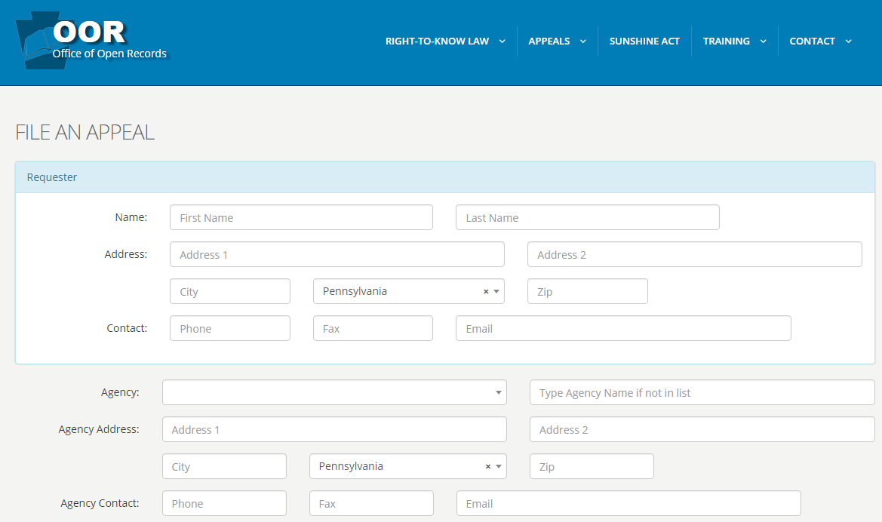
OOR Mediation

Slide 11
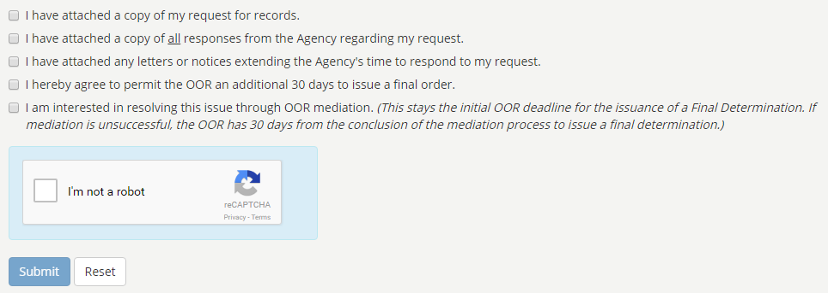
OOR Mediation

Slide 12
OOR Mediation
What happens during mediation
Mediations conducted by OOR mediator
Most often, sessions take place via telephone
When convenient to the parties, a mediation session may take place in person
OOR may travel for in-person mediation

Slide 13
OOR Mediation
Confidentiality
Mediation sessions not open to the public
Nothing in mediation can be reported on
All discussions, negotiations & materials created for mediation process are confidential
If mediation successful, records may be used for news stories & appeal is withdrawn
If mediation is unsuccessful, appeal transferred to different OOR Appeals Officer

Slide 14
OOR Mediation
What happens after mediation
If appeal is withdrawn, OOR acknowledges that fact but does not decide merits
If mediation is unsuccessful, traditional appeal process begins
  Both parties can make submissions to the OOR, which has 30 days to issue an FD

Slide 15
OOR Mediation
Representation during mediation
Parties may be represented by counsel in mediation – not necessary
Any resolution proposed during mediation may be discussed with, e.g., the participant’s boss/editor or attorney before being finalized

Slide 16
OOR Mediation
Parties can communicate on their own
Once OOR has facilitated the mediation, parties free to discuss case on their own
  This often leads to positive results

Slide 17
OOR Mediation
Mediation timeline
Some mediations resolved in a single call, others take many months
Either party can end mediation at any time

Slide 18
OOR Training
OOR provides RTKL & Sunshine Act training
On-site training: RTKL basics, recent FDs and court cases & more
  Custom training for specific audiences
  Details on OOR website
  Or call George Spiess, 717-346-9903

Slide 19
THANK YOU
Erik Arneson, Executive Director
http://openrecords.pa.gov
@ErikOpenRecords
@OpenRecordsPA
earneson@pa.gov
(717) 346-9903

