Slide 1

Doylestown Intelligencer
January 18, 2017
Erik Arneson, Executive Director
http://openrecords.pa.gov
@ErikOpenRecords
@OpenRecordsPA
earneson@pa.gov
(717) 346-9903

Slide 2
Right-to-Know Law Basics
All gov’t records presumed to be public
30 exceptions in the RTKL
  Fewer apply to financial records & agg. data
Exceptions in other laws & regulations
Attorney-client privilege & other privileges
  Only those recognized by Pennsylvania courts
  Not the “self-critical evaluation” privilege
Can be made non-public by court order

Slide 3
What is a Record?
A record is…
“information, regardless of physical form or characteristics, that documents a transaction or activity of an agency and that is created, received or retained pursuant to law or in connection with a transaction, business or activity of the agency”

Slide 4
Records Take Many Shapes
The Right-to-Know Law…
Doesn’t distinguish between formats
  Email, paper, audio, video, etc.
Doesn’t distinguish between agency devices & personal devices
It only cares if the document / email / whatever is a “record” – and then if that record is a “public record”

Slide 5
Records, Not Questions
Seek access to records, don’t ask questions
The RTKL gives access to public records – it’s not a way to ask questions
  Why did the Chairman vote yes?
  Why did Company A get this contract?
  How many times were streets plowed in January?
Agencies may deny RTK requests which ask questions

Slide 6
How to File: Possession
Submit your request to the correct agency
Submit RTK requests submitted to the agency that actually has the record
Requests must be addressed to the Agency Open Records Officer (AORO)
OOR maintains a list of AOROs on our website

Slide 7
How to File: Using the Form
Use the appropriate form to request records
Agencies may have their own form, but must accept the OOR’s Uniform RTK Request Form
Be as specific as possible when describing the records: Subject, Dates, From/To, etc.
Requests can be emailed, mailed, faxed, or hand delivered

Slide 8
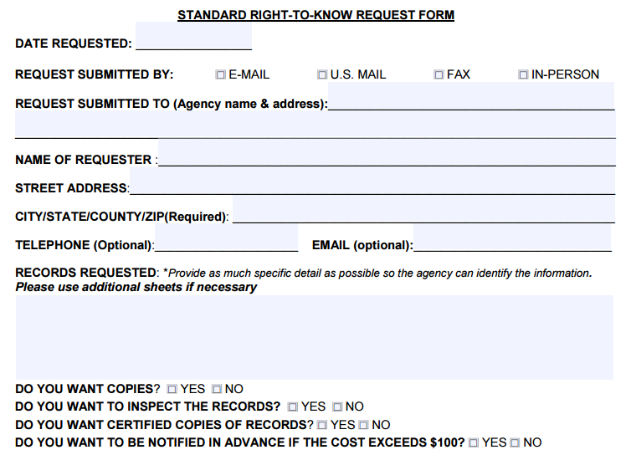
How to File: Using the Form

Slide 9
How to File: Using the Form
Answer all of the questions
Inspecting records vs. receiving copies
Indicate format preference
Indicate cost restrictions or limits
Include good contact information – agencies may have questions

Slide 10
Who Must Respond to Requests?
Every government agency (state & local) must respond to RTK requests
Every agency has an AORO
Must respond within 5 business days
  Response must be in writing
  Allow time for mailing
Can extend the timeline by 30 calendar days
Response: grant, deny, or a mix of both

Slide 11
Agency Response: Extensions
Agencies can invoke a 30-day extension
Within the initial 5-day window, an agency can invoke a 30 calendar day extension
You must be notified in writing, with a reason and a date to expect a response
Keep track of all dates & deadlines in case you need to appeal

Slide 12
Agency Response: Costs & Format
The OOR has developed a fee schedule
No charge for electronic records
Up to $.25/page for hard copies
Agencies do not have to create a record
Requesters can photograph records
Agencies only required to provide records in existing format (hard copy or electronic)

Slide 13
Agency Response: Denials
If an agency denies a request, it must:
Provide the denial in writing
Explain what records are being withheld
Explain why records are being withheld
Explain how to appeal the denial
Failure to respond by the statutory deadline is a “deemed denial” and can be appealed

Slide 14
Office of Open Records
Created by RTKL: Independent & quasi-judicial
Decide appeals filed by people denied access to records by government agencies
18 total staff
  Executive Director & Deputy Director
  12 Attorneys
  Chief of Training & Outreach
  3 Administrative

Slide 15
Appealing a Denial
Most denials can be appealed to the OOR
If a request is denied, an appeal can be filed within 15 business days
Most appeals filed with the OOR
  Not Attorney General, Auditor General, Treasurer
  Not General Assembly
  Denials from local agencies based on criminal investigatory records appealed to county DA
  (but PSP denials appealed to OOR)

Slide 16
Criminal Investigative Records of a
Local Law Enforcement Agency
Section 503(d)(2):
“The district attorney of a county shall designate one or more appeals officers to hear appeals … relating to access to criminal investigative records in possession of a local agency of that county.”
OOR transfers such cases to the DA
OOR hears cases involving PSP

Slide 17
Appeal Process
OOR appeal process is simple
Appeal can be filed using OOR’s online form
  About 10 to 15 minutes to fill out
No lawyer necessary
OOR assigns Appeals Officer to oversee case
Both sides can present evidence & argument
OOR has 30 days to issue Final Determination

Slide 18
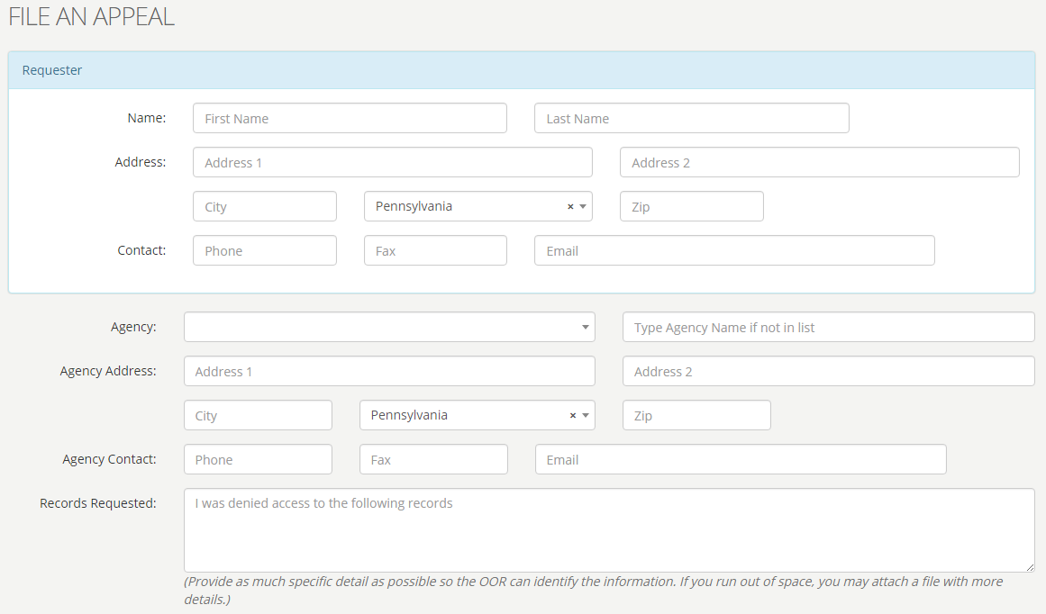
Online OOR Appeal Form

Slide 19
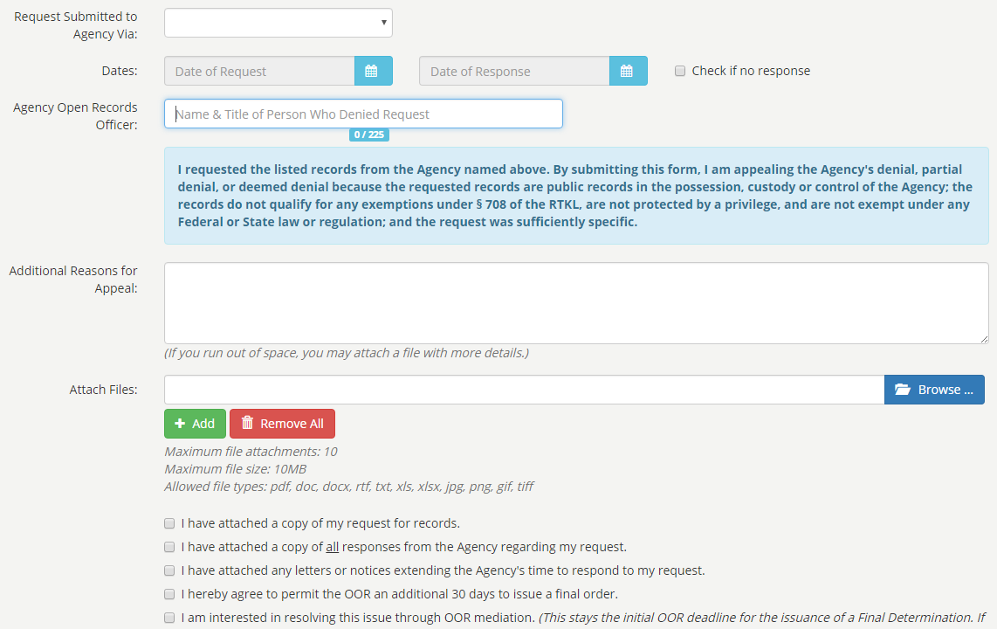
Online OOR Appeal Form

Slide 20

OOR - Appeals Filed in 2015
2,926 appeals filed w/ OOR in 2015

Slide 21
OOR Caseload
Thousands of RTK appeals are filed every year
In 2015, OOR heard 2,926 appeals
  That’s total appeals, not total requests
  No central database of # of requests
Of the appeals, 61.3% involved local agencies

Slide 22

Local Agency Appeals in 2015

Slide 23

State Agency Appeals in 2015
1,132 appeals involving state agencies in 2015

Slide 24
Other RTKL-Related Legislation
Other bills & recent laws w/ RTK issues:
Medical Marijuana
Uber / Lyft
Police shootings (when names are released)
Coroner’s records (manner & cause of death)
Names of lottery winners
Bodycam recordings

Slide 25
OOR’s Mediation Program
Goal: Resolve more cases informally
> 50 cases referred to mediation in 2016
Both sides agree to confidentiality
OOR provides trained mediator
If mediation successful, appeal is withdrawn
There’s no harm in agreeing to mediation
  Worst-case scenario: FD is slightly delayed

Slide 26
Training from the OOR
Training on the RTKL & Sunshine Act
OOR website filled with information
  www.openrecords.pa.gov
On-site training: basics, recent cases & more
  Details on OOR website
  Or call George Spiess, 717-346-9903

Slide 27
OOR Resources
Website, Twitter, Email Lists & More
Web: http://openrecords.pa.gov
Blog: http://openrecordspa.wordpress.com
Twitter: @OpenRecordsPA
  Executive Director: @ErikOpenRecords
YouTube Channel
Podcast on iTunes (Open Records in Pennsylvania)
Email lists: Daily Digest of FDs & General Updates
  Sign up at website

Slide 28
THANK YOU
Erik Arneson, Executive Director
http://openrecords.pa.gov
@ErikOpenRecords
@OpenRecordsPA
earneson@pa.gov
(717) 346-9903

