Slide 1

Public Utility Commission CLE
June 1, 2017
Erik Arneson, Executive Director
http://openrecords.pa.gov
@ErikOpenRecords
@OpenRecordsPA
earneson@pa.gov
(717) 346-9903

Slide 2
Right-to-Know Law Basics
Key elements of the RTKL:
All gov’t records presumed to be open
If it wants to withhold a record, agency bears burden of proving it’s not public
Office of Open Records (OOR)
  Decides RTKL appeals for most agencies
  Provides training on RTKL & Sunshine Act

Slide 3
Right-to-Know Law Basics
All gov’t records presumed to be public
30 exceptions in the RTKL
  Fewer apply to financial records & agg. data
Exceptions in other laws & regulations
Attorney-client privilege & other privileges
  Only those recognized by Pennsylvania courts
  Not the “self-critical evaluation” privilege
Can be made non-public by court order

Slide 4
What is a Record?
A record is…
“information, regardless of physical form or characteristics, that documents a transaction or activity of an agency and that is created, received or retained pursuant to law or in connection with a transaction, business or activity of the agency”

Slide 5
Records Take Many Shapes
The Right-to-Know Law…
Doesn’t distinguish between formats
  Email, paper, audio, video, texts, social media, etc.
Doesn’t distinguish between agency devices & personal devices
It only cares if the document / email / whatever is a “record” – and then if that record is a “public record”

Slide 6
Who Must Respond to Requests?
Every government agency (state & local) must respond to RTK requests
Each agency must have an Agency Open Records Officer (AORO)
Must respond within 5 (agency) business days
  Response must be in writing
Can extend final response by 30 calendar days
Response: grant, deny, or a mix of both

Slide 7
Agency Open Records Officer
AORO responsibilities include:
Must post contact information
Receives & processes RTK requests
  All staff should forward RTK requests to AORO
Gathers & reviews responsive records
Issues responses to RTK requests
Tracks all dates & deadlines

Slide 8
Agency Response: Costs
OOR required to issue a fee schedule
Up to $0.25/page for hard copies
No charge for electronic records
  Redacted records may be at $0.25/page rate
No charge for labor, including redaction
Requesters can photograph records
Other legislated charges take precedent
  e.g., accident reports

Slide 9
Agency Response: Denials
If an agency denies a request, it must:
Provide the denial in writing
Explain what records are being withheld
Explain why records are being withheld
Explain how to appeal the denial
Failure to respond by the statutory deadline is a “deemed denial” and can be appealed

Slide 10
Appealing a Denial
Most denials can be appealed to the OOR
If a request is denied, an appeal can be filed within 15 business days
Most appeals filed with the OOR, except:
  Judiciary
  General Assembly
  Statewide Row Offices
  Local Law Enforcement Records

Slide 11
RTKL is NOT a Confidentiality Law
Records may be released outside of the RTKL
An agency may exercise its discretion to make any otherwise exempt record accessible if:
  Disclosure is not prohibited by federal or state law or regulation; and
  The record is not protected by privilege; and
  The agency head determines that public interest favoring access outweighs any interest favoring withholding.

Slide 12
Third-Party Records
Records submitted to gov’t agencies by third-parties go through the same test
Info submitted to a gov’t agency by a third-party contractor also presumed to be public
Common exceptions that may apply:
  (b)(10): internal, predecisional deliberations
  (b)(11): trade secrets & conf. proprietary info
  (b)(26): financial information of a bidder

Slide 13
Third-Party Contractor Records
Some third-party records NOT submitted to gov’t agencies may still be public
Section 506(d): “A public record … in the possession of a party with whom the agency has contracted to perform a governmental function … and which directly relates to the governmental function and is not exempt … shall be considered a public record of the agency for purposes of this act.”

Slide 14
Requests for Trade Secrets
Contractors are required to give agencies notice that submitted info includes a trade secret
Section 707(b): “An agency shall notify a third party of a request for a record IF the third party provided the record AND included a written statement … that the record contains a trade secret or confidential proprietary information.”

Slide 15
Contracts Available
Online State Contract Database
All state agency contracts > $5,000
http://contracts.patreasury.gov/
Local contracts also available – but not online
Request under RTKL
Some redactions may be made
Can appeal denials/redaction to the OOR

Slide 16
Procurement Records Available
Procurement Provisions
Records related to agency procurement or disposal of supplies, services or construction are available under RTKL after…
  A contract is awarded, or
  All bids are rejected

Slide 17
Record Retention
The RTKL does not address record retention
Goal is a strong, effective retention policy
Must balance agency needs & transparency
  Can’t simply say “0 days for everything”

Slide 18
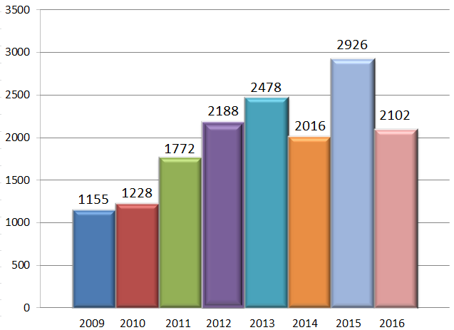
OOR - Appeals Filed by Year
2,102 appeals filed w/ OOR in 2016

Slide 19
OOR Caseload
Thousands of RTK appeals are filed every year
In 2016, OOR heard 2,102 appeals
  That’s total appeals, not total requests
  No central database of # of requests
Of the appeals, 67.7% involved local agencies

Slide 20
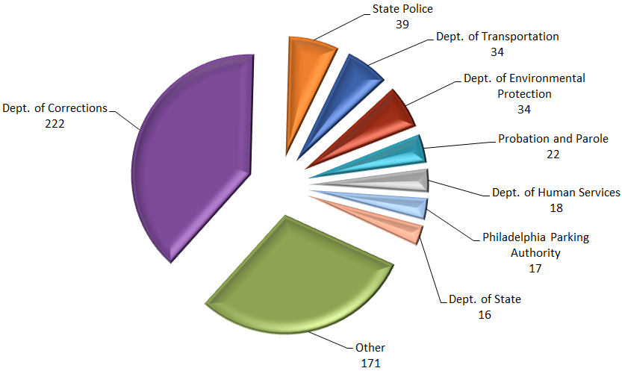
State Agency Appeals in 2016
573 appeals involving state agencies in 2016

Slide 21
OOR’s Mediation Program
Goal: Resolve more cases informally
49 successful mediations in 2016
Both sides agree to confidentiality
OOR provides trained mediator
If mediation successful, appeal is withdrawn
There’s no harm in agreeing to mediation
  Worst-case scenario: FD is slightly delayed

Slide 22
Training from the OOR
Training on the RTKL & Sunshine Act
OOR website filled with information
  www.openrecords.pa.gov
On-site training: basics, recent cases & more
  Details on OOR website
  Or call George Spiess, 717-346-9903

Slide 23
OOR Resources
Website, Twitter, Email Lists & More
Web: http://openrecords.pa.gov
Blog: http://openrecordspa.wordpress.com
Twitter: @OpenRecordsPA
  Executive Director: @ErikOpenRecords
YouTube Channel
Podcast on iTunes (Open Records in Pennsylvania)
Email lists: Daily Digest of FDs & General Updates
  Sign up at website

Slide 24
THANK YOU
Erik Arneson, Executive Director
http://openrecords.pa.gov
@ErikOpenRecords
@OpenRecordsPA
earneson@pa.gov
(717) 346-9903

