Slide 1

Committee of Seventy Interns
July 31, 2018
Erik Arneson, Executive Director
http://openrecords.pa.gov
@ErikOpenRecords
@OpenRecordsPA
earneson@pa.gov
(717) 346-9903

Slide 2
Right-to-Know Law Basics
All gov’t records presumed to be public
30 exceptions in the RTKL
  Fewer apply to financial records & agg. data
Exceptions in other laws & regulations
Attorney-client privilege & other privileges
  Only those recognized by Pennsylvania courts
  Not the “self-critical evaluation” privilege
Can be made non-public by court order

Slide 3
What is a Record?
A record is…
“information, regardless of physical form or characteristics, that documents a transaction or activity of an agency and that is created, received or retained pursuant to law or in connection with a transaction, business or activity of the agency”

Slide 4
Records Take Many Shapes
The Right-to-Know Law…
Doesn’t distinguish between formats
  Paper, email, audio, video, social media, texts, etc.
Doesn’t distinguish between agency devices & personal devices (or agency/personal email)
All the matters: Is the document, email, etc. a “record”? And if so, is it a “public record”?

Slide 5
Records, Not Questions
Seek access to records, don’t ask questions
The RTKL gives access to public records – it’s not a way to ask questions
  Why did the Chairman vote yes?
    Request meeting minutes & audio recording of meeting
  Why did Company A get this contract?
    Request copies of all submitted bids
  How many times were streets plowed in January?
    Request plowing schedule & records of any modifications
Agencies may deny requests which ask questions

Slide 6
How to File: Possession
Submit your RTK request to the correct agency
Submit requests to the agency that actually has the record (generally not the OOR)
Address requests to the Agency Open Records Officer (AORO)
AORO database available on OOR website

Slide 7
How to File: Using the Form
Use the appropriate form to request records
Agencies may have their own form, but must accept the OOR’s Uniform RTK Request Form
Be specific when describing records: subject matter, date range, type of record, etc.
Requests can be emailed, mailed, faxed, or hand delivered

Slide 8
Who Must Respond to Requests?
Every government agency (state & local) must respond to RTK requests
Every agency has an AORO
Must respond within 5 business days
  Response must be in writing
  Allow time for mailing
Can extend the timeline by 30 calendar days
Response: grant, deny, or a mix of both

Slide 9
Agency Response: Extensions
Agencies can invoke a 30-day extension
Within the initial 5-day window, an agency can invoke a 30 calendar day extension
You must be notified in writing, with a reason and a date to expect a response
Keep track of all dates & deadlines in case you need to appeal

Slide 10
Agency Response: Costs & Format
The OOR has developed a fee schedule
No charge for electronic records
Up to $.25/page for hard copies
Agencies do not have to create a record
Requesters can photograph records
Agencies only required to provide records in existing format (hard copy or electronic)

Slide 11
Agency Response: Denials
If an agency denies a request, it must:
Provide the denial in writing
Explain what records are being withheld
Explain why records are being withheld
Explain how to appeal the denial
Failure to respond by the statutory deadline is a “deemed denial” and can be appealed

Slide 12
Office of Open Records
Created by RTKL: Independent & quasi-judicial
Decide appeals filed by people denied access to records (approx. 2,400 per year)
Provide RTKL & Sunshine Act training
18 total staff
  Executive Director & Deputy Director
  12 Attorneys (incl. 10 Appeals Officers)
  Chief of Training & Outreach
  3 Administrative

Slide 13
Appealing a Denial
Most denials can be appealed to the OOR
If a request is denied, an appeal can be filed within 15 business days
Most appeals filed with the OOR
  Not Attorney General, Auditor General, Treasurer
  Not Courts, General Assembly
  Denials from local agencies based on criminal investigatory records appealed to county DA
  (but PSP denials appealed to OOR)

Slide 14
Criminal Investigative Records of a
Local Law Enforcement Agency
Section 503(d)(2):
“The district attorney of a county shall designate one or more appeals officers to hear appeals … relating to access to criminal investigative records in possession of a local agency of that county.”
OOR transfers such cases to the DA
OOR hears cases involving PSP

Slide 15
Appeal Process
OOR appeal process is simple
Appeal can be filed using OOR’s online form
  About 10 to 15 minutes to fill out
No lawyer necessary
OOR assigns Appeals Officer to oversee case
Both sides can present evidence & argument
OOR has 30 days to issue Final Determination

Slide 16
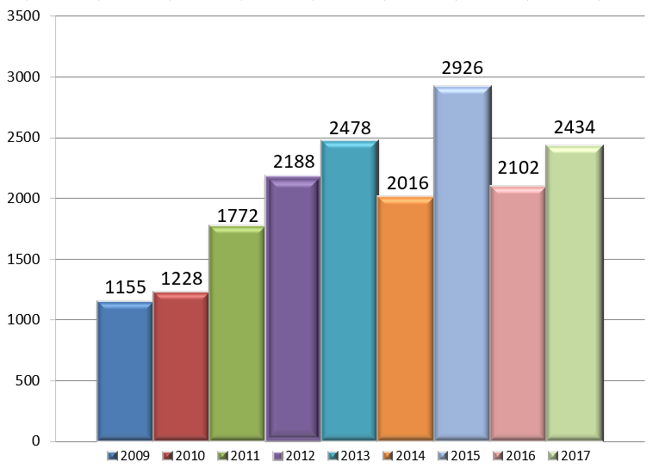
OOR – Appeals Filed in 2017
2,434 appeals filed w/ OOR in 2017

Slide 17
OOR Caseload
Thousands of RTK appeals are filed every year
In 2017, OOR heard 2,434 appeals
  That’s total appeals, not total requests
  No central database of # of requests
    LBFC Study: 109,000 requests received by state & local agencies, combined, in 2016

Slide 18
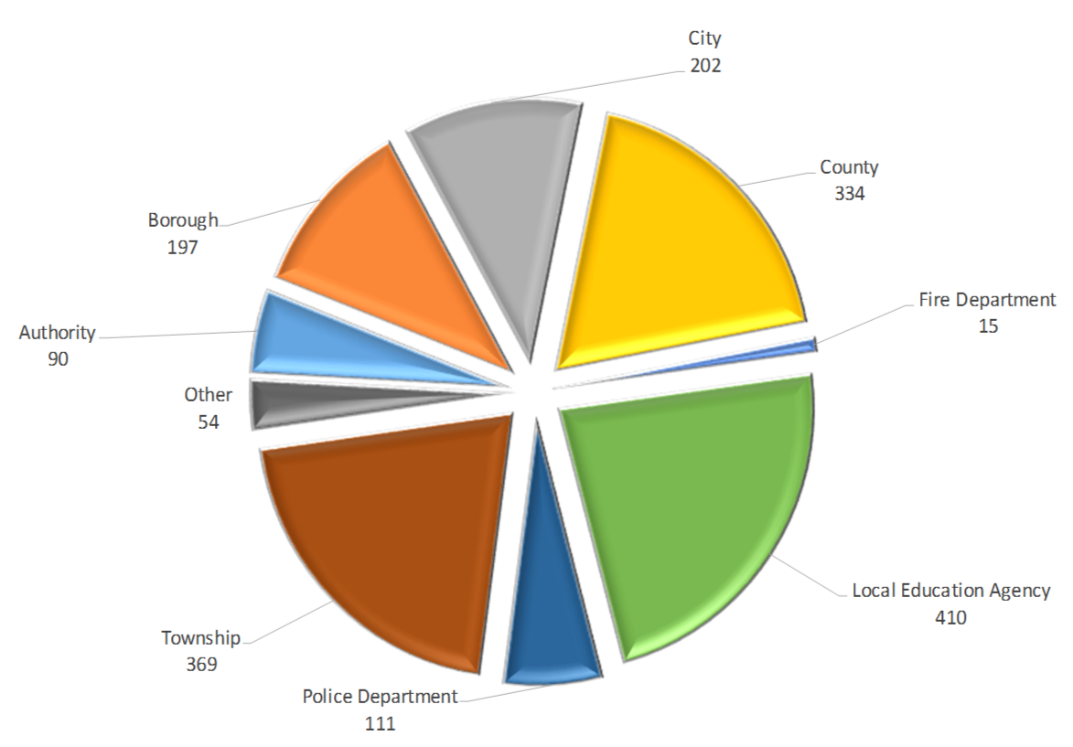
Local Agency Appeals in 2017

Slide 19
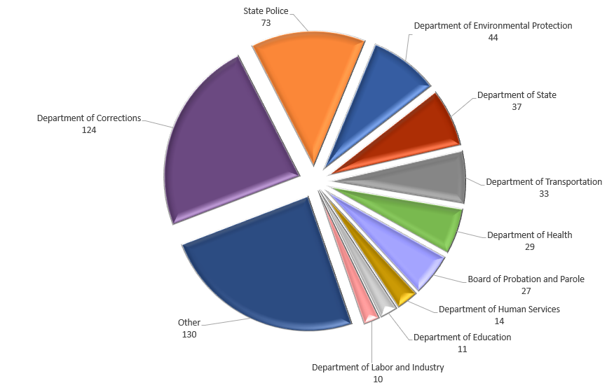
State Agency Appeals in 2017

Slide 20
Other RTKL-Related Legislation
Other bills & recent laws w/ RTK issues:
Police video & audio (e.g., bodycams)
Medical Marijuana
Uber / Lyft
Police shootings (officer names)
Coroner’s records (manner & cause of death)
Names of lottery winners

Slide 21
Cost of the RTKL
Legislative Budget & Finance Committee Study:
54% of agencies reported $500 or less
92% of agencies reported $10,000 or less
Total cost (all agencies, 2016) ~ $5.7 million to $9.7 million
  More than 6,000 agencies: avg. cost just $950 to $1,617 per agency

Slide 22
OOR Resources
Website, Twitter, Email Lists & More
Web: http://openrecords.pa.gov
Blog: http://openrecordspa.wordpress.com
Twitter: @OpenRecordsPA
  Executive Director: @ErikOpenRecords
YouTube Channel
Podcast on iTunes (Open Records in Pennsylvania)
Email lists: Daily Digest of FDs & General Updates
  Sign up at website

Slide 23
THANK YOU
Erik Arneson, Executive Director
http://openrecords.pa.gov
@ErikOpenRecords
@OpenRecordsPA
earneson@pa.gov
(717) 346-9903

