Slide 1

Dr. Logan Molyneux
Temple University
September 4, 2018
Erik Arneson, Executive Director
https://openrecords.pa.gov
@ErikOpenRecords
@OpenRecordsPA
earneson@pa.gov
(717) 346-9903

Slide 2


Slide 3
A Brief History
RTKL introduced 3/29/2007, signed 2/14/2008, eff. 1/1/2009
Senator Dominic Pileggi, new majority leader – SB 1
Existing RTK Act presumed gov’t records were not public
  Requester had to prove public nature & all appeals went to court
  Basically limited to financial records
Act 3 of 2008 – complete rewrite, new RTKL
  Flipped presumption
  Created Office of Open Records (free appeals)

Slide 4
The Office of Open Records
OOR is an independent, quasi-judicial agency
Executive Director = 6-year term, max 2 terms
2008: Gov. Rendell appointed Terry Mutchler, first ED
2014: Gov. Corbett didn’t make an appointment
Jan. 2015: Gov. Corbett appointed Erik Arneson
Jan. 2015: Gov. Wolf sworn in, fired Erik Arneson
Arneson v. Wolf went to PA Supreme Court
Court held that Executive Director can only be fired “for cause”

Slide 5
Right-to-Know Law Basics
All state & local government records presumed to be public
30 exceptions in the RTKL
  Fewer apply to financial records & aggregated data
Exceptions in other laws & regulations
Attorney-client privilege & other privileges
  Only if recognized by PA courts; not “self-critical evaluation”
Records can be made non-public by court order

Slide 6
Which of These are Records?
Which of these do you think are “records” under the RTKL?
An agency’s budget for FY 2018-19
Inappropriate emails sent to a co-worker on gov’t computer
Video recording of a city council meeting
Police detective’s interview notes
Database of lead tests done by city w/ home addresses

Slide 7
Which of These are Records?
Which of these do you think are “records” under the RTKL?
An agency’s budget for FY 2018-19
Inappropriate emails sent to a co-worker on gov’t computer
Video recording of a city council meeting
Police detective’s interview notes
Database of lead tests done by city w/ addresses
  OOR ordered “100 block of Pine St.” rather than specific addresses
  Currently pending in Allegheny County Court of Common Pleas

Slide 8
What is a Record?
A record is…
“information, regardless of physical form or characteristics, that documents a transaction or activity of an agency and that is created, received or retained pursuant to law or in connection with a transaction, business or activity of the agency”
PA Office of Attorney General v. Philadelphia Inquirer
  Personal communications, even if they violate agency policies, are not records under the RTKL

Slide 9
Records Take Many Shapes
The Right-to-Know Law…
Doesn’t distinguish between formats
  Paper, email, texts, social media, audio, video, etc.
Doesn’t distinguish between agency & personal devices
(or agency & personal email accounts)
  Practical issues re: accessing personal devices & email
  Best practice: Agency business done on agency devices & email
Bottom line: Is it a record? And if so, is it a public record?

Slide 10

How to File a RTK Request
Submit your RTK request to the correct agency
Submit requests to the agency that has the record
(generally not the OOR)
Address requests to Agency Open Records Officer (AORO)
AORO database available on OOR website

Slide 11
More About Agency AOROs
Many agencies, but not all, have a single AORO
Some agencies have separate AOROs by bureau, dep’t, etc.
Commonwealth agencies: DEP, DCNR, DOC, DCED, etc.
Philadelphia has a Right-to-Know Law policy
  Approximately 40 AOROs
  Very important to send request to the right AORO
  If not sure, say so: “If this request is misdirected, please let me know as soon as possible so that I can withdrawn this request and direct it to the proper AORO.”

Slide 12
How to File a RTK Request
Basic steps include:
Use the appropriate form to request records
  Agencies may have their own form, but must accept OOR’s Standard RTK Request Form
Be specific when describing records: subject matter, date range, type of record, etc.
Requests can be emailed, mailed, faxed, or hand delivered
Make a note of request date

Slide 13
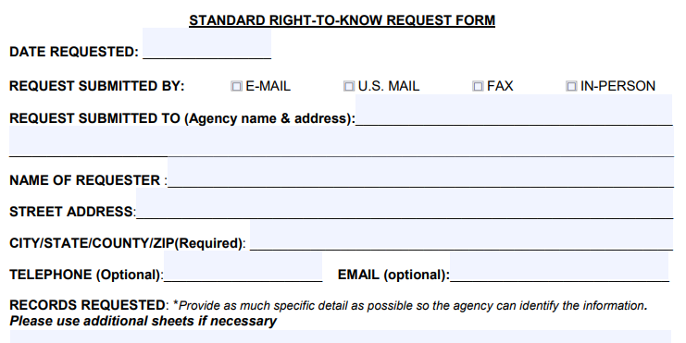
How to File a RTK Request
OOR Standard RTK Request Form, part 1

Slide 14
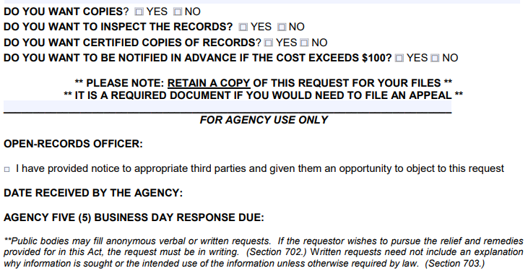
How to File a RTK Request
OOR Standard RTK Request Form, part 2

Slide 15
Writing a Good RTK Request:
1. Seek Records, Don’t Ask Questions
Requests should seek access to records, not ask questions
Why did the Chairman vote yes?
  Request meeting minutes & audio recording of meeting
Why did Pileggi Lumber get this contract?
  Request copies of submitted bids & council emails re: Pileggi Lumber
How many times was Pine Street plowed in January?
  Request plowing schedule & records of any modifications
Agencies may deny requests which ask questions

Slide 16
Writing a Good RTK Request:
2. Be Specific
Specificity is determined on a case-by-case basis
Primary goal is to enable agency to know what to look for
Vast “fishing expeditions” are not permitted (hook vs. net)
Phrases like “any and all” & “but not limited to” raise questions
  “Any and all documents, including but not limited to emails, memos, and spreadsheets, regarding the 2018 Pine Street Bridge Project”
Poor storage & organization of an agency’s records is not held against the requester (Dep’t of Envtl. Prot. v. Legere)

Slide 17
More About Specificity
Specificity is a 3-part test: Pa. Dep’t of Educ. v. Post-Gazette
Subject Matter: “Must identify the ‘transaction or activity’ of the agency for which the record is sought”
Scope: “Must identify a discrete group of documents (e.g., type or recipient)”
Timeframe: “Should identify a finite period of time for which the records are sought”
  The most fluid factor – failure to identify a finite timeframe will not automatically render a sufficiently specific request overbroad & a short timeframe will not transform an overbroad request into a specific one

Slide 18
Specificity: Examples
Commonwealth Court cases on specificity:
Pa. Dep’t of Educ. v. Pittsburgh Post-Gazette: A request seeking “all of the emails of Acting Secretary of Education Carolyn Dumaresq as they pertain to the performance of her duties as Acting Secretary since she was appointed on Aug. 25, 2013 to date [Aug. 5, 2014]” was insufficiently specific because “it is, by virtue of the Secretary’s position, a request for emails about all of the agency’s activity over nearly a one-year period. In other words, it is a fishing expedition”

Slide 19
Specificity: Examples
Commonwealth Court cases on specificity:
Dep’t of Envtl. Prot. v. Legere: A request for 4 years of Section 208 determination letters was sufficiently specific because the subject matter was extremely specific
Dep’t of Corr. v. St. Hilaire: A request for “all records” documenting inmate injuries or death for five years was sufficiently specific because the request had clear parameters even though a large number of records were implicated

Slide 20
Specificity: Examples
Commonwealth Court cases on specificity:
Office of the Governor v. Engelkemier: Request for all emails from Chief of Staff Katie McGinty from January 2015 to July 2015, with keywords, was sufficiently specific – but note discussion about Office waiving specificity argument earlier in the process and potential for “broad” keywords to be insufficiently specific
Keywords can be helpful, but use caution

Slide 21
Writing a Good RTK Request:
3. Think Twice Before Requesting a List
Requesting a “list” can be problematic
If no actual list exists, agency not required to create one
  “List of all lawsuits filed against the agency in 2017”
  “List of all properties with zoning violations, 2015 to present”
Better to seek records containing the information you want
  “Records showing captions of lawsuits filed against agency in 2017”
  “Records showing zoning violations issued, 2015 to present”
Valid to add: “If info can be provided in a list, that’s preferred”

Slide 22
Writing a Good RTK Request:
4. Accessing Information in Databases
Information in databases subject to presumption of openness
Terminology is vital – try to use agency jargon
  Create, export, compile, format, CSV, TXT, comma-delimited…
Database software used by the agency
  If possible, learn capabilities of program/database – ask if unsure
  How do agency employees extract info from database
Where relevant, consider the use of suggested queries
  Queries may be necessary for extracting information

Slide 23
Databases: Commonwealth Court
Gingrich v. Pennsylvania Game Commission (2012)
“Requesters may provide suggestions or examples in order to better inform an agency about the information requested, and we have no desire to discourage that practice. … Providing data from an agency database does not constitute creating a record. … [I]nformation contained in a database must be accessible to requesters and provided in a format available to the agency.”

Slide 24
Databases: Commonwealth Court
Department of Environmental Protection v. Cole (2012)
Commonwealth Court: “[A]n agency can be required to draw information from a database, although the information must be drawn in formats available to the agency. In short, to the extent requested information exists in a database, it must be provided … To hold otherwise would encourage an agency to avoid disclosing public records by putting information into electronic databases.”

Slide 25
Databases: Additional Cases
Intersection of RTKL & databases still being developed
Agency may be made to prove query was properly structured
  OOR 2017-1761: Violent crime data from Pittsburgh
Don’t be overly specific & hurt your request
  OOR 2016-2041: Sought TXT or CSV, records only exist in PDF
Law currently only specifies electronic vs. hard copy
  OOR 2017-0246: Sought “comma- or tab-delimited,” provided in PDF

Slide 26
Speaking of Databases…
Two useful resources:
Online Contract Database, http://contracts.patreasury.gov/
  State agency contracts of $5,000 or more
PennWATCH, http://pennwatch.pa.gov/
  State employee salaries & compensation
  State agency employee counts
  Basic state budget data

Slide 27
Tip: Communicate with the Agency
Good communication can prevent & solve many issues
Good practice to let agency know you’re willing to talk
Requesters often submit broad requests to ensure they get all the records they want
  Understandable, but can be expensive & frustrating
  Requesters don’t want surprise bills
  Agencies don’t want unnecessary work
Many agencies willing to discuss requests
If agreement reached on revised request, put it in writing

Slide 28
Tip: Communicate with the Agency
Reason for making RTKL request
Agency cannot require requester to provide reason for request
  They can ask, but requester can decline to answer
However, requester may sometimes want to provide info
  Can help agency understand request & speed response
  Can help reduce number of valueless records received
  Can reduce cost if hard copies must be made

Slide 29
Timeline of a RTKL Response
Every state & local agency must respond to RTK requests
Must respond in writing within 5 (agency) business days
  If no response received, request is deemed denied
  Allow additional 3 business days for postal mail before filing appeal
Agency can extend timeline by 30 calendar days
  Any other extension must be agreed to by requester & in writing
  Be cautious with “rolling production schedules”
Response: grant, deny, or a mix of both

Slide 30
Agency Response: Extensions
Agencies can invoke a 30-day extension
Within the initial 5-day window, an agency can invoke a 30 calendar day extension for reasons listed in RTKL
If the agency does this, the requester must be notified in writing, with a reason and a date to expect a response
Track all dates & deadlines in case you need to appeal

Slide 31
Tracking Dates: An Example
Merlin / Morning Call v. Easton Area SD (2008-1065)
March 23, 2018 – request made
March 29, 2018 – agency took 30-day extension (to May 3)
  School had multiple snow days during initial 5 business day window
May 17, 2018 – agency claimed another 30-day extension
June 1, 2018 – agency issued response (part grant, part denial)
June 12, 2018 – requester filed appeal with OOR
OOR has no choice but to dismiss case as untimely

Slide 32
Agency Response: Costs & Format
OOR fee schedule developed pursuant to RTKL
No charge for electronic records
  Redactions may necessitate printing electronic records
Up to $0.25/page for hard copies (8.5 x 11, b&w)
Requesters can photograph records
Agencies required to provide records in medium requested (electronic vs. hard copy), do not have to create a record

Slide 33
Agency Response: Denials
If an agency denies a request, it must:
Provide the denial in writing
Explain what records are being withheld
Explain why records are being withheld
Explain how to appeal the denial
Failure to respond by statutory deadline (or agreed-to extension) is a “deemed denial” & can be appealed

Slide 34
Appealing a RTKL Denial
Most denials can be appealed to the OOR
If request is denied, appeal can be filed within 15 business days
Most appeals filed with the OOR
  Not Attorney General, Auditor General, Treasurer, General Assembly
  Not Courts (requests & appeals governed by Rule 509)
  Denials from local agencies based on criminal investigatory records appealed to county DA (but PSP denials appealed to OOR)
Can also appeal redactions (which are denials) & fees

Slide 35
Criminal Investigative Records of a
Local Law Enforcement Agency
Section 503(d)(2):
“The district attorney of a county shall designate one or more appeals officers to hear appeals … relating to access to criminal investigative records in possession of a local agency of that county”
OOR transfers such cases to the DA
  Can file concurrent appeals, esp. if multiple issues involved
OOR hears cases involving PSP

Slide 36
How to Appeal a RTKL Denial
OOR appeal process designed to be simple
File appeals using online form at OOR website
  About 10 to 15 minutes to fill out
No lawyer necessary
OOR assigns Appeals Officer to oversee case
Both sides can present evidence & argument
OOR has 30 days to issue Final Determination

Slide 37
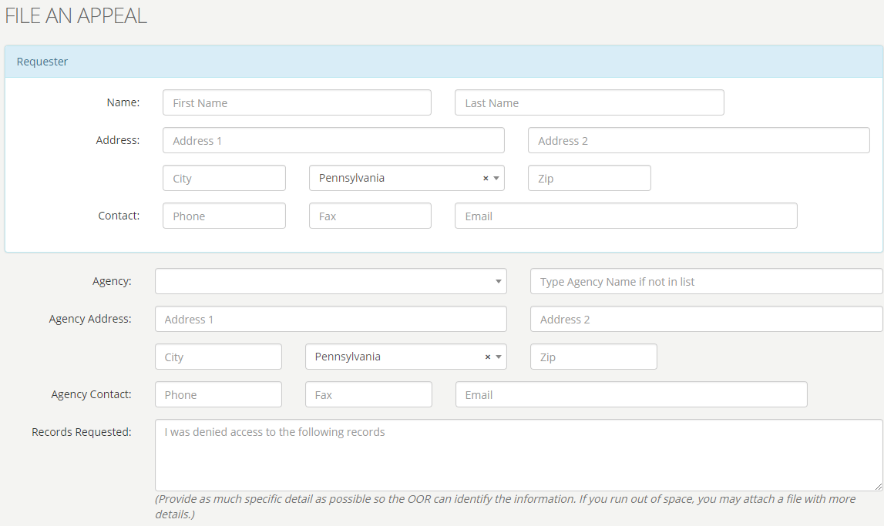
OOR – Online Appeal Form

Slide 38
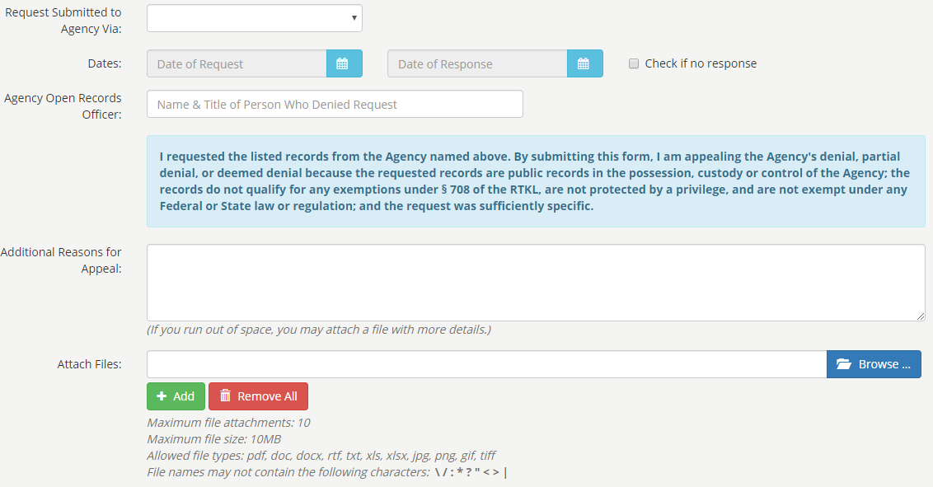
OOR – Online Appeal Form

Slide 39
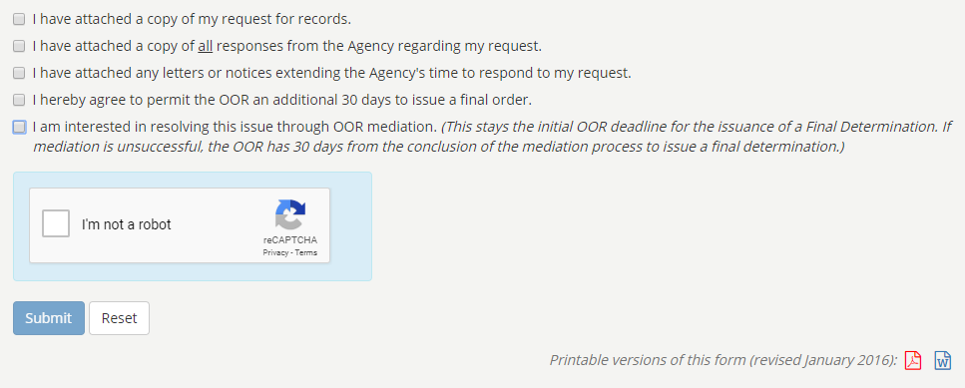
OOR – Online Appeal Form

Slide 40
Tip: Consider Requesting Mediation
RTKL authorizes OOR to establish informal mediation program
Goal: Mutually agreeable settlement
Voluntary & confidential
Either side can end mediation at any time
  If mediation ends, case moves to normal appeal process (new AO)
OOR has trained mediators
Can save time & expense

Slide 41
Requesting Police Recordings
RTKL does not apply to police recordings
Act 22 of 2017 covers police video & audio recordings
Agency has 30 days to respond, may deny for various reasons
Denials may be appealed within 30 days to court; $125 fee
Law enforcement agencies & DAs have fairly broad discretion to release a recording (with or without a written request).
More info on OOR website

Slide 42
Office of Open Records
Created by RTKL: Independent & quasi-judicial
Decide appeals filed by people denied access to records (approx. 2,400 per year)
Provide RTKL & Sunshine Act training
18 total staff
  Executive Director & Deputy Director
  12 Attorneys (incl. 10 Appeals Officers)
  Chief of Training & Outreach
  3 Administrative

Slide 43
OOR Caseload
Thousands of RTK appeals filed every year
In 2017, OOR heard 2,434 appeals
  That’s total appeals, not total requests
  No central database of # of requests
    LBFC Study estimated 109,000 requests received by state & local agencies, combined, in 2016

Slide 44
Cost of the RTKL
Legislative Budget & Finance Committee:
Study released in 2018 (data covering calendar year 2016)
54% of agencies reported $500 or less annual cost
  92% of agencies reported $10,000 or less
Total cost (all agencies, 2016) ~ $5.7 million to $9.7 million
  Median cost = $500
  > 6,000 agencies, so avg. cost = $950 to $1,617 per agency

Slide 45
Potential Amendments to the RTKL
SB 465 & SB 466 (Blake), also numerous other bills
Many potential amendments generally agreed to
Inmate requests limited to certain categories of records
New fees for commercial requests (excludes media)
Campus police department = local agency
708(b)(17) does not apply to final safety inspections
Require preservation of records after a request
Courts can fine agencies $500/day for ignoring an OOR order

Slide 46
OOR Resources
Website, Twitter, Email Lists & More
Web: https://openrecords.pa.gov
Blog: https://openrecordspa.wordpress.com/
Email lists: Daily Digest of FDs & General Updates
  https://www.openrecords.pa.gov/EmailSubscriptions.cfm
Twitter: @OpenRecordsPA
  Executive Director: @ErikOpenRecords
YouTube Channel
Open Records in PA Podcast: Apple Podcasts, Stitcher, etc.

