Slide 1

OOR Annual Training
November 1, 2018
Erik Arneson, Executive Director
https://openrecords.pa.gov
@ErikOpenRecords
@OpenRecordsPA
earneson@pa.gov
(717) 346-9903

Slide 2
Introduction
Pennsylvania’s RTKL will soon be 10 years old
This is the 10th OOR Annual Training
RTKL became fully effective Jan. 1, 2009
100s of thousands of requests processed
More than 20,000 appeals decided
Still seeing many unique and unusual cases

Slide 3
Introduction
In 2018, results from 2 surveys of AOROs
OOR: January 2018
LBFC: February 2018
Starting 2019, OOR will conduct annual survey of AOROs to collect & analyze ongoing data

Slide 4
Introduction
Standard Right-to-Know Request Form update
Goal: Make the request form more helpful for both agencies and requesters
Sept. 2018: Posted draft & sought input
Oct. 2018: Revised draft to reflect input
Nov. 2018: New Standard RTKL Request Form will be available this month

Slide 5
Introduction
Other recent updates available on OOR website
Official RTKL Fee Schedule
Key RTKL Legal Decisions (updated regularly)
Sample Agency RTKL Policy
RTKL Guide for Law Enforcement Agencies
Trade Secrets & Confidential Proprietary Info
RTKL Flowchart

Slide 6
Introduction
New Training Capabilities for the OOR
Moved to a new office (333 Market) in 2018
2019 will include:
  More webinars
  More YouTube videos
  More podcasts
  More on-site training at 333 Market Street
  Training at locations across the state

Slide 7
Introduction
Submit questions for panel discussion at
openrecords@pa.gov

Slide 8
OOR Annual Training
November 1, 2018
George Spiess, Training Coordinator
https://openrecords.pa.gov
gespiess@pa.gov
(717) 346-9903

Slide 9
OOR Website Resources
Agency Open Records Officer Searchable Database

Slide 10
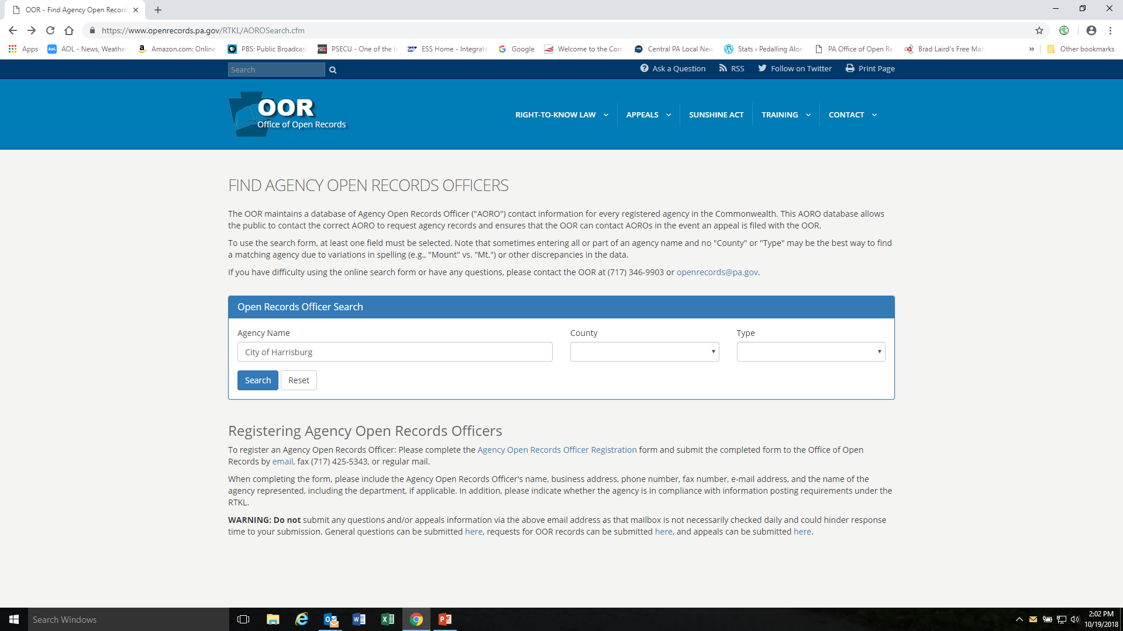

Slide 11
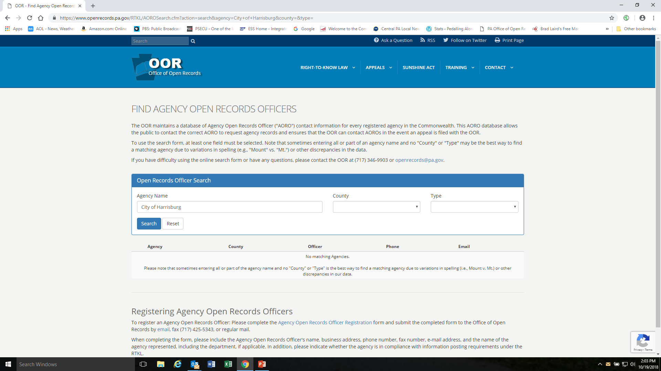

Slide 12
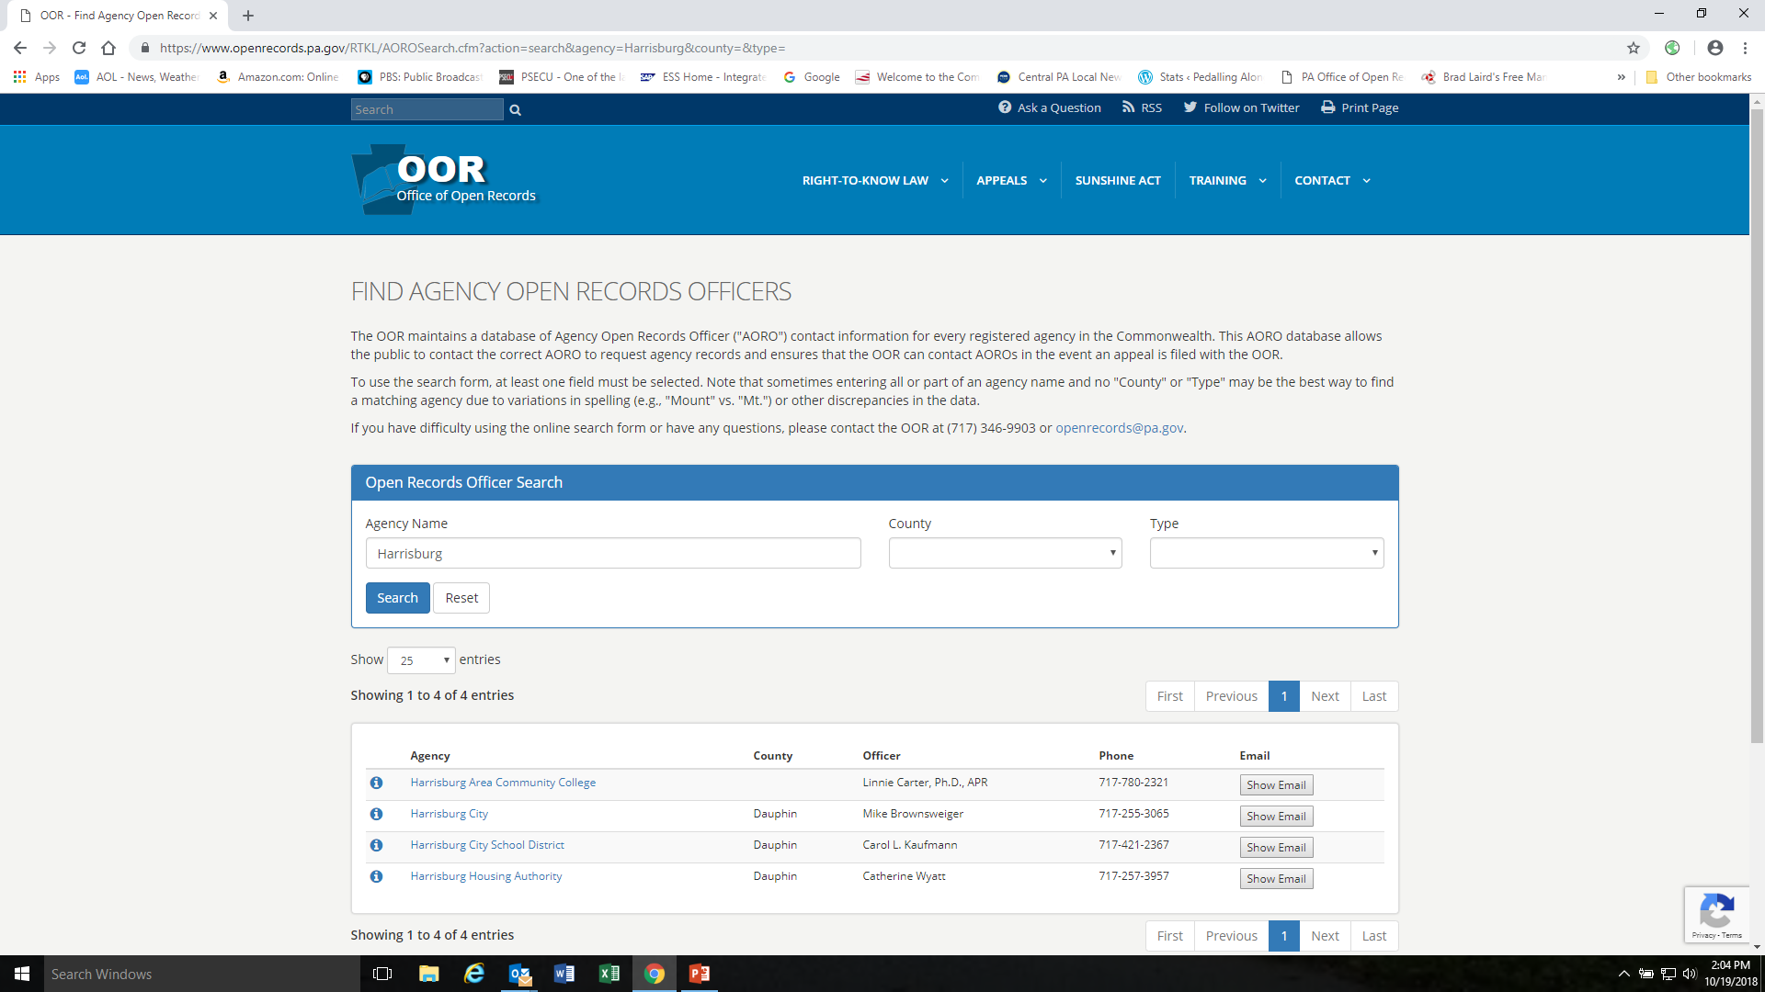

Slide 13
OOR Website Resources
Online Appeal Form

Slide 14
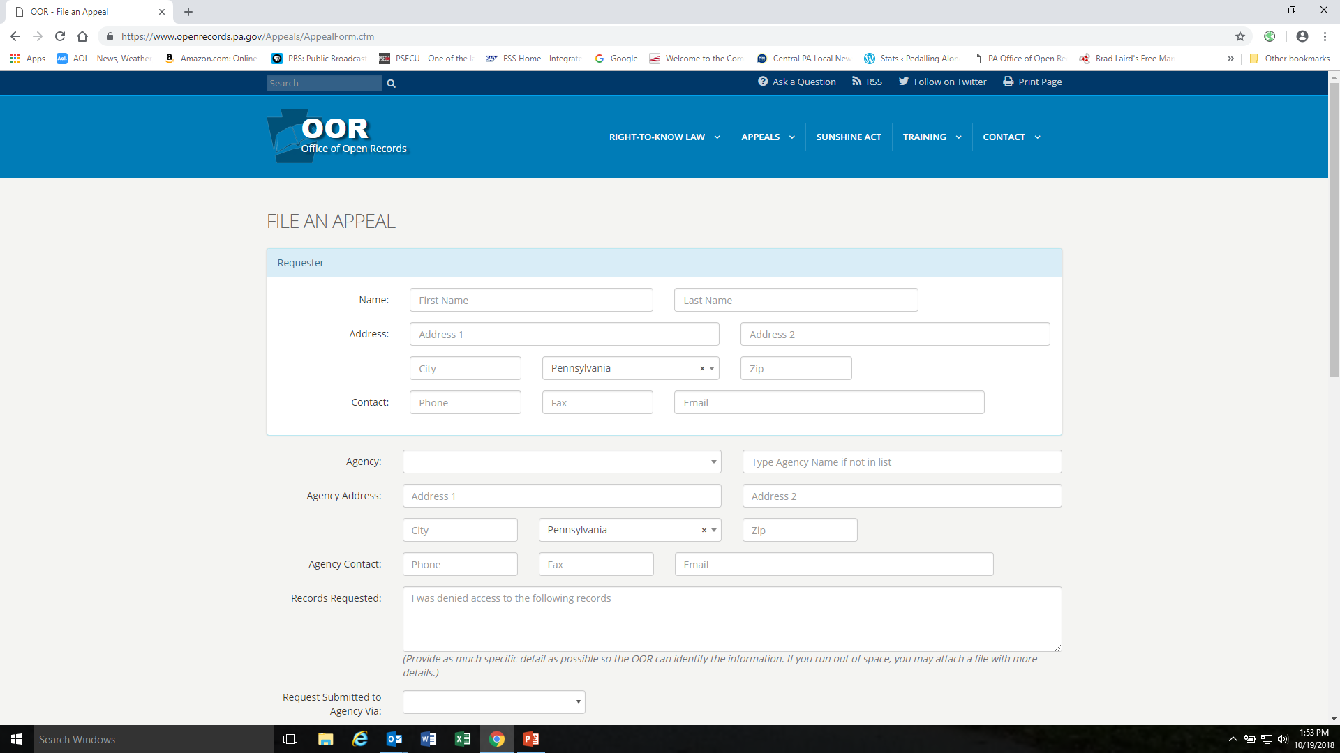

Slide 15
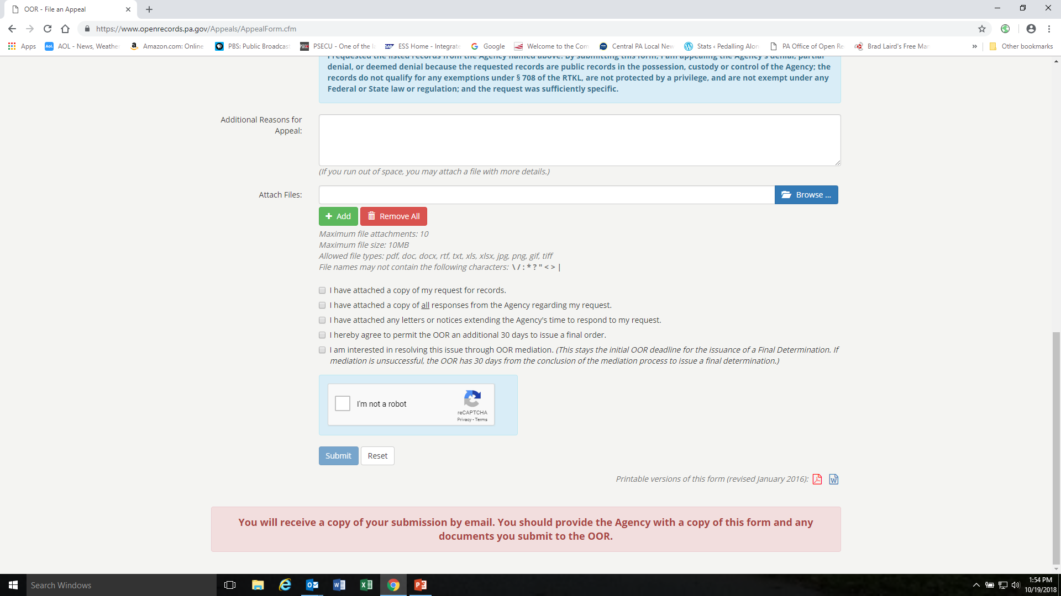

Slide 16
OOR Website Resources
Final Determinations Online Search Engine

Slide 17
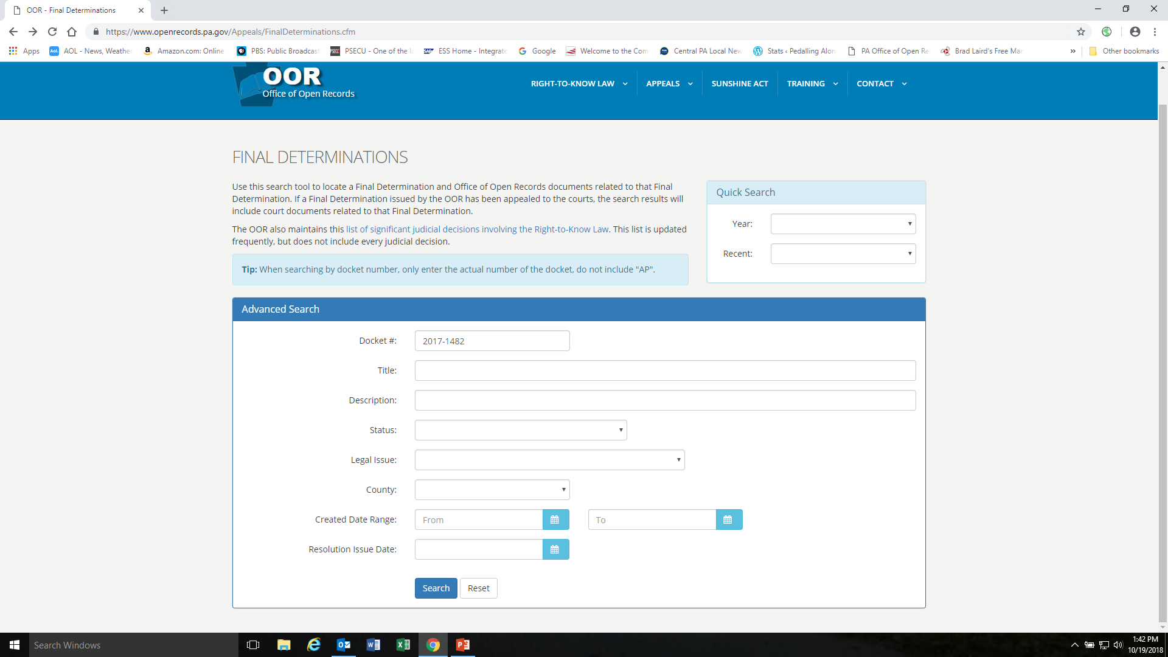

Slide 18
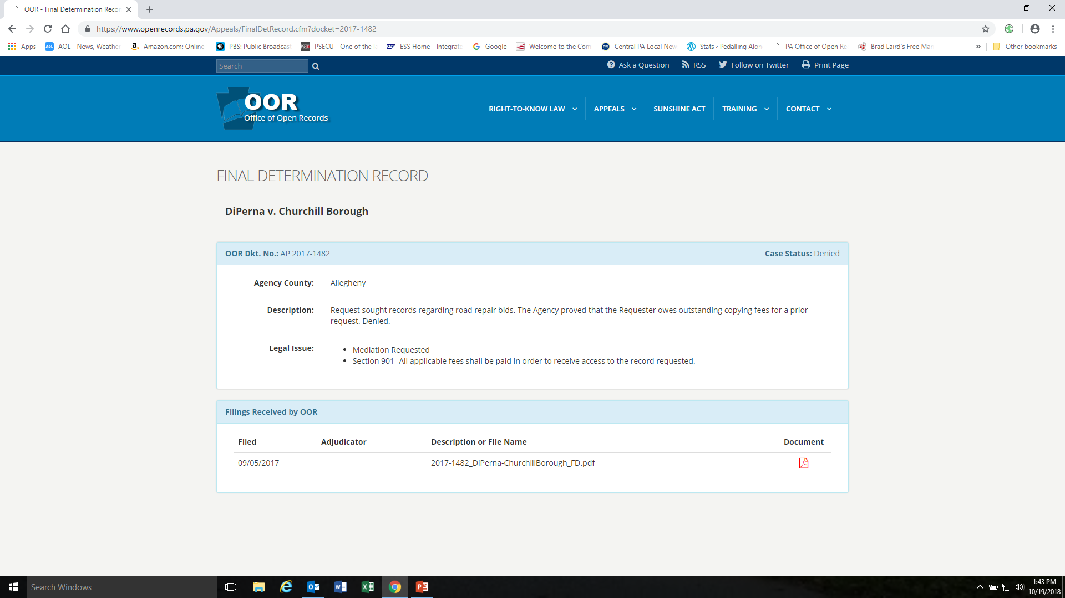

Slide 19
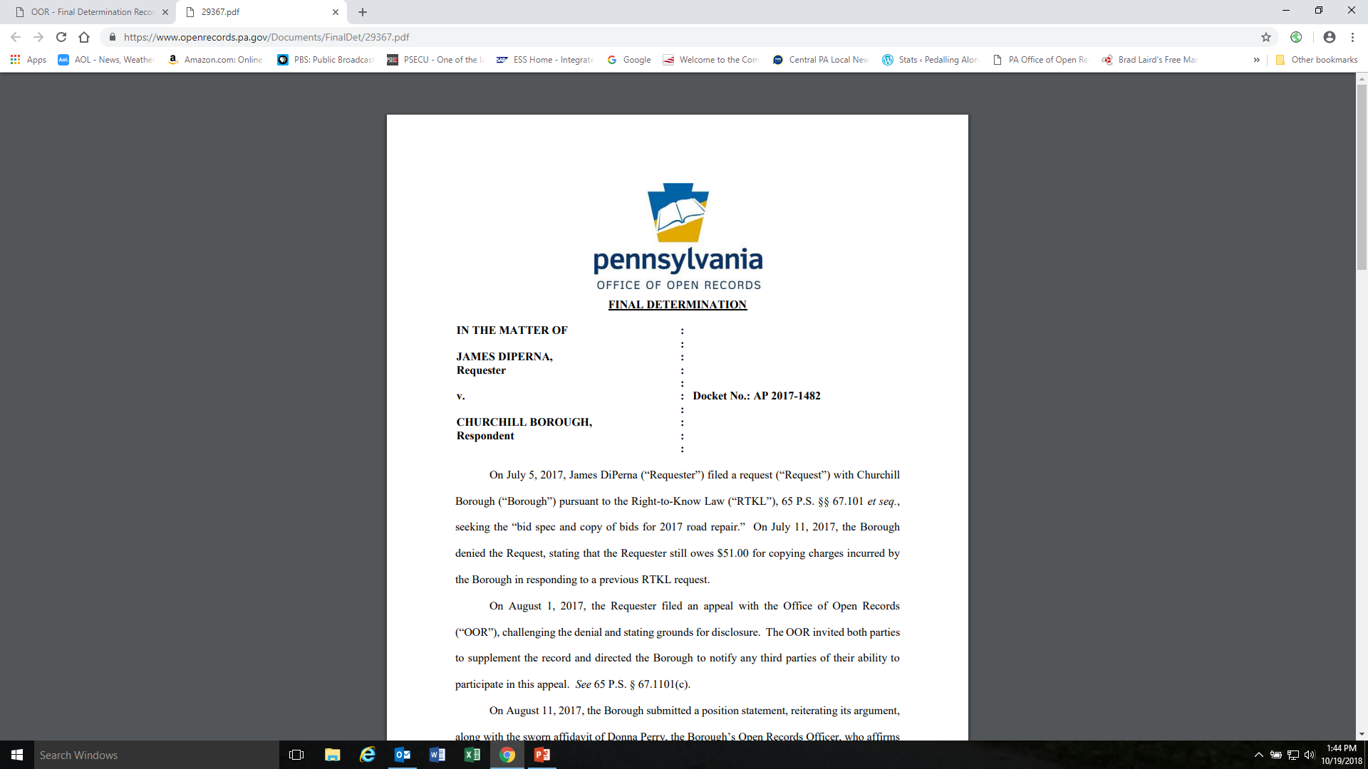

Slide 20


Slide 21
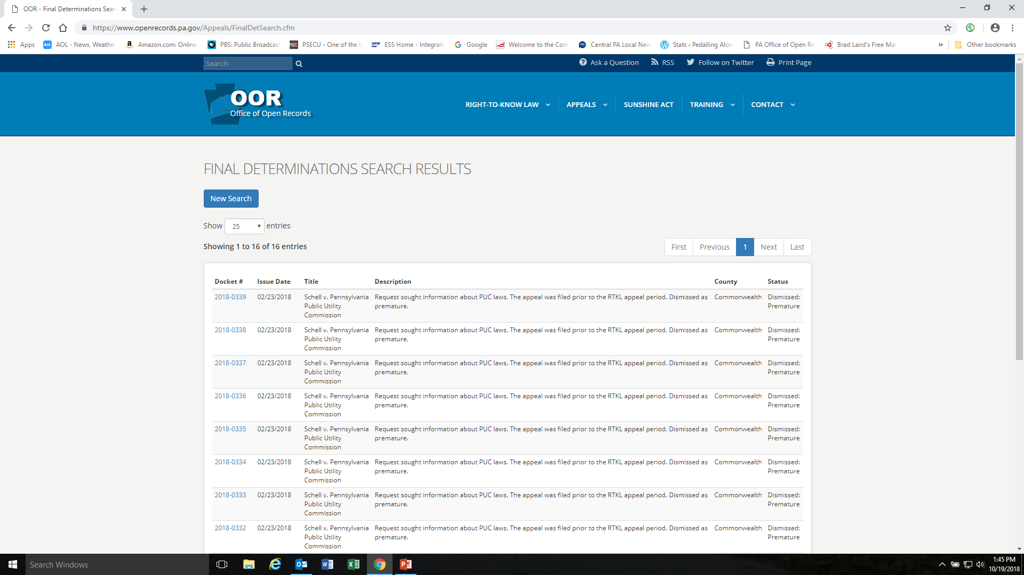

Slide 22
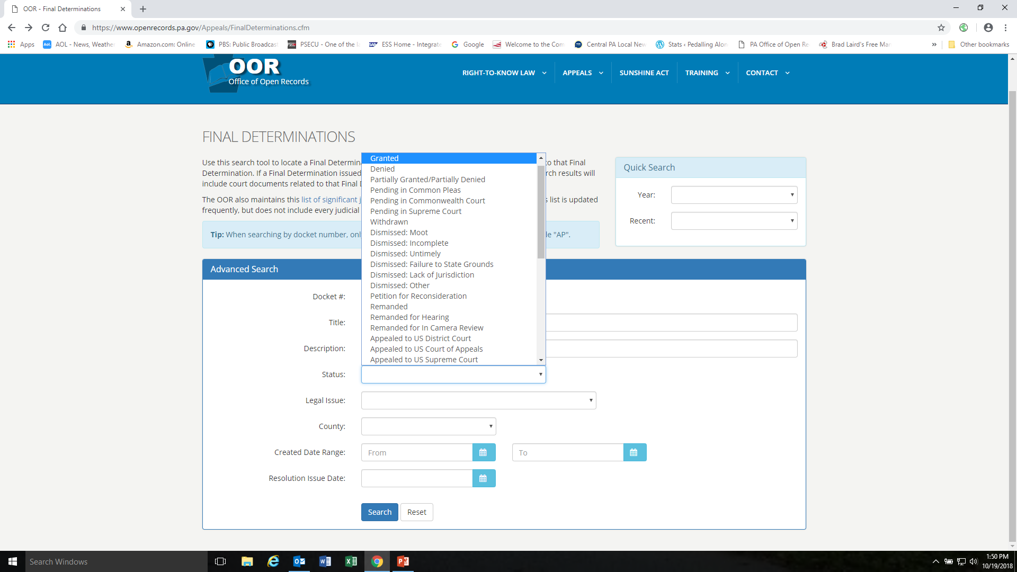

Slide 23
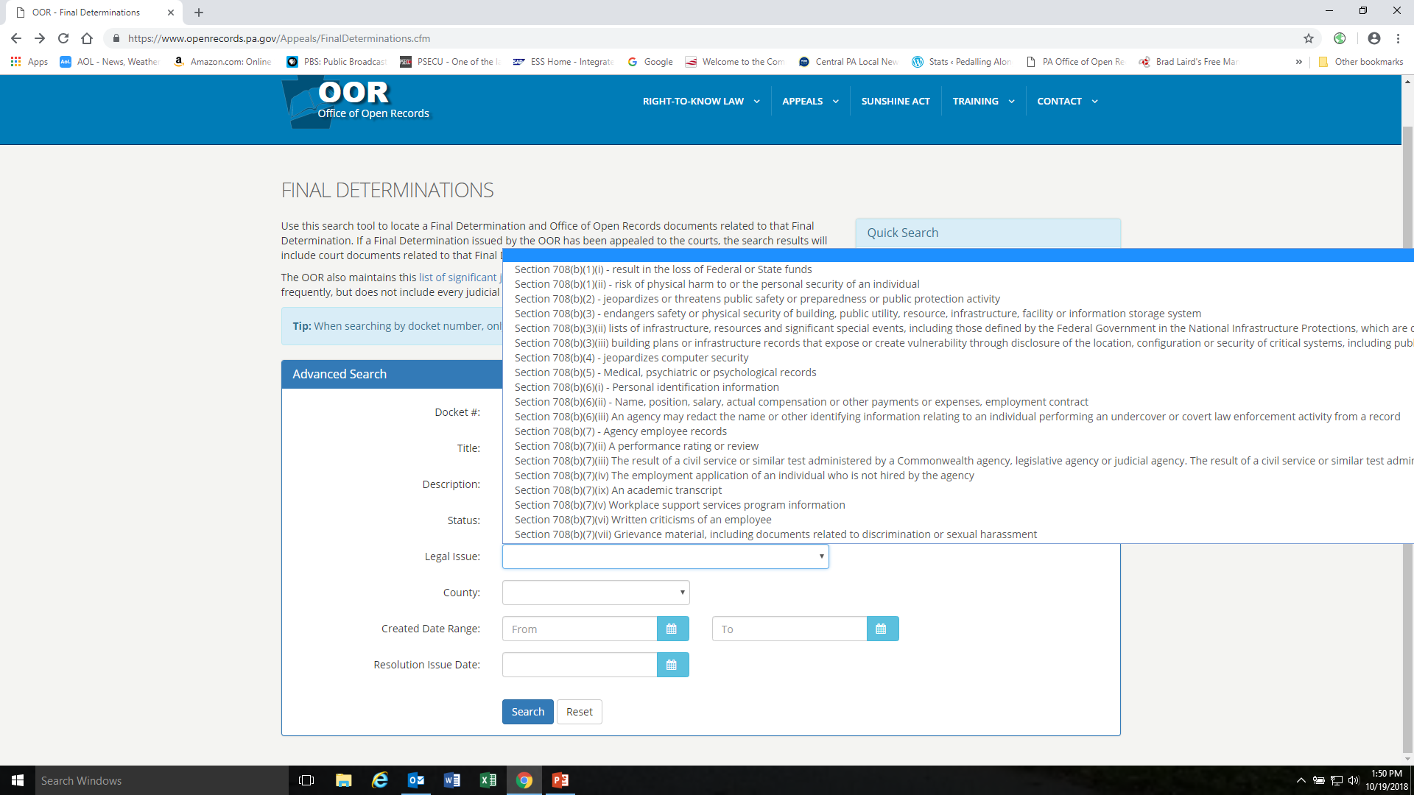

Slide 24
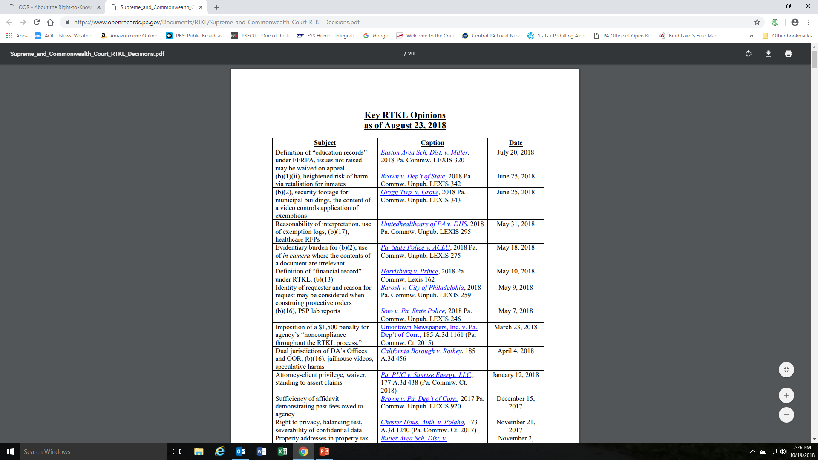

Slide 25
OOR Website Resources
Online RTKL Request Form for OOR Records

Slide 26
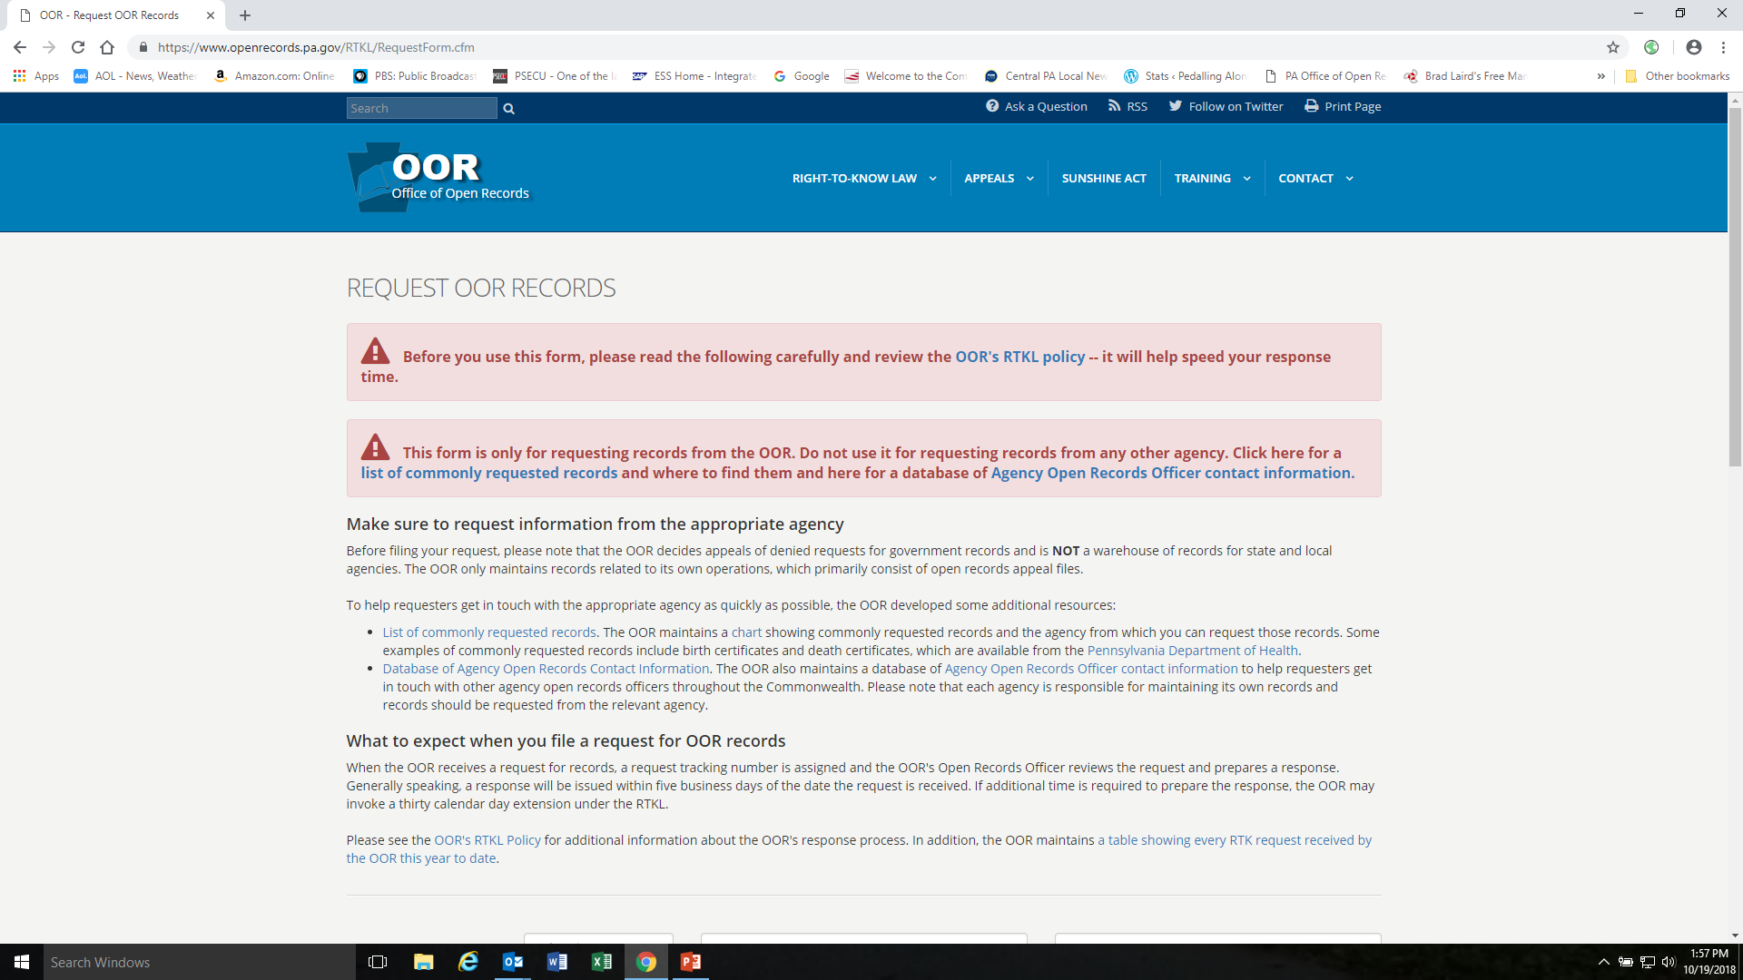

Slide 27
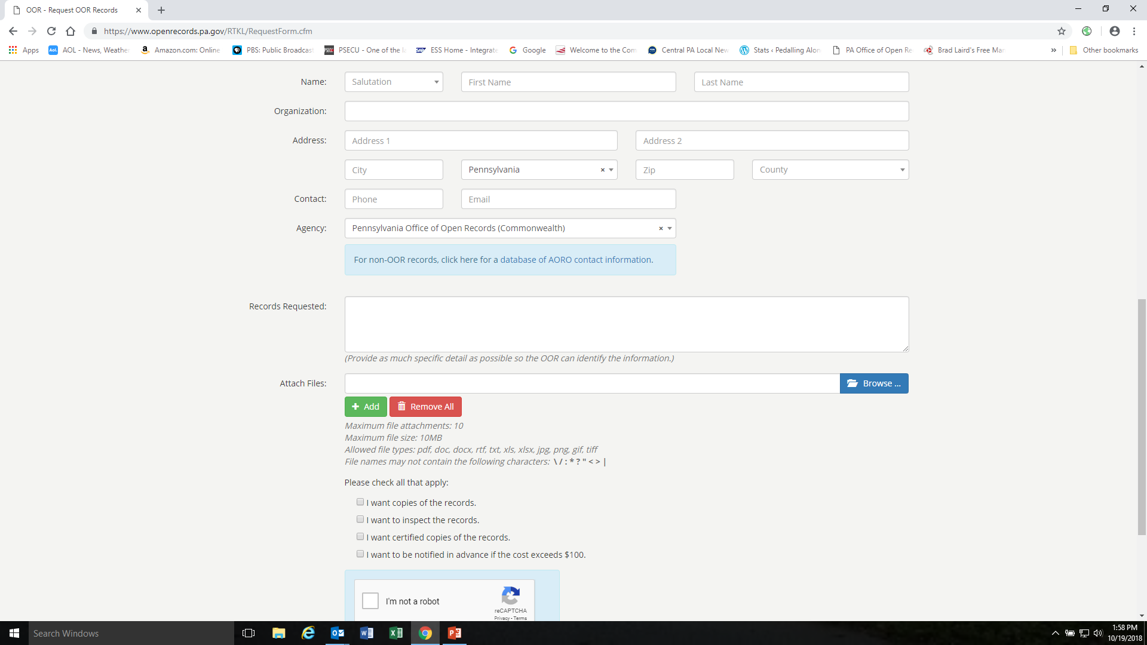

Slide 28
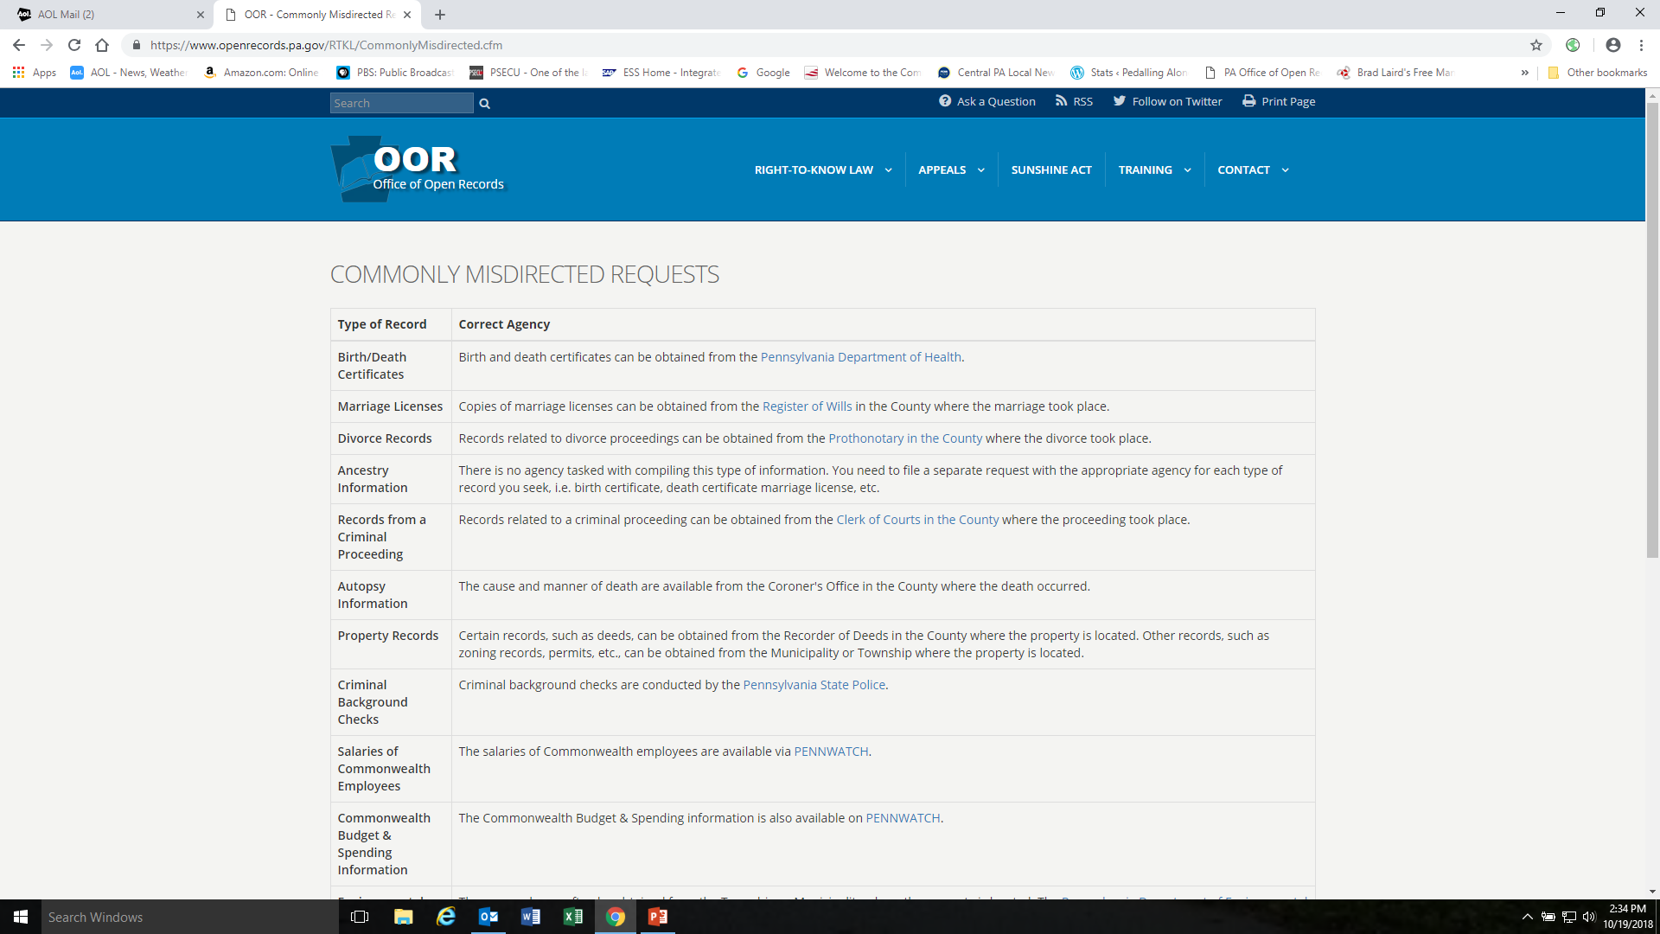

Slide 29
OOR Website Resources
Outreach and Training

Slide 30
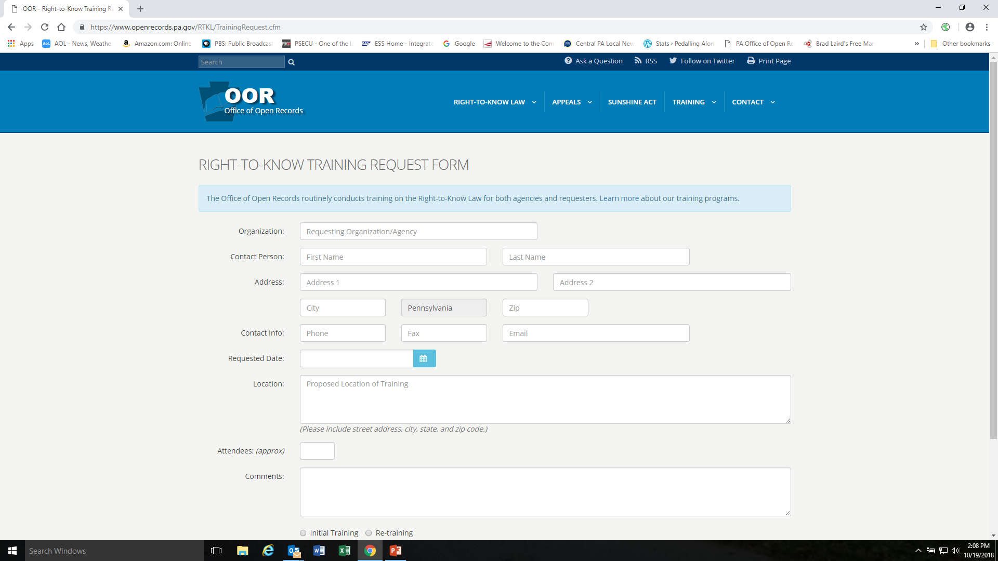

Slide 31
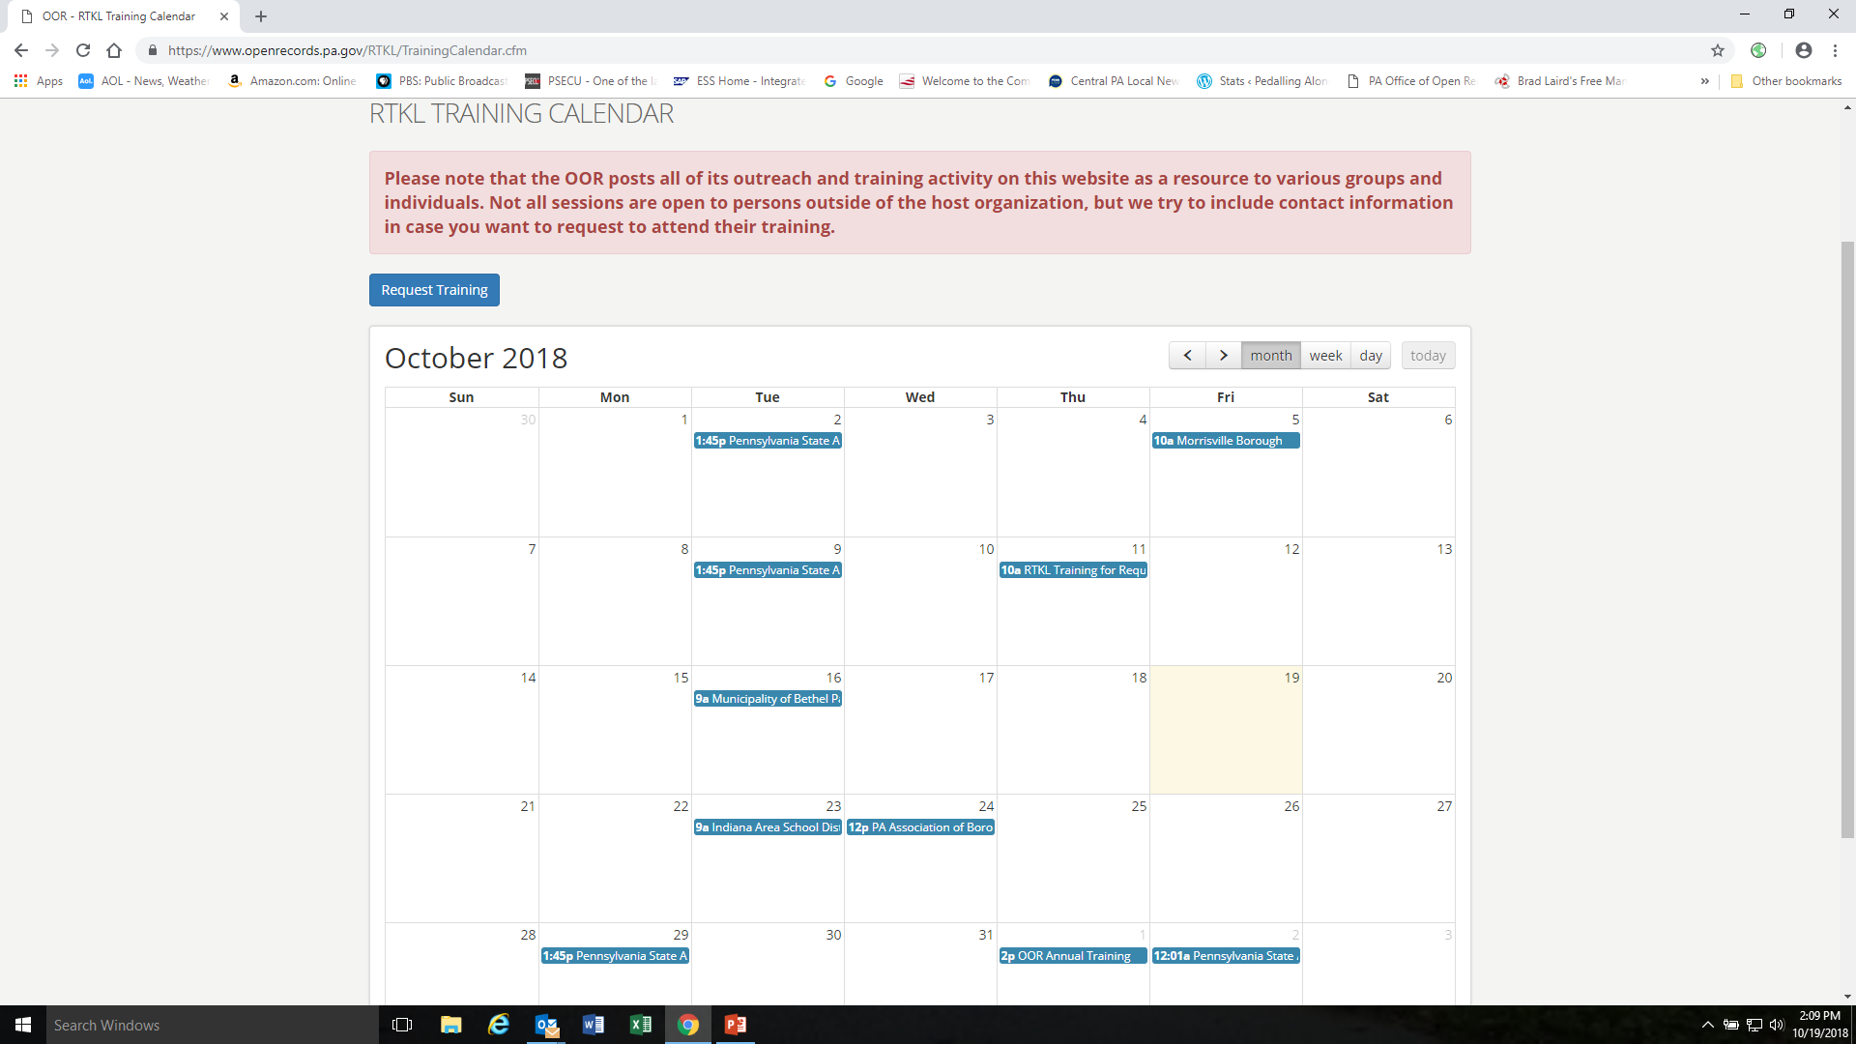

Slide 32
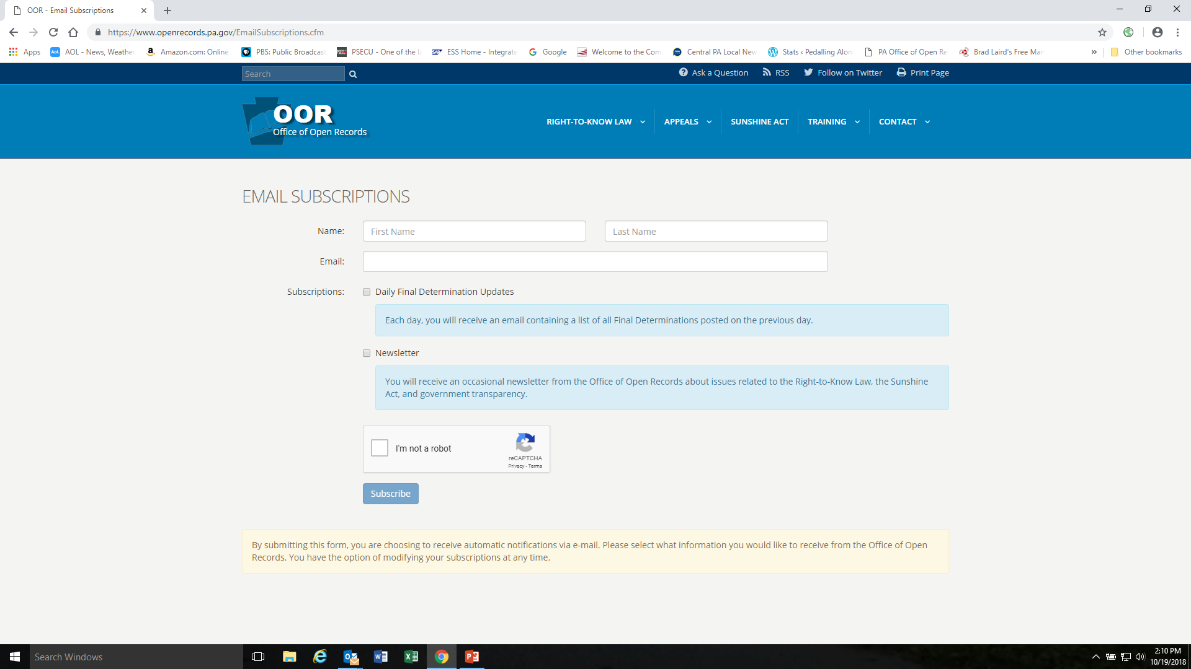

Slide 33
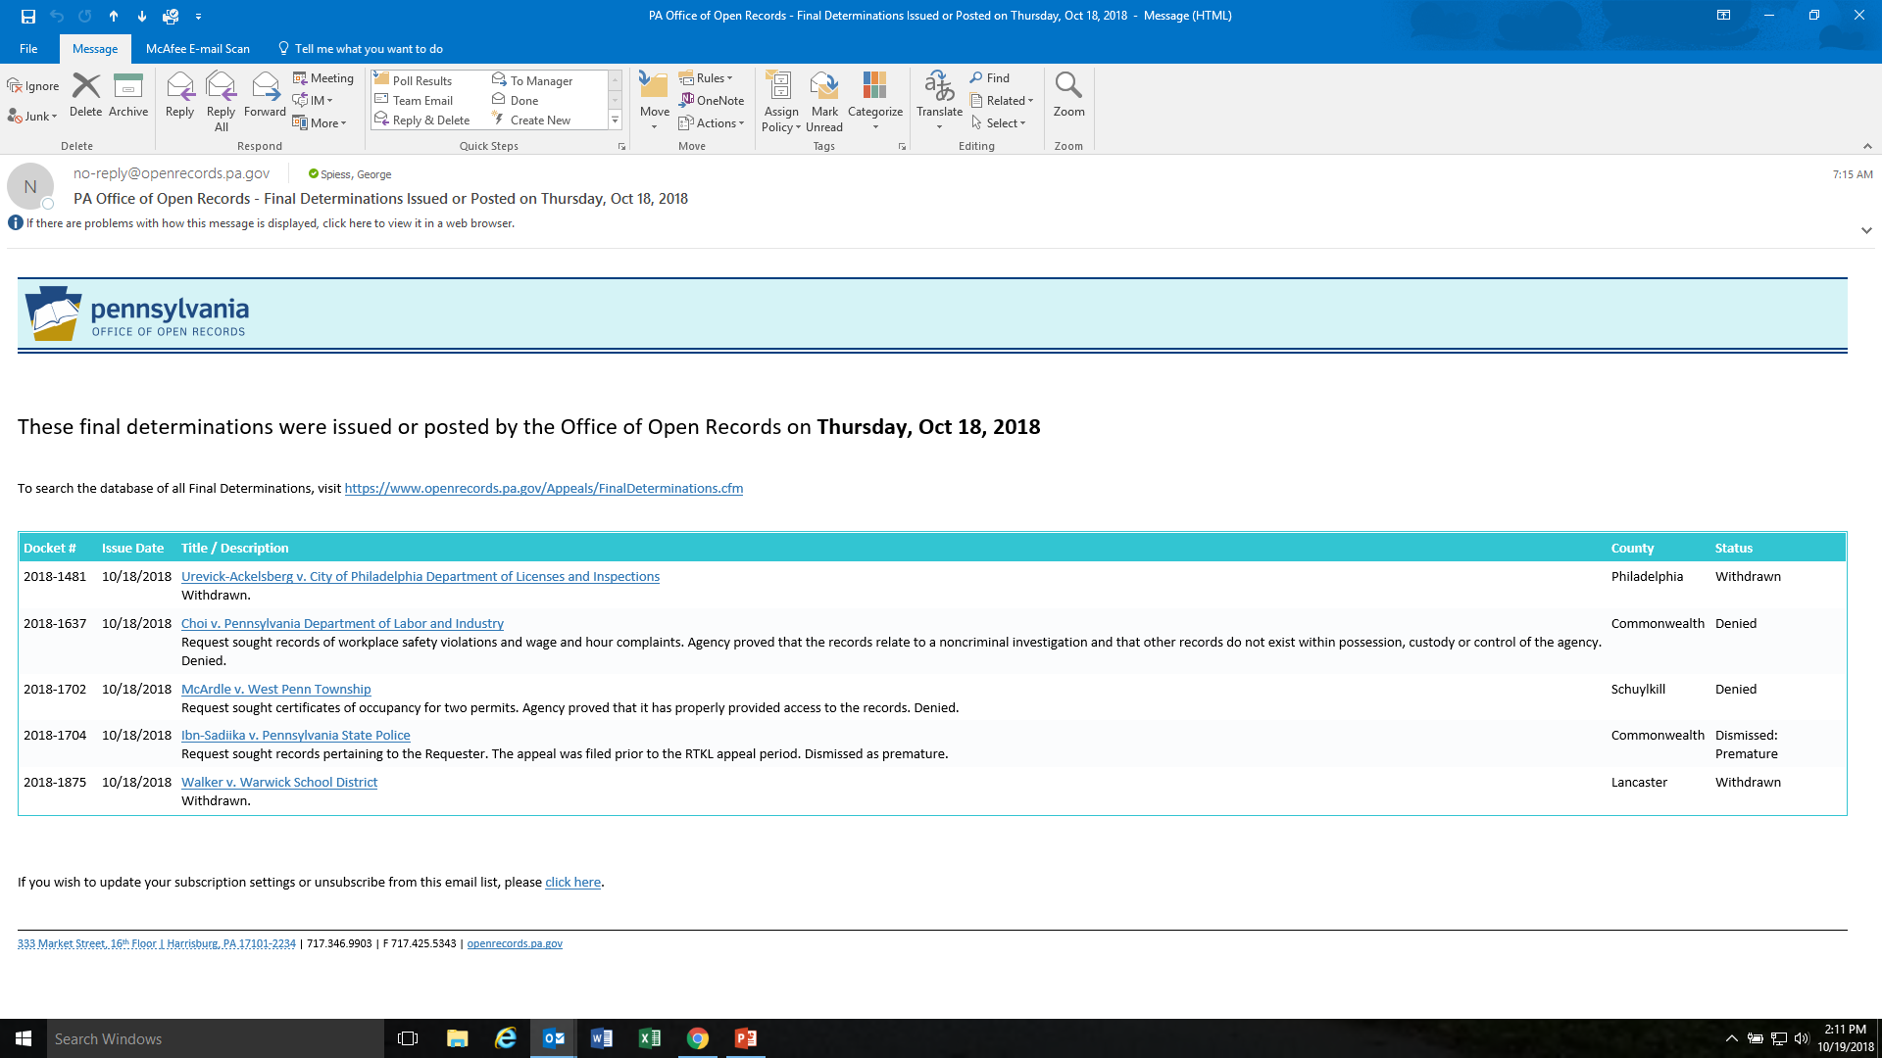

Slide 34
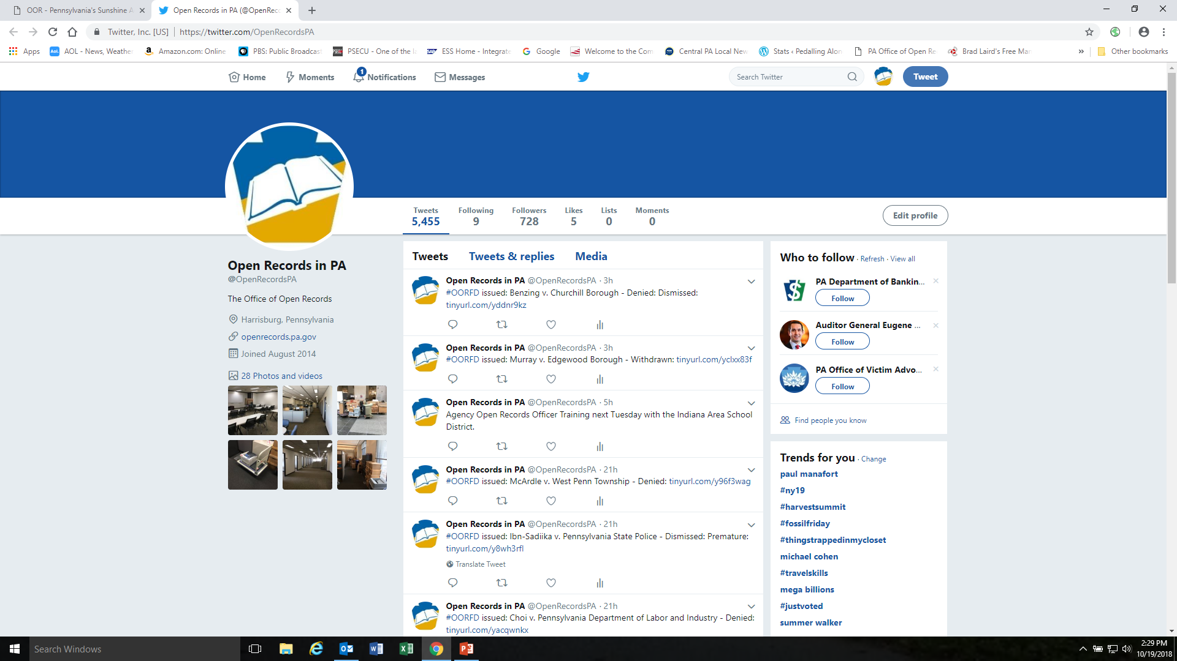

Slide 35
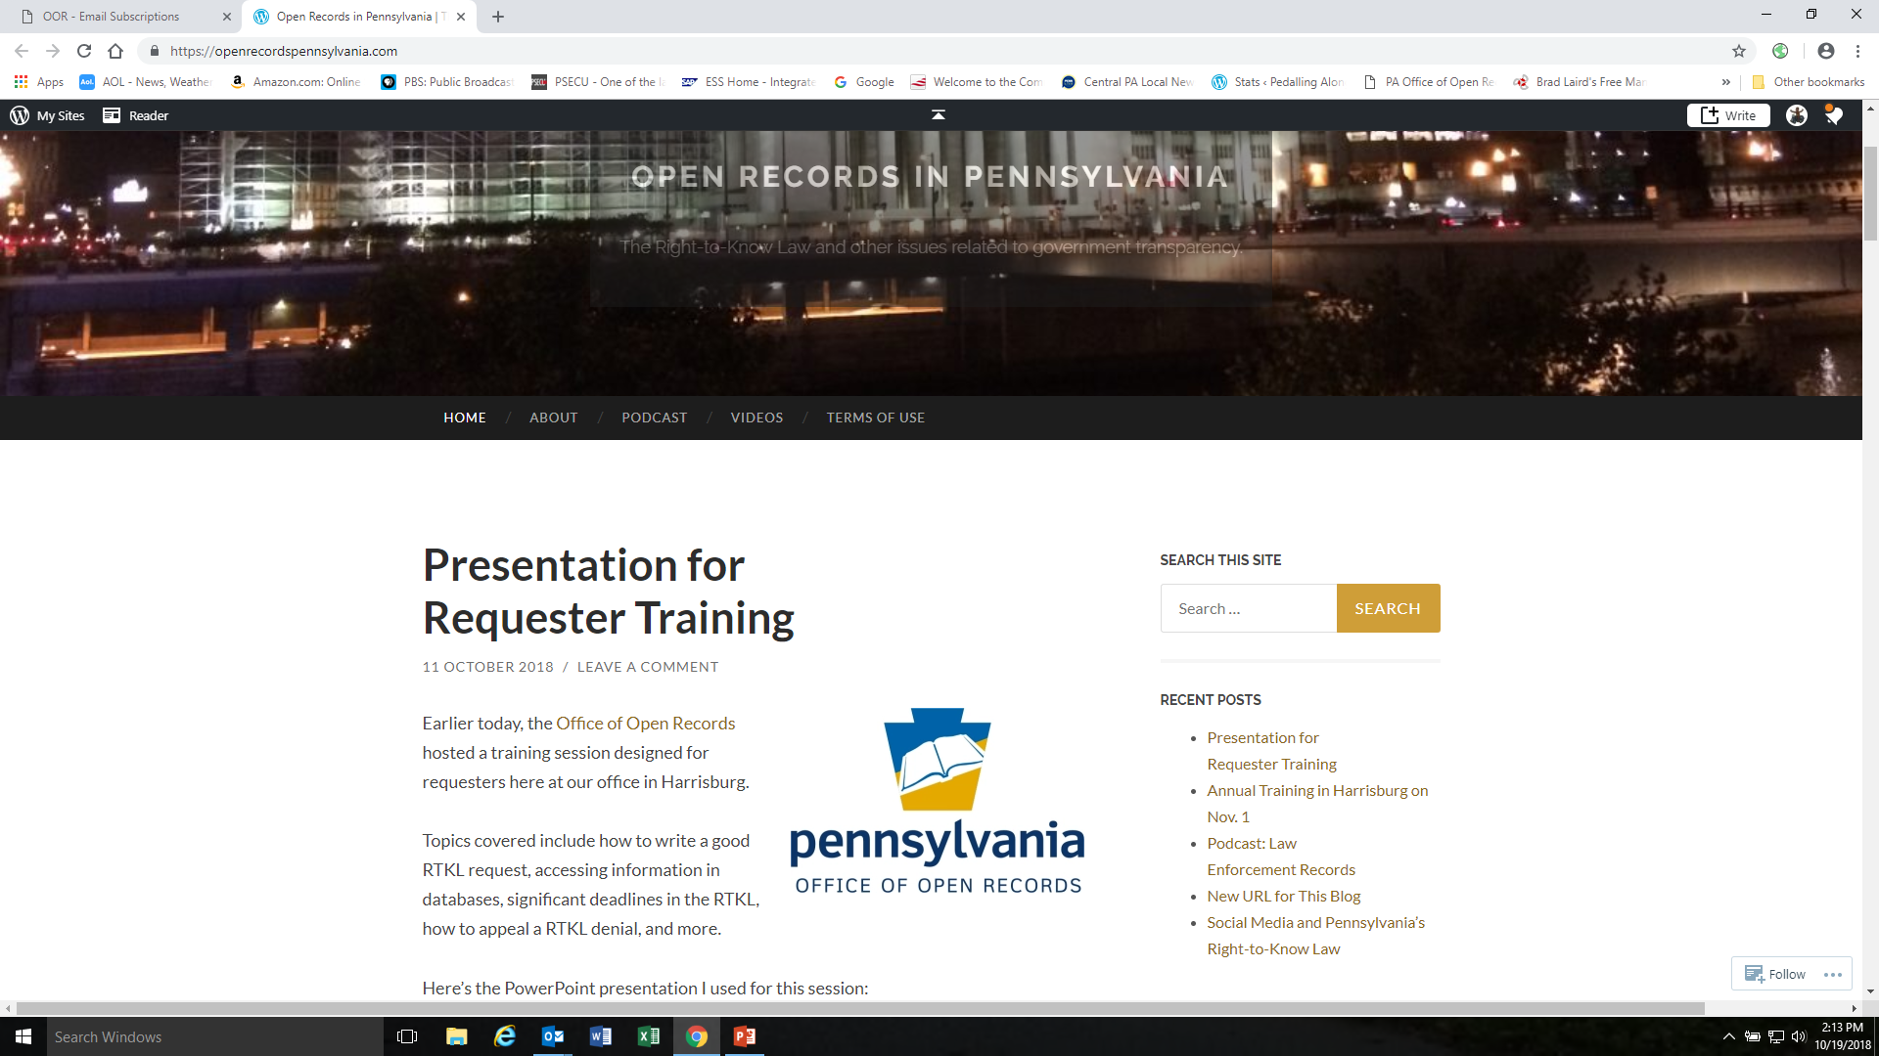

Slide 36
OOR Annual Training
November 1, 2018
Charles Brown, Chief Counsel
https://openrecords.pa.gov
charlebrow@pa.gov
(717) 346-9903

Slide 37
Case Summary
Reese v. Pennsylvanians for Union Reform, 173 A.3d 1143 (Pa. 2017)
Butler Area Sch. Dist. v. Pennsylvanians for Union Reform, 172 A.3d 1173 (Pa. Commw. Ct. 2017)
Chester Hous. Auth. v. Polaha, 173 A.3d 1240 (Pa. Commw. Ct. 2017)

Slide 38
Case Summary
Pa. State Police v. Grove, 161 A.3d 877 (Pa. 2017)
California Borough v. Rothey, 2018 Pa. Commw. LEXIS 144 (Pa. Commw. Ct. 2018)
Easton Area Sch. Dist. v. Miller, 191 A.3d 75 (Pa. Commw. Ct. 2018)

Slide 39
Case Summary
Gregg v. Twp. v. Grove, 2018 Pa. Commw. Unpub. LEXIS 343 (Pa. Commw. Ct. 2018)
City of Harrisburg v. Prince, 2018 Pa. Commw. LEXIS 162 (Pa. Commw. Ct. 2018)
Brown v. Pa. Dep’t of Corr., 2017 Pa. Commw. Unpub. LEXIS 920 (Pa. Commw. Ct. 2017)

Slide 40
Case Summary
Pa. State Police v. ACLU, 2018 Pa. Commw. Unpub. LEXIS 275 (Pa. Commw. Ct. 2018)
Miller v. Cty. of Centre, 173 A.3d 1162 (Pa. 2017)
Magee v. Phila. Dist. Atty., 2018 Pa. Commw. Unpub. LEXIS 505 (Pa. Commw. Ct. 2018)

Slide 41
Case Summary
UnitedHealthCare v. Pa. Dep’t of Human Servs., 2018 Pa. Commw. LEXIS 175 (Pa. Commw. Ct. 2018)
Pa. Dep’t of Human Servs. v. McKelvey, 2018 Pa. Commw. Unpub. LEXIS 520 (Pa. Commw. Ct. 2018)
City of Phila. v. Barosh, 2018 Pa. Commw. Unpub. LEXIS 259 (Pa. Commw. Ct. 2018)

Slide 42
Case Summary
IBEW v. City of Reading, Dkt. 17-16-78 (Berks C.C.P. 2018)
Uniontown Newspapers, Inc. v. Pa. Dep’t of Corr., 2018 Pa. Commw. LEXIS 189 (Pa. Commw. Ct. 2018)

Slide 43
OOR Annual Training
November 1, 2018
Nathan Byerly, Deputy Executive Director
Delene Lantz, General Counsel
https://openrecords.pa.gov
Nbyerly@pa.gov; Dlantz-Joh@pa.gov
(717) 346-9903

Slide 44
RTKL & Sunshine Act Ethical Considerations
Ethics definition
Moral principles that govern a persons’ behavior or the conducting of an activity.

Slide 45
Who do ethics apply to?
Citizens?
Agency Open Records Officers?
Attorneys?
Appeals Officers?
Executive Directors?

Slide 46
Legal Ethics
Pennsylvania has the Rules of Professional Conduct that define a lawyers responsibility to their client and applies to: client-lawyer relationship, counselor, advocate, transactions with persons other than clients, law firm and associations, public service, integrity in the profession.
https://www.pacode.com/secure/data/204/chapter81/s81.4.html

Slide 47
Public Official and Employee Ethics
The State Ethics Commission enforces the Public Official and Employees Ethics Act , 65 Pa.C.S. §§ 1101-1113, which applies to public officials and employees - public office is a public trust and that any effort to realize personal financial gain through public office other than compensation provided by law is a violation of that trust.
https://www.ethics.pa.gov/Pages/default.aspx

Slide 48
PUBLIC OFFICIAL
Any person elected by the public or elected or appointed by a governmental body, or an appointed official in the executive, legislative, or judicial branch of the Commonwealth of Pennsylvania or any political subdivision thereof, provided that it shall not include members of advisory boards that have no authority to expend public funds other than reimbursement for personal expense, or to otherwise exercise the power of the state or any political subdivision thereof.

Slide 49
PUBLIC EMPLOYEE
Any individual employed by the Commonwealth of Pennsylvania or a political subdivision who is responsible for taking or recommending official action of a non-ministerial nature with regard to: (1) contracting or procurement; (2) administering or monitoring grants or subsidies; (3) planning or zoning; (4) inspecting, licensing, regulating, or auditing any person; or (5) any other activity where the official action has an economic impact of greater than a de minimis nature on the interests of any person.
The term ”public employee” shall not include individuals who are employed by the state or any political subdivision thereof in teaching as distinguished from administrative duties.

Slide 50
RTKL Ethical Considerations
Privileges:
The attorney-work product doctrine, the attorney-client privilege, the doctor-patient privilege, the speech and debate privilege or other privilege recognized by a court interpreting the laws of the Commonwealth of Pennsylvania. 65 P.S. § 67.102

Slide 51
OOR Ethical Considerations
OOR review of privileges
The Pennsylvania Office of Open Records’ involvement in the process of the Pennsylvania’s Right-to-Know Law (RTKL), 65 Pa. Stat. Ann. §§ 67.101-67.3104, does not implicate, much less infringe upon, the Pennsylvania Supreme Court’s exclusive authority to govern the conduct of attorneys practicing law in the Commonwealth of Pennsylvania. Accordingly, when the OOR exercises subject matter jurisdiction and determines whether a request is covered by the attorney-client privilege, the work-product doctrine, or the ethics-based rule of confidentiality, the OOR does not infringe upon the supreme court’s authority under Pa. Const. art. V, § 10(c). Commonwealth v. Ctr. Twp., 95 A.3d 354 (Pa. Cmwlth. 2014).

Slide 52
OOR Ethical Considerations
How to determine if a privilege applies to records:
OOR has the authority to request production of an exemption log and to conduct in camera review of documents where an exemption or privilege has been asserted. Commonwealth v. Ctr. Twp., 95 A.3d 354, 369-70 (Pa. Cmwlth. 2014). "Records reviewed in camera may serve as a sufficient basis for a fact-finder to assess whether an exemption applies." Office of the Governor v. Davis, 122 A.3d 1185 (Pa. Cmwlth. 2015).

Slide 53
OOR In camera process
A proceeding during which an Appeals officer reviews records claimed to be non-public.
The in camera inspection index must contain the following information, unless otherwise directed by the appeals officer:
The Bates number or range of numbers on which the record appears.
The date of the record.
A description of the type of record (such as, e-mail, memo, text message).
The name and title of the author and each recipient of the record (such as, agency attorney, official, employee, or contractor).
A general description of the subject matter of the record.
A citation to the legal basis justifying the withholding of each record or redaction from the record.

Slide 54
Agency Ethical Considerations
Good Faith
Section 901 of the RTKL provides: Upon receipt of a written request for access to a record, an agency shall make a good faith effort . . . to respond as promptly as possible under the circumstances existing at the time of the request . . . . The time for response shall not exceed five business days from the date the written request is received by the open-records officer for an agency.
We presume that Commonwealth agencies will act in good faith in discharging their statutory duties under the RTKL... Section 703 of the RTKL obliges agency employees who receive RTKL record requests to forward the requests to the agency's open-records officer. Further, Section 901 specifically directs agencies to make a good faith effort to respond to RTKL requests as promptly as possible, and in any event to respond within "five business days from the date the written request is received by the open-records officer." Cmwlth v Donahue, 626 Pa. 437 (2014).

Slide 55
Agency Ethical Considerations
Affidavits: Conclusory vs. Specific
Affidavits are the means through which a governmental agency details the search it conducted for the documents requested and justifies nondisclosure of the requested documents under each exemption upon which it relied upon. The affidavits must be detailed, nonconclusory, and submitted in good faith. . . . Absent evidence of bad faith, the veracity of an agency’s submissions explaining reasons for nondisclosure should not be questioned. .. a generic determination or conclusory statements are not sufficient to justify the exemption of public records. Office of the Governor v. Scolforo, 65 A.3d 1095 (Pa. Cmwlth. 2013).
Moreover, the affidavit must be specific enough to permit OOR or a reviewing court to ascertain whether the claimed exemption applies to the records. UnitedHealthcare of Pa., Inc. v. Pa. Dep't of Human Servs., 187 A.3d 1046 (Pa. Cmwlth. 2018).
Retention of Records

Slide 56
Affidavits Section 901
A local agency may provide affidavits to detail the search its Right to Know Law (RTKL), 65 Pa. Stat. Ann. §§ 67.101-67.3104, officer conducted for documents responsive to a RTKL request and the justification, if applicable, for any exemption from public disclosure or privilege relied upon for denying a requester access to responsive documents. Relevant and credible testimonial affidavits may provide sufficient evidence in support of a claimed exemption; however, conclusory affidavits, standing alone, will not satisfy the burden of proof an agency must sustain to show that a requester may be denied access to records under the RTKL. Office of the DA of Phila. v. Bagwell, 155 A.3d 1119 (Pa. Cmwlth. 2017).

Slide 57
Affidavits for privileges - Attorney-client Privilege
Four elements must be satisfied in order to successfully invoke the protections of the attorney-client privilege:
(1) the asserted holder of the privilege is or sought to become a client,
(2) the person to whom the communication was made is a member of the bar of a court, or his subordinate,
(3) the communication relates to a fact of which the attorney was informed by his client, without the presence of strangers, for the purpose of securing either an opinion of law, legal services or assistance in a legal matter, and not for the purpose of committing a crime or tort, and
(4) the privilege has been claimed and is not waived by the client.
Affidavits should establish through factual statements the elements of the exemption asserted
Every exemption cited should be broken down into its individual elements. Each such element should be supported a factual (non-conclusory) assertion.

Slide 58
Sanctions
Section 1304 of the RTKL seeks to remedy the damage to the requester where an agency has denied access to records in bad faith and to the agency where a requester has launched a frivolous challenge to a denial of access by restoring the requester or the agency to the place where each would have been prior to petitioning the court for review. 65 Pa. Stat. Ann. § 67.1304.
Section 1305(a) of the RTKL provides that, "[a] court may impose a civil penalty of not more than $1,500 if an agency denied access to a public record in bad faith." 65 P.S. § 67.1305(a). An example of bad faith is a local agency’s failure to comply with the mandate of Section 901 of the RTKL, which requires that a local agency make a good faith search for information responsive to a request and determination of whether that information is public. 65 P.S. § 67.901; Chambersburg Area School District v. Dorsey, 97 A.3d 1281, 1291-1292 (Pa. Cmwlth. 2014).
Section 1305(b) of the RTKL provides that “[a]n agency or public official who does not promptly comply with a court order under this act is subject to a civil penalty of not more than $500 per day until the public records are provided.” 65 P.S. § 67.1305(b). Office of the DA of Phila. v. Bagwell, 155 A.3d 1119 (Pa. Cmwlth. 2017).

Slide 59
RTKL & Sunshine Act Ethical Considerations
OOR and the Sunshine Act
Why the OOR
  The Law
  The Numbers
  The Trend

Slide 60
RTKL & Sunshine Act Ethical Considerations
Sunshine Act Section 702: Purpose
  Secrecy in public affairs undermines the faith of the public in government and the public's effectiveness in fulfilling its role in a democratic society.
  [T]he public policy of this Commonwealth [is] to insure the right of its citizens to have notice of and the right to attend all meetings of agencies at which any agency business is discussed or acted upon

Slide 61
RTKL & Sunshine Act Ethical Considerations
Rule 1.1 Competence
A lawyer shall provide competent representation to a client. Competent representation requires the legal knowledge, skill, thoroughness and preparation reasonably necessary for the representation.
Know the Act
  Examples
    Recordings
    Who can speak and when
    Notice
    Meetings or e-mails where quorum deliberates

Slide 62
RTKL & Sunshine Act Ethical Considerations
Rule 1.7: Conflict of Interest: Current Clients
A concurrent conflict of interest exists if:
  the representation of one client will be directly adverse to another client; or
  there is a significant risk that the representation of one or more clients will be materially limited by the lawyer's responsibilities to another client, a former client or a third person or by a personal interest of the lawyer.
Rule 1.8: Current Clients: Specific Rules
Rule 1.9: Duties to Former Clients
  a lawyer shall not represent a client if the representation involves a concurrent conflict of interest.

Slide 63
RTKL & Sunshine Act Ethical Considerations
Rule 8.9: Misconduct
It is professional misconduct for a lawyer to:
  (c) engage in conduct involving dishonesty, fraud, deceit or misrepresentation

Slide 64
Questions
Submit questions for panel discussion at
openrecords@pa.gov

