Slide 1

Dr. Benjamin W. Cramer
Penn State University
November 5, 2018
Erik Arneson, Executive Director
https://openrecords.pa.gov
@ErikOpenRecords
@OpenRecordsPA
earneson@pa.gov
(717) 346-9903

Slide 2
A Brief History
RTKL introduced 3/29/2007, signed 2/14/2008, eff. 1/1/2009
Senator Dominic Pileggi, new majority leader – SB 1
Then-existing RTK Act presumed gov’t records were not public
  Requester had to prove public nature & all appeals went to court
  In practice, basically limited to financial records
Act 3 of 2008 – gov’t records now presumed to be public
  Agencies bear the burden of proof to withhold records
  Created independent Office of Open Records (free appeals)

Slide 3
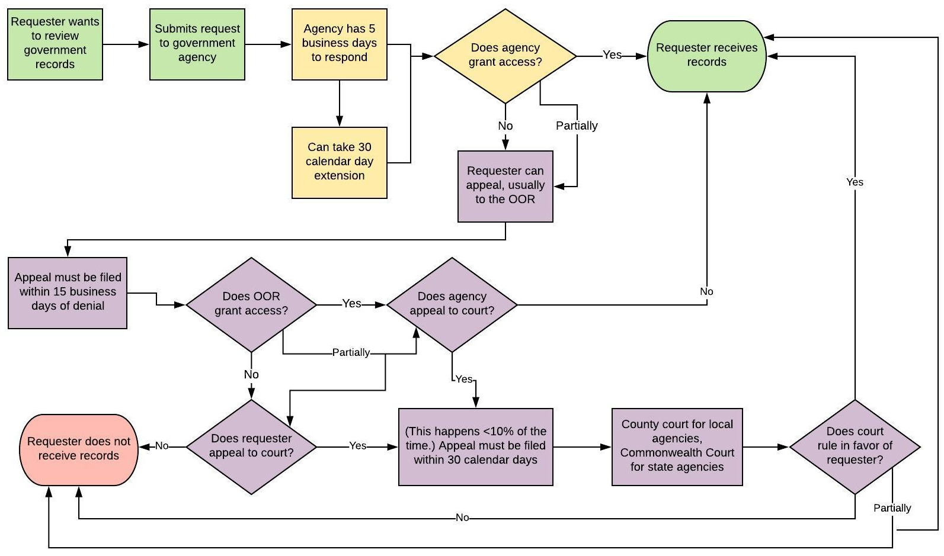
Right-to-Know Law Basics

Slide 4
Which of These are Records?
Which of these do you think are “records” under the RTKL?
An agency’s budget for FY 2018-19
Inappropriate emails sent to a co-worker on gov’t computer
Video recording of an Environmental Quality Board meeting
DEP inspector’s on-site notes
City, county or state proposal to Amazon for HQ2
Database of lead tests done by city w/ home addresses

Slide 5
Which of These are Records?
Which of these do you think are “records” under the RTKL?
An agency’s budget for FY 2018-19
Inappropriate emails sent to a co-worker on gov’t computer
Video recording of an Environmental Quality Board meeting
DEP inspector’s on-site notes
City, county or state proposal to Amazon for HQ2
Database of lead tests done by city w/ addresses
  OOR ordered “100 block of Pine St.” rather than specific addresses

Slide 6
What is a Record?
A record is…
“information, regardless of physical form or characteristics, that documents a transaction or activity of an agency and that is created, received or retained pursuant to law or in connection with a transaction, business or activity of the agency”
PA Office of Attorney General v. Philadelphia Inquirer
  Personal communications, even if they violate agency policies, are not “records” under the RTKL

Slide 7
Right-to-Know Law Basics
All state & local government records presumed to be public
30 exceptions in the RTKL allow agencies to withhold records
  Fewer exceptions apply to financial records & aggregated data
Exceptions in other laws & regulations
  Other laws also make records expressly public (e.g., Coroner’s Act)
Attorney-client privilege & other privileges
  Only if recognized by PA courts; not “self-critical evaluation”
Records can be made non-public by court order

Slide 8
Records Take Many Shapes
The Right-to-Know Law…
Doesn’t distinguish between formats
  Paper, email, texts, social media, audio, video, etc.
Doesn’t distinguish between agency & personal devices
(or agency & personal email accounts)
  Practical issues re: accessing personal devices & email
  Best practice: Agency business done on agency devices & email
Bottom line: Is it a record? And if so, is it a public record?

Slide 9

How to File a RTK Request
Submit your RTK request to the correct agency
Submit requests to the agency that has the record
(generally not the OOR)
Address requests to Agency Open Records Officer (AORO)
AORO database available on OOR website

Slide 10
What is an “Agency”?
RTKL covers state & local agencies, not federal agencies
State: DEP, DOC, PennDOT, etc.
Local: municipalities, school districts, many authorities
Universities & colleges in Pennsylvania:
  SSHE = state agencies
  State-related (Penn State, Temple, Pitt, Lincoln) = hybrid
  Private = not covered by RTKL other than gov’t contracts

Slide 11
How to File a RTK Request
Basic steps include:
Use the appropriate form to request records
  Agencies may have their own form, but must accept OOR’s Standard RTKL Request Form
Be specific when describing records: subject matter, date range, type of record, etc.
Requests can be emailed, mailed, faxed, or hand delivered
Make a note of request date

Slide 12
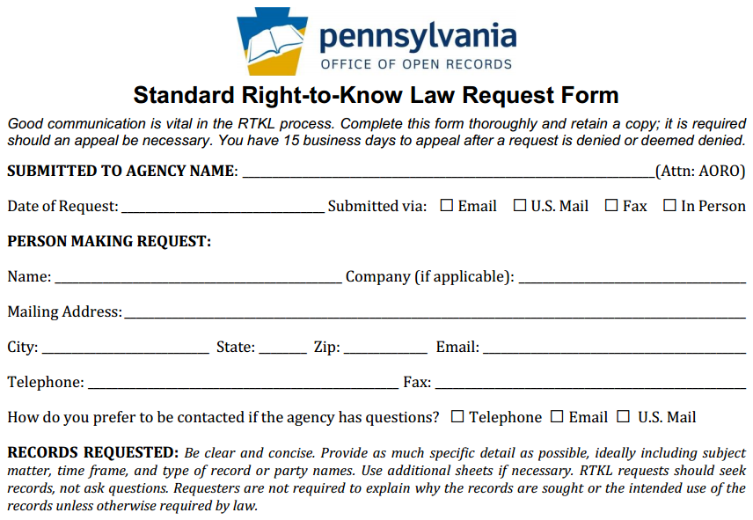
How to File a RTK Request
OOR Standard
RTK Request
Form, part 1

Slide 13
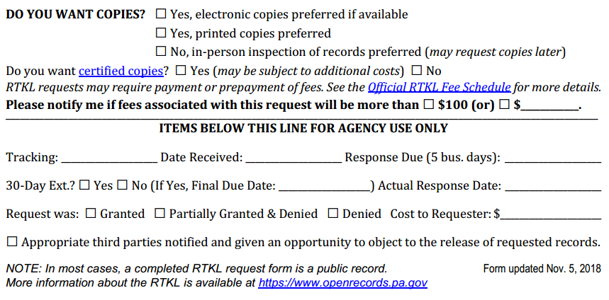
How to File a RTK Request
OOR Standard
RTK Request
Form, part 2

Slide 14
Writing a Good RTK Request
Seek records; do not ask questions
Agencies may deny requests which ask questions
Why did the Chairman vote yes?
  Request meeting minutes & audio recording of meeting
Why did Acme Lumber get this contract?
  Request copies of submitted bids & council emails re: Acme Lumber

Slide 15
Writing a Good RTK Request:
2. Be Specific
Specificity is determined on a case-by-case basis
Three-part test (Pa. Dep’t of Educ. v. Post-Gazette)
  Subject: “The ‘transaction or activity’ of the agency for which the record is sought”
  Scope: “A discrete group of documents (e.g., type or recipient)”
  Timeframe: “A finite period of time”
Vast “fishing expeditions” not permitted (hook vs. net)
Phrases like “any and all” & “but not limited to” raise questions

Slide 16
Specificity: Examples
Commonwealth Court cases on specificity:
Pa. Dep’t of Educ. v. Pittsburgh Post-Gazette
  Can not seek all emails of a public employee over 1 year
Dep’t of Envtl. Prot. v. Legere:
  Seeking 4 years of “Section 208” letters is allowed
  Agency’s organizational decisions not held against requester
Dep’t of Corr. v. St. Hilaire:
  “All records” for 5 years documenting injuries & deaths is allowed

Slide 17
Writing a Good RTK Request:
3. Think Twice Before Requesting a List
Requesting a “list” can be problematic
If no actual list exists, agency not required to create one
  “List of all lawsuits filed against the agency in 2017”
Better to seek records containing the information you want
  “Records showing captions of lawsuits filed against agency in 2017”
Valid to add: “If info can be provided in a list, that’s preferred”

Slide 18
Writing a Good RTK Request:
4. Accessing Information in Databases
Information in databases subject to presumption of openness
If possible, know what format the database can export to
  Seeking a specific, but incorrect format, can lead to a denial
When relevant, consider using suggested queries
  Queries may be necessary for extracting information
Terminology is important – try to use agency jargon

Slide 19
Speaking of Databases…
Two useful resources:
Online Contract Database, http://contracts.patreasury.gov/
  State agency contracts of $5,000 or more
PennWATCH, http://pennwatch.pa.gov/
  State employee salaries & compensation
  State agency employee counts
  Limited basic state budget data

Slide 20
Tip: Communicate with the Agency
Good communication can prevent & solve many issues
Good practice to let agency know you’re willing to talk
Requesters often submit broad requests
  Understandable, but can be expensive & frustrating for both sides
If agreement reached on revised request, put it in writing
Agency cannot require requester to provide reason for request
  They can ask, but requester can decline to answer
  Requester may sometimes want to provide info

Slide 21
Environmental RTKL Cases
Legere & Times-Tribune v. Dept. of Environmental Protection
(Commonwealth Court, 2012)
OOR Docket: 2011-1451 (OOR case files are public)
Sought all “Section 208” letters from 1/1/2008
Letters sent under the Oil & Gas Act when DEP “finds that the pollution or dimunition was caused by the drilling, alteration or operation activities or if it presumes the well operator responsible for pollution…”
Agency’s organizational choices not held against a requester

Slide 22
Environmental RTKL Cases
Heltzel & PublicSource v. Dept. of Labor & Industry
(Commonwealth Court, 2014)
OOR Docket: 2013-1232
Sought PA’s Tier II hazardous chemicals inventory database
Federal Emergency Planning & Community Right-to-Know Act
  Facilities storing hazardous chemicals must submit inventory forms
Commw. Ct.: OOR is authorized to interpret federal laws
  EPCRA limits information requests to specified individual facilities
  EPCRA’s access process operates independently of RTKL

Slide 23
Environmental RTKL Cases
Tate & McClatchy Newspapers v. PA Emergency Mgm’t Agency
(OOR, 2014)
OOR Docket: 2014-1199, also see 2014-1015 & 2014-1313
Sought reports submitted to PEMA re: crude oil shipments
  Related correspondence between PEMA & two state legislators
Norfolk Southern & CSX participated as interested parties
OOR reviewed reports in camera
  Confidentiality clauses, alone, are unenforceable under RTKL
OOR granted appeal, no appeal to Commonwealth Court

Slide 24
Environmental RTKL Cases
Hopey & Post-Gazette v. Dept. of Environmental Protection
(Office of Open Records, 2016)
OOR Docket: 2016-0540
Sought NOVs issued to ProTechnics & related records
  Division of Core Laboratories, supplies fracking “tracers”
Some records exempt under PA’s Radiation Protection Act (RPA)
Also: non-criminal investigation, working papers, predecisional deliberative, attorney-client privilege, confidential proprietary
Appeal granted in part, denied in part
  During appeal, DEP provided about 44 pages of exemption logs

Slide 25
Environmental RTKL Cases
Smith v. Dept. of Environmental Protection
(Commonwealth Court, 2016)
OOR Docket: 2016-0587
Sought numerous records re: ProTechnics / Core Laboratories
Much of the request was denied, denial upheld on appeals
Commw. Ct.: Under RPA regulations, “investigative reports pertaining to well sites are public records unless the report contains trade secrets and/or confidential proprietary information which can be redacted”

Slide 26
Environmental RTKL Cases
McGowan v. Dept. of Environmental Protection
(Commonwealth Court, 2014; OOR, 2015 on remand)
OOR Docket: 2013-2305
Sought: Water quality report for Perkiomen Creek
Remanded to OOR for in camera re: internal, deliberative
Factual info & data can be severed from deliberative records

Slide 27
Environmental RTKL Cases
Delaware Riverkeeper Network v. Dept. of Enviro. Protection
(Commonwealth Court, 2015)
OOR Docket: 2014-0880
Sought: Sample data from DEP’s Technologically-Enhanced Naturally Occuring Radioactive Material (TENORM) Study
OOR granted, Commw. Ct. overturned
Study qualified as non-criminal investigation under 708(b)(17)
DEP authorized by RPA to conduct studies, issue reports, etc.

Slide 28
RTKL Process Timeline: Requests
From the day a request is submitted…
Agency must respond within 5 (agency) business days
Agency can extend timeline by 30 calendar days
  Any other extension must be agreed to by requester & in writing
  Be cautious with “rolling production schedules” – do it all in writing
Track all dates & deadlines in case you need to appeal
Appeal must be filed within 15 (OOR) business days of agency’s denial or deemed denial

Slide 29
RTKL Process Timeline: Appeals
From the day an appeal is filed…
OOR must issue decision within 30 calendar days
No extensions without permission of the requester
  OOR Appeals Officers may seek extensions – please say yes
  We only seek extensions when we actually need them, not to delay
Any appeal to court must be filed within 30 calendar days of the OOR’s Final Determination

Slide 30
Appealing a RTKL Denial
Most denials can be appealed to the OOR
If request is denied, appeal can be filed w/in 15 business days
Most appeals filed with the OOR
  Not Attorney General, Auditor General, Treasurer, General Assembly
  Not Courts (requests & appeals governed by Rule 509)
Can also appeal redactions (which are denials) & fees
Appeal via online form at OOR website (about 15 minutes)
  No lawyer needed; both sides can present evidence & argument

Slide 31
Tip: Consider Requesting Mediation
RTKL authorizes OOR to establish informal mediation program
Goal: Mutually agreeable settlement
Voluntary & confidential
Either side can end mediation at any time
  If mediation ends, case moves to normal appeal process (new AO)
OOR has trained mediators
Can save time & expense

Slide 32
Agency Response: Costs & Format
OOR fee schedule developed pursuant to RTKL
General rule: No charge for electronic records
  Redactions may necessitate printing electronic records
Up to $0.25/page for hard copies (8.5 x 11, b&w)
Requesters can photograph records
Agencies required to provide records in medium requested (electronic vs. hard copy), do not have to create a record

Slide 33
Potential Amendments to the RTKL
SB 465 & SB 466 (Blake), also numerous other bills
Many potential amendments generally agreed to
Final safety inspection reports would generally be public
New fees for commercial requests (excludes media)
State-related universities put much more budget info online
Campus police department = local agency
Inmate requests limited to certain categories of records
Courts can fine agencies $500/day for ignoring an OOR order

Slide 34
OOR Resources
Website, Twitter, Email Lists & More
Web: https://openrecords.pa.gov
Blog: https://openrecordspennsylvania.com
Email lists: Daily Digest of FDs & General Updates
  https://www.openrecords.pa.gov/EmailSubscriptions.cfm
Twitter: @OpenRecordsPA
  Executive Director: @ErikOpenRecords
YouTube Channel
Open Records in PA Podcast: Apple Podcasts, Stitcher, etc.

