Slide 1

Sisters in Crime – Delaware Valley Chapter
Tredyffrin Public Library
November 17, 2018
Erik Arneson, Executive Director
https://openrecords.pa.gov
@ErikOpenRecords
@OpenRecordsPA
earneson@pa.gov
(717) 346-9903

Slide 2
Pennsylvania’s Right-to-Know Law
RTKL gives citizens access to government records
Requester sends a request to a state or local agency
Agency must respond within 5 business days
  Can extend response time by 30 calendar days
  Must grant or deny request (or a mix of both) in writing
  Track all dates & deadlines in case you need to appeal
If denied, requester can appeal to Office of Open Records
  Independent, impartial, quasi-judicial
  Appeals are free, no lawyer needed (90% cases end at OOR level)

Slide 3
A Brief History
RTKL introduced 3/29/2007, signed 2/14/2008, eff. 1/1/2009
Senator Dominic Pileggi, new majority leader – SB 1
Then-existing RTK Act presumed gov’t records were not public
  Requester had to prove public nature & all appeals went to court
  In practice, basically limited to financial records
Act 3 of 2008 – complete rewrite, new RTKL
  Flipped presumption: gov’t records now presumed to be public
  Created the Office of Open Records

Slide 4
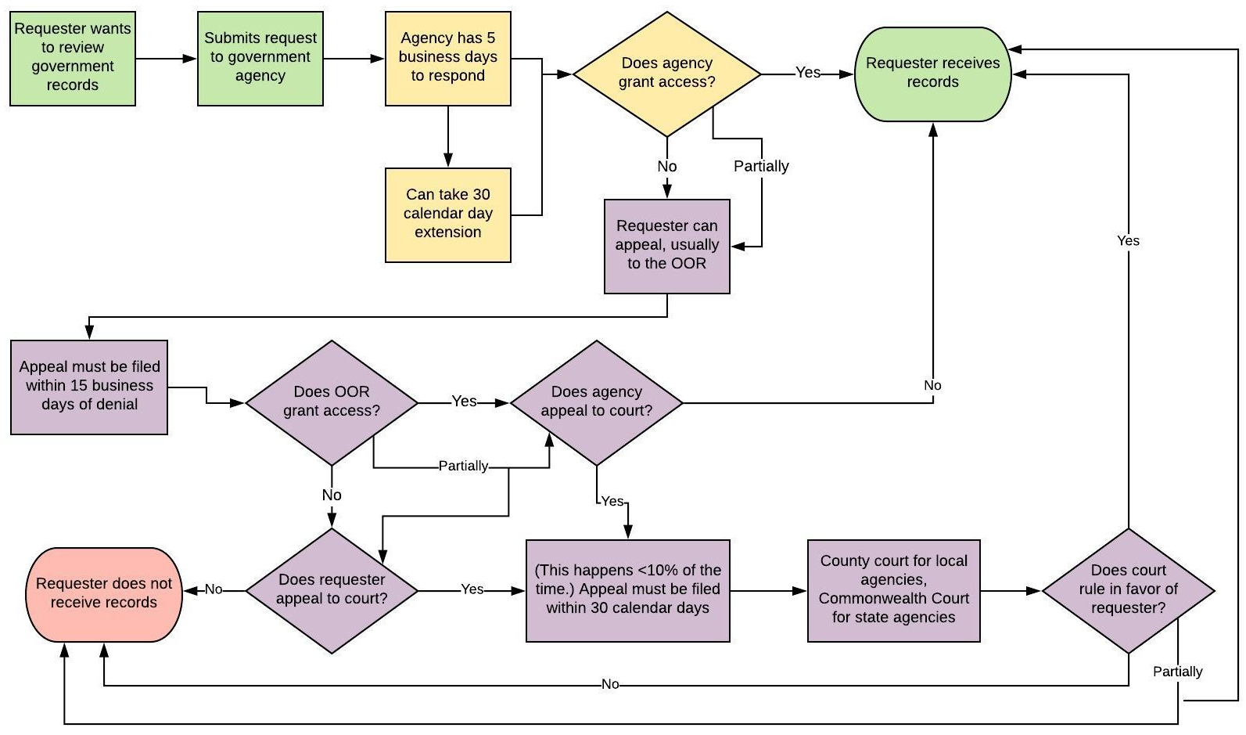
Right-to-Know Law Flowchart

Slide 5
What is a Record?
A record is…
“information, regardless of physical form or characteristics, that documents a transaction or activity of an agency and that is created, received or retained pursuant to law or in connection with a transaction, business or activity of the agency”
PA Office of Attorney General v. Philadelphia Inquirer
  Personal communications, even if they violate agency policies, are not “records” under the RTKL

Slide 6
Right-to-Know Law Basics
All state & local government records presumed to be public
30 exceptions in the RTKL
  Fewer apply to financial records & aggregated data
Exceptions in other laws & regulations
  Other laws also make records expressly public (e.g., Coroner’s Act)
Attorney-client privilege & other privileges
  Only if recognized by PA courts; not “self-critical evaluation”
Records can be made non-public by court order

Slide 7
Records Take Many Shapes
The Right-to-Know Law…
Doesn’t distinguish between formats
  Paper, email, texts, social media, audio, video, etc.
Doesn’t distinguish between agency & personal devices
(or agency & personal email accounts)
  Practical issues re: accessing personal devices & email
  Best practice: Agency business done on agency devices & email
Bottom line: Is it a record? And if so, is it a public record?

Slide 8

How to File a RTK Request
Submit your RTK request to the correct agency
State agencies: DEP, DOC, PennDOT, etc.
Local agencies: Cities, boroughs, townships, school districts
Address requests to Agency Open Records Officer (AORO)
AORO database available on OOR website

Slide 9
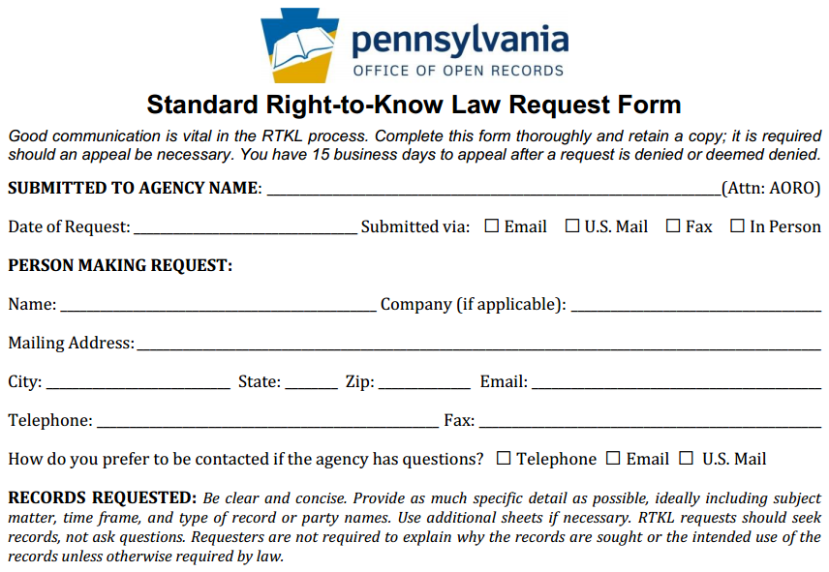
How to File a RTK Request
OOR Standard
RTK Request
Form, part 1

Slide 10
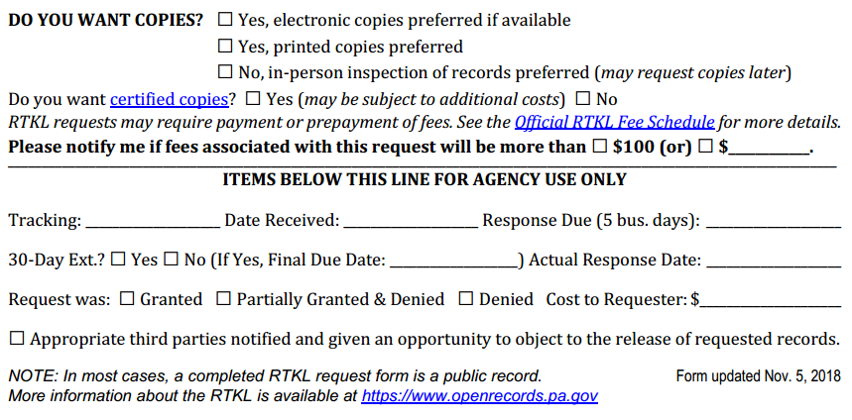
How to File a RTK Request
OOR Standard
RTK Request
Form, part 2

Slide 11
Police Departments & Police-Related Records
Fairly broad exception for criminal investigative records
Police departments can withhold records “relating to or resulting in a criminal investigation” (Section 708(b)(16))
Does not apply to blotter information
  “a chronological listing of arrests, usually documented contemporaneous with the incident, which may include, but is not limited to, the name and address of the individual charged and the alleged offenses”
Does not apply to aggregated data (e.g., crime statistics)
Does not apply (mostly) to financial records (can be redacted)

Slide 12
Police Departments & Police-Related Records
More police-related records
911 recordings: Released at agency (911 call center) discretion
Coroner records: Covered by Coroner’s Act
Pennsylvania Uniform Crime Reporting (UCR) System
  Includes monthly summary arrest reports
  Montgomery County:
    2017 YTD murder arrests: 3
    2018 YTD murder arrests: 9
    Embezzlement arrests YTD down 71%

Slide 13

No Time Limit on Investigative Exceptions
Murder in the Stacks by David DeKok
Nov. 28, 1969 (~50 years ago)
Betsy Aardsma of Holland, Mich., murdered in Penn State’s library
Stabbed once, but first responders thought she had fainted
Library cleaned up what they did not know was a crime scene

Slide 14
Police Recordings: Video & Audio
RTKL does not apply to police recordings
Act 22 of 2017 covers police video & audio recordings
Must make request within 60 days of recording
Agency has 30 days to respond, may deny for various reasons
Denials may be appealed within 30 days to court; $125 fee
Law enforcement agencies & DAs have fairly broad discretion to release a recording (with or without a written request)
Bodycam & dashcam policies are explicitly public
More info on OOR website

Slide 15
Court Records
RTKL does not apply to court records
Judges, Prothonotary, Clerk of Courts, etc.
Access to most court records covered by common law
Unified Judicial System has a public records section on website
Rule 509 covers access to financial records

Slide 16
Tip: Communicate with the Agency
Good communication can prevent & solve many issues
Good practice to let agency know you’re willing to talk
  Especially true with police records
  If you have an informal way to seek police records, use it first
Agency cannot require requester to provide reason for request
  They can ask, but requester can decline to answer
  Requester may sometimes want to provide info

Slide 17
Appealing a RTKL Denial
Most RTKL denials can be appealed to the OOR
Appeal must be filed within 15 business days of denial
File appeals using online form at OOR website
  About 15 minutes to fill out
No lawyer necessary
OOR assigns Appeals Officer (attorney) to oversee case
Both sides can present evidence & argument
OOR has 30 days to issue Final Determination

Slide 18
Tip: Consider Requesting Mediation
RTKL authorizes OOR to establish a mediation program
Alternative to traditional appeal process
OOR has trained mediators
Goal: Mutually agreeable settlement
Voluntary & confidential
Either side can end mediation at any time
  If mediation ends, case moves to normal appeal process (new AO)
Can save time & expense

Slide 19
Agency Response: Costs & Format
OOR fee schedule developed pursuant to RTKL
General rule: No charge for electronic records
  Redactions may necessitate printing electronic records
Up to $0.25/page for hard copies (8.5 x 11, b&w)
Requesters can photograph records
Agencies required to provide records in medium requested (electronic vs. hard copy), do not have to create a record
  Remember: RTKL does not apply to court records

Slide 20
Two Great Databases
Two useful resources:
Online Contract Database, http://contracts.patreasury.gov/
  State agency contracts of $5,000 or more
PennWATCH, http://pennwatch.pa.gov/
  State employee positions, salaries & compensation
    PA State Police trooper examples: $60,610, $103,193
    Forensic Scientist 2, Senior Applications Developer, Mechanic Supervisor
  State agency employee counts
    PA State Police has 6,154 employees

Slide 21
Statewide Cost of the RTKL
Legislative Budget & Finance Committee:
Study released in 2018 (data covering calendar year 2016)
54% of agencies reported $500 or less annual cost
  92% of agencies reported $10,000 or less
Total cost (all agencies, 2016) ~ $5.7 million to $9.7 million
  Median cost = $500
  > 6,000 agencies, so avg. cost = $950 to $1,617 per agency

Slide 22
OOR Resources
Website, Twitter, Email Lists & More
Web: https://openrecords.pa.gov
Blog: https://openrecordspennsylvania.com
Email lists: Daily Digest of FDs & General Updates
  https://www.openrecords.pa.gov/EmailSubscriptions.cfm
Twitter: @OpenRecordsPA
  Executive Director: @ErikOpenRecords
YouTube Channel
Open Records in PA Podcast: Apple Podcasts, Stitcher, etc.

