Slide 1

Standard Right-to-Know Law Request Form
March 6, 2019
Erik Arneson, Executive Director
https://www.openrecords.pa.gov/
openrecords@pa.gov
(717) 346-9903
@OpenRecordsPA
@ErikOpenRecords

Slide 2
Filing a Right-to-Know Law Request in PA
Basic steps in filing a RTKL request in Pennsylvania:
Determine which agency has the record(s) you want
Fill out the Office of Open Records’ Standard Request Form
  All state & local agencies must accept it
  Some agencies also have their own forms
Submit the form to the appropriate agency
Agency must respond within 5 business days
  Can take a 30 calendar day extension for various reasons

Slide 3
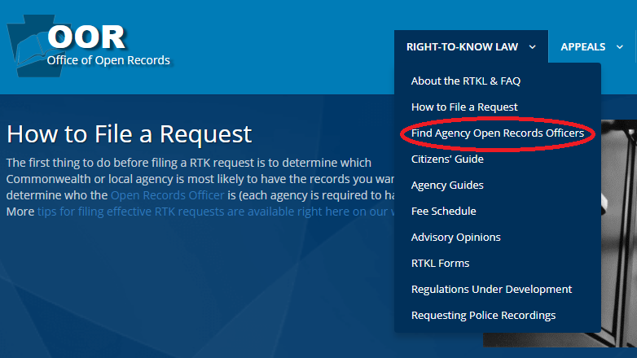
How to File a RTK Request
Using the AORO Database

Slide 4

How to File a RTK Request
Using the AORO Database

Slide 5
More About Agency AOROs
Many agencies, but not all, have a single AORO
Commonwealth agencies: DEP, DCNR, DOC, DCED, etc.
Some agencies have separate AOROs by bureau, dep’t, etc.
  e.g., Philadelphia has approximately 40 AOROs
  Municipalities sometimes have separate AOROs for Police Dep’ts.
If you’re not sure you have the right agency, say so:
  “If this request is misdirected, please let me know as soon as possible so that I can withdraw this request and direct it to the proper AORO.”

Slide 6
More About Agency AOROs
If you can’t find the name of an AORO
Double-check spelling when searching AORO Database
Check agency website
Call agency
If you still can’t find a name: Address request to “AORO”
More than 6,000 agencies in PA
  Some very small w/ limited resources (e.g., one part-time employee)
  Some agencies have no website & no email

Slide 7
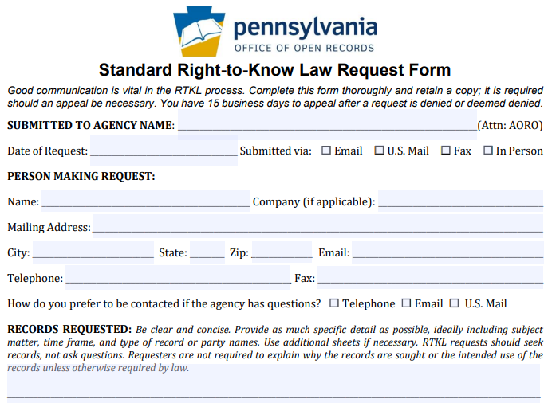
How to File a RTKL Request
OOR Standard
RTK Request
Form, part 1

Slide 8
How to File a RTKL Request
OOR Standard
RTK Request
Form, part 1

Slide 9
How to File a RTKL Request
OOR Standard
RTK Request
Form, part 1

Slide 10
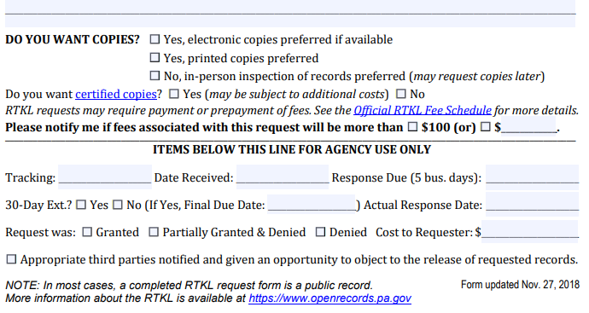
How to File a RTKL Request
OOR Standard
RTK Request
Form, part 2

Slide 11
How to File a RTKL Request
OOR Standard
RTK Request
Form, part 2

Slide 12
How to File a RTKL Request
OOR Standard
RTK Request
Form, part 2

Slide 13
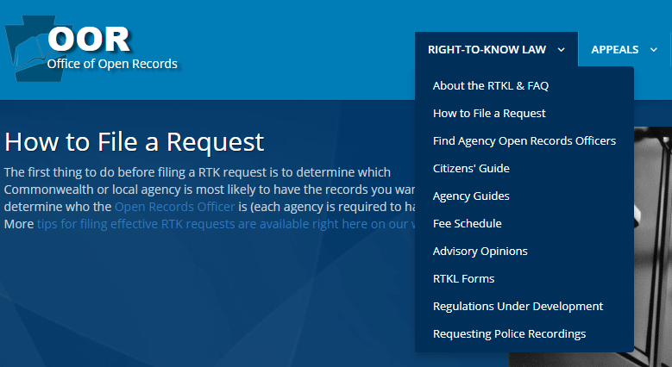
How to File a RTKL Request
Finding the OOR’s Standard Request Form

Slide 14
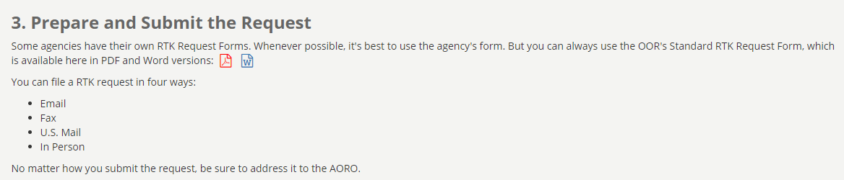
How to File a RTKL Request
Finding the OOR’s Standard Request Form

Slide 15
How to File a RTKL Request
Finding the OOR’s Standard Request Form

Slide 16
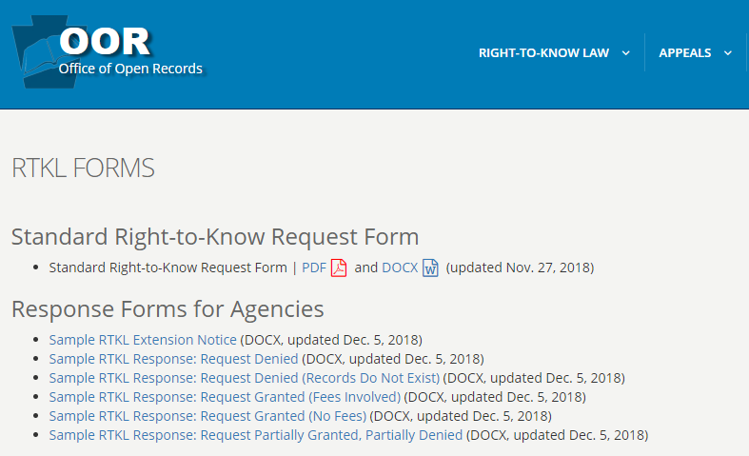
How to File a RTKL Request
Finding the OOR’s Standard Request Form

Slide 17
OOR Resources
Website, Twitter, Email Lists & More
Web: https://openrecords.pa.gov/
Blog: https://openrecordspennsylvania.com/
Email lists: Daily Digest of FDs & General Updates
  https://www.openrecords.pa.gov/EmailSubscriptions.cfm
Twitter: @OpenRecordsPA
  Executive Director: @ErikOpenRecords
YouTube Channel
Open Records in PA Podcast: Apple Podcasts, Stitcher, etc.

