Slide 1

The Office of Open Records webinar will begin soon
Use the “Conversation” box to submit questions
Submitted questions are records under the RTKL
After the webinar ends:
  Email openrecords@pa.gov or call 717-346-9903
OOR website has resources for agencies & requesters
  https://www.openrecords.pa.gov/

Slide 2
AOROs: Preparing Affidavits for Appeals
March 14, 2019
Nathanael Byerly, Deputy Director
Erik Arneson, Executive Director
https://openrecords.pa.gov
@ErikOpenRecords
@OpenRecordsPA
openrecords@pa.gov
(717) 346-9903

Slide 3
Introduction
Topics
  Why is an affidavit needed
  What is an affidavit
  Writing an affidavit
Terms
  AO = Appeals Officer
  FD = Final Determination
  AORO = Agency Open Records Officer
  Affidavits = attestations, statement of facts
Purpose
  Improve Efficiency
  Assist AOROs

Slide 4
Why is an affidavit needed
The burden is on the agency to show that the exemption asserted applies. See 65 P.S. § 67.708(a).
Affidavits are how an agency details and supports why an exemption applies to a certain record. It is evidence.
    Testimonial affidavits found to be relevant and credible may provide sufficient evidence in support of a claimed exemption. Heavens v. Pa. Dep’t of Envtl. Prot., 65 A.3d 1069, 1073 (Pa.Cmwlth 2013).

Slide 5
Why is an affidavit needed
If the agency fails to file a sufficient affidavit (evidence) in support of its legal argument, it will likely fail to meet the burden.
Practice Tip: When an agency files an argument with the OOR alleging that a record is exempt or does not exist, it should always be supported by an affidavit.
The same standard applies to third party direct interest participants. It is good practice to tell third parties that they will also need to file an affidavit in support of any legal argument.

Slide 6
What is an affidavit
An affidavit is a factual statement made under oath or penalty of perjury. It claims that a fact – or set of facts – is true to the best of the affiant’s knowledge.
  It is a factual statement, not a legal argument.
  Legal conclusions, arguments, and affiant opinions should be made in the letter brief, not the affidavit.
  The affidavit supports the legal arguments; it should not make the legal arguments.
    EXAMPLE:
      Factual statement: The records requested contain employee social security numbers.
      Legal argument/conclusion: The records are exempt under § 708(b)(6) because they contain personal information.

Slide 7
What is an affidavit: Fact vs. Conclusion
It is a factual statement not a conclusion - conclusory.
  Factual: The requested email was deleted on April 7, 2018 as part of the County’s record retention policy.
  Conclusory: The requested email does not exist.
  Factual: The requested document contains the social security number of John Doe.
  Conclusory: The record is exempt under § 708(b)(6).

Slide 8
Writing an affidavit: Pre-Drafting
Put yourself in the place of the AO.
The AO probably does not know:
  the facts or history of your case
  acronyms your agency uses
  what your agency calls or names records/files
  the contents of the records
  the agency filing and backup system
  the agency’s retention schedule/policy
  unique nature of documents
The AO only needs to know what is applicable to the case.
  For example, the AO doesn’t need to know irrelevant details surrounding the records or the relationship between the agency and requester
Tell a story – Be a Guide

Slide 9
Writing an affidavit: Structure
Include the caption and docket number of the case at the top.
  Example: Smith v. Home County, OOR Dkt. AP 2019-5678
Indicate that the affidavit is one of these three:
  pursuant to 18 Pa.C.S. § 4904 (option used on OOR forms)
  made under penalty of perjury
  made under oath and notarized
Arrange the facts in a coherent manner.
State each fact in a separate paragraph.
Number the paragraphs so that the affidavit is easier to read and refer to in the FD.
Reference any supporting documents by marking them as exhibits.
Use a reference or index where necessary.
  Numbered pages
  Dates
  Bate Stamp

Slide 10
Writing an affidavit: The affiant
The affidavit should include the name and title of the person giving the testimony.
  Why is it important that this person is telling the AO this?
  Why does this person know what the affidavit says is true?
  How or why does this person know about the records at issue?
  Why would they know where the records are or what they contain?
  What would they know about the facts or situation(s) surrounding the record or request?

Slide 11
Writing an affidavit: Drafting
An affidavit should establish a nexus between the exemption and any withheld records or redactions.
It should answer these general questions:
  Who
  What
  Where
  When
  How
  Why

Slide 12
Writing an affidavit: Examples
Example: Records do not exist or are not in the possession* of agency.
  Questions should at least include:
    Who looked for the records
    Where did the AORO or affiant look for the records
    Why did they look there
    What records did the AORO or affiant look at during search
    Who would know if a record was never created
    When was the search conducted
    What keywords were used as part of the search
    Where else would the records be – another agency
    Were all copies destroyed/deleted
      When
      Why
      By whom
    What is agency retention policy

Slide 13
Writing an affidavit: Examples
Moore v. Department of Corrections, 2017 Pa. Commw. Unpub. LEXIS 704, 177 A.3d 1073
Request was for records that DOC claimed did not exist
  DOC provided affidavit to OOR that stated that:
    “no responsive records exist within the Department’s custody, possession or control”
    the AORO “reviewed [Moore’s] request and researched it”
Court held that this was conclusory and generic
  More details are needed and at a minimum should include a description of the records the AORO reviewed

Slide 14
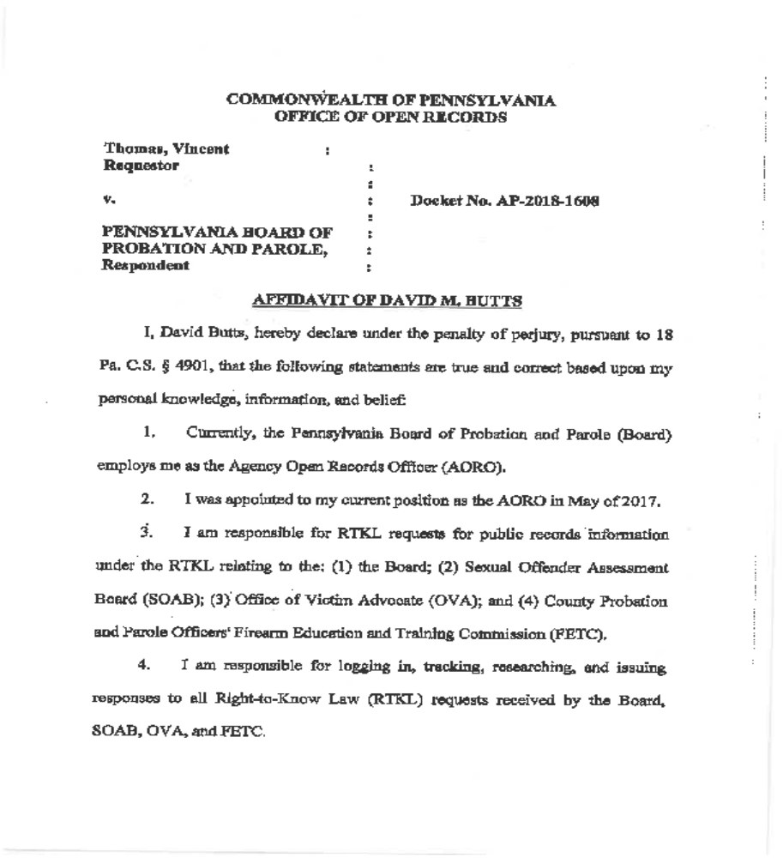

Slide 15
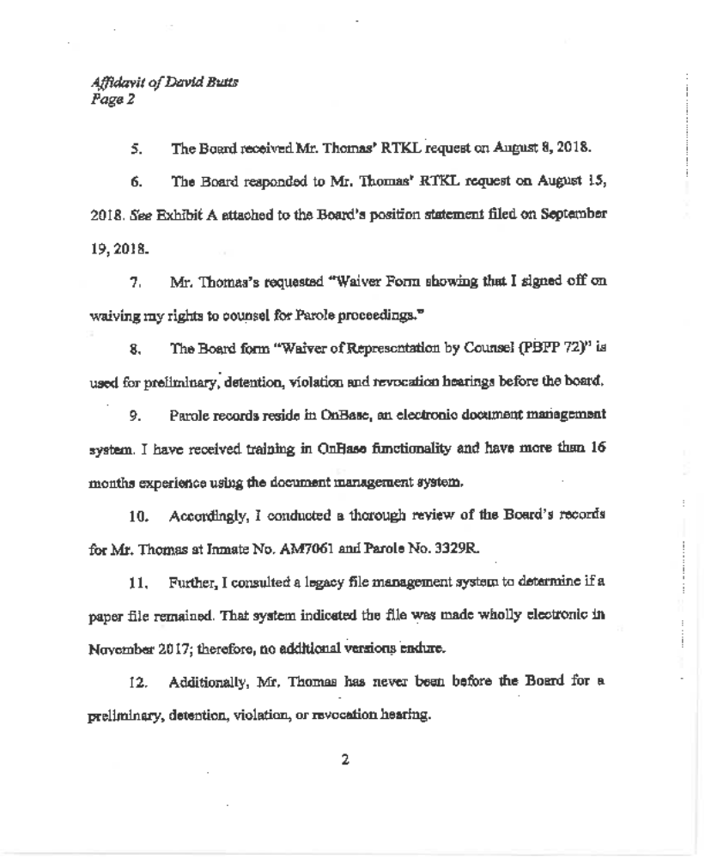

Slide 16
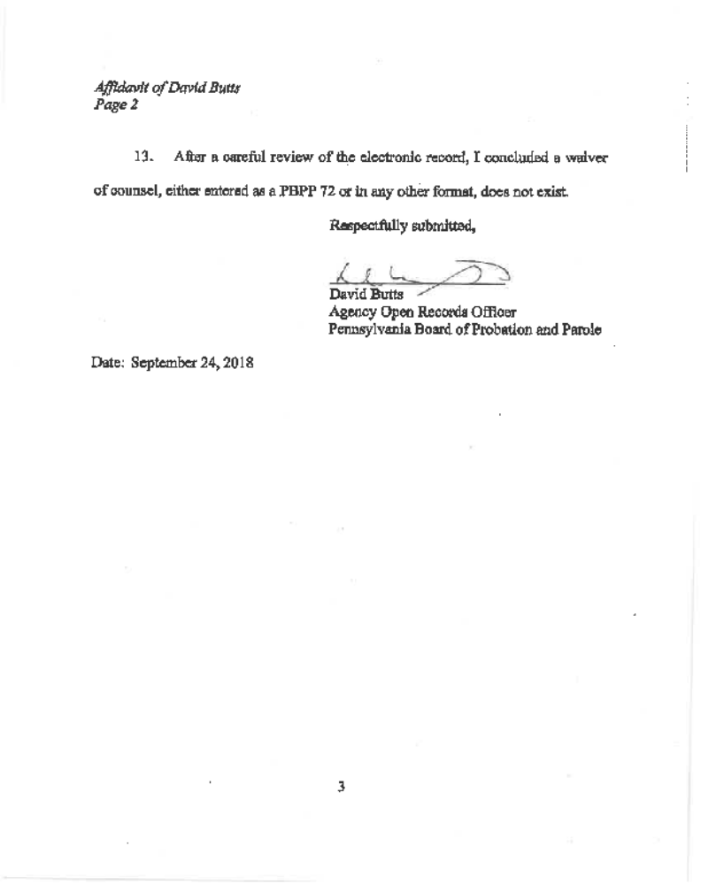

Slide 17
Writing an affidavit: Examples
The AORO Guidebook Exhibits 16 – 18 are updated OOR samples:
    https://www.openrecords.pa.gov/RTKL/AgencyGuides.cfm
Look at the exemption and ask what facts would help determine if the exemption may apply.
  Example: Release of video would threaten public safety and endanger safety of the building
    Not enough to just say it’s a risk or it’s a threat to security
    Questions should at least include:
      What is in the record that makes it a threat or risk
      Why/How would release threaten safety or security
      Can info be redacted
      Who is attesting that threat or risk exists
        Experience
        Expertise
        Knowledge of situation

Slide 18
Writing an affidavit: Examples
Gregg Twp. v. Grove, 2018 Pa.Commw.Unpub. LEXIS 343; 2018 WL 3097074
Request was for footage from security cameras in building used for municipal offices
  Agency denied claiming release would threaten public safety and endanger safety of the building § 708(b)(2) and (3)
Court held agency did not meet burden and video was public
  Why?
    Affidavit was silent as to what was depicted in the video
    Affidavit referred generally to all of the cameras but failed to explain why footage from one camera will jeopardize safety
    Affidavit did not explain how the cameras are used to enhance public safety – monitored some contemporaneously
    Affidavit did not address whether information could be redacted
    Affidavit had conclusory statements without explaining details about how security will be jeopardized

Slide 19
Writing an Affidavit: Editing
Re-read and edit your affidavit.
Proofread for both accuracy and grammar.
  Example:
    The records requested are not within the Agency’s possession, custody, or control.
    The records requested are within the Agency’s possession, custody, or control.
One word can make a big difference.
Eliminate language that makes the affidavit contradictory.

Slide 20
Follow-up from the AO
Respond to AO requests for more information.
  Do not take it personally
  Do not take it as an attack on your credibility
  More detail may be needed
  More explanation of process, terms, or content may be required
  A stated fact is better than making an inference of fact

Slide 21
Court cases and OOR Final Determinations
Look for situations or facts similar to yours.
  What exemption was cited
  What records were requested
  Why did the court or the OOR say the affidavit did or did not support the agency’s argument

Slide 22
Brown v. DOC, 2017 Pa. Commw. Unpub. LEXIS 653, 177 A.3d 1066
DOC denied a request for records due to outstanding fees
Court said that DOC failed to show the requester owed outstanding fees
Affidavit stated:
  Records were copied and prepared for Requester
  Requester had not paid
  He had an outstanding balance
Affidavit should have also identified the documents that were copied as well as the number of pages included in the charge

Slide 23
List of court cases
Affidavits must be detailed, nonconclusory, and submitted in good faith. Office of the Governor v. Scolforo, 65 A.3d 1095, 1103-1104, 2013 Pa. Commw. LEXIS 120, *20-22, 2013 WL 1729755;
The affidavit must (1) include detailed information describing the nature of the records sought and (2) connect the nature of the various records to the reasonable likelihood that they can be properly withheld under an exemption. Carey v. Pa. Dep't of Corr., 61 A.3d 367, 375-376, 2013 Pa. Commw. LEXIS 30, *16-19, 2013 WL 257149; Harrisburg Area Cmty. College v. Office of Open Records, 2011 Pa. Commw. Unpub. LEXIS 378, *19, 2011 WL 10858088;
It’s not sufficient to recite a list of subjects that records might include, which would cause them to fall under a certain exception. The affidavit must describe “how” the records reflect information that is protected by the exception. Office of the Governor v. Scolforo, 65 A.3d 1095, 1103-1104, 2013 Pa. Commw. LEXIS 120, *20-22, 2013 WL 1729755;
When an affidavit discusses a group or category of records, the affiant must explain which of the records in that category are protected and which are not. Carey v. Pa. Dep't of Corr., 61 A.3d 367, 375-376, 2013 Pa. Commw. LEXIS 30, *16-19, 2013 WL 257149;
An affidavit must be specific enough to permit the Court [and AO] to evaluate the exemptions as they apply to particular documents. Vista Health Plan, Inc. v. Dep't of Human Servs., 2018 Pa. Commw. Unpub. LEXIS 295, *19, 189 A.3d 41, 2018 WL 2436329;

Slide 24
Webinar Q&A
Please send your questions now
Use the “Conversation” box to submit questions
Submitted questions are records under the RTKL
After the webinar ends:
  Email openrecords@pa.gov or call 717-346-9903
OOR website has resources for agencies & requesters
  https://www.openrecords.pa.gov/

