Slide 1

Pennsylvania Library Association
October 13, 2019
Erik Arneson, Executive Director
https://openrecords.pa.gov
@ErikOpenRecords
@OpenRecordsPA
earneson@pa.gov
(717) 346-9903

Slide 2
What is the Right-to-Know Law?
The RTKL governs access to most state and local gov’t records
What is a “record”?
  “information, regardless of physical form or characteristics, that documents a transaction or activity of an agency and that is created, received or retained pursuant to law or in connection with a transaction, business or activity of the agency”
How do you get access to a record?
  Submit a RTKL request – every agency MUST respond

Slide 3
Office of Open Records
Created by RTKL: Independent & quasi-judicial
Decide appeals filed by people denied access to records
Provide RTKL & Sunshine Act training
20 total staff
  Executive Director & Deputy Director
  13 Attorneys (incl. 11 Appeals Officers)
  Chief of Training & Outreach
  4 Administrative

Slide 4
Right-to-Know Law Basics
The basic RTKL process looks like this:
Requester submits request to state or local agency
Agency responds: grant, deny, or mix of both
If request is denied (even in part), requester can appeal to OOR
  Free, no lawyer needed
OOR issues a binding final determination
Either side can appeal to court (happens <10% of the time)
  Court of Common Pleas for local agencies
  Commonwealth Court for state agencies

Slide 5
Records Take Many Shapes
The Right-to-Know Law…
Doesn’t distinguish between formats
  Paper, email, texts, social media, audio, video, etc.
Doesn’t distinguish between agency & personal devices
  Or between agency & personal email accounts
  Or between agency & personal social media accounts
All that matters: Is it a record? And if so, is it a public record?

Slide 6
Right-to-Know Law Basics
All state & local government records presumed to be public
30 exceptions in the RTKL
  Fewer apply to financial records & aggregated data
Exceptions in other laws & regulations
  e.g., HIPAA, FERPA
Attorney-client privilege & other privileges recognized in PA
Records can be made non-public by court order
When a denial is appealed, agency bears burden of proof

Slide 7
Right-to-Know Law Basics
Examples of commonly requested public records
Meeting minutes
Agency budgets
Invoices & Expenditures
  (e.g., road repaving costs, solicitor invoices)
Settlement agreements
Copies of required reports
  (e.g., Interscholastic Athletics Opportunity report)
Aggregated (depersonalized) data

Slide 8

How to File a RTK Request
Submit your RTK request to the correct agency
Submit requests to the agency that has the record
  Rarely the OOR – we receive >900 misdirected requests every year
Address requests to Agency Open Records Officer (AORO)
AORO database available on OOR website

Slide 9
More About Agency AOROs
Many agencies, but not all, have a single AORO
Commonwealth agencies: DEP, DCNR, DOC, DCED, etc.
Some agencies have separate AOROs by bureau, dep’t, etc.
  e.g., Philadelphia has approximately 40 AOROs
Important to send request to the right AORO
  If not sure, say so: “If this request is misdirected, please let me know so I can withdraw it and direct it to the proper AORO.”

Slide 10
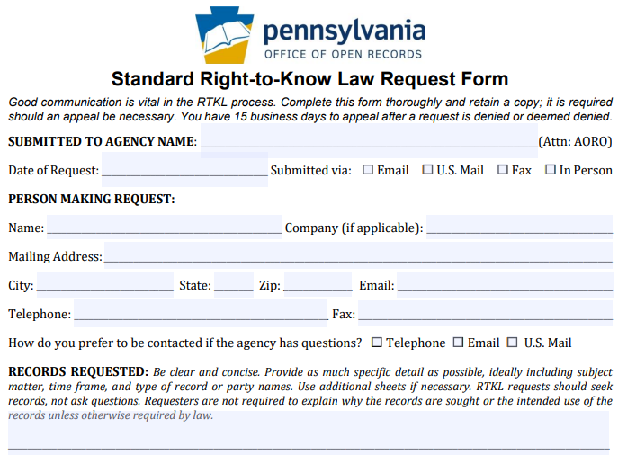
How to File a RTKL Request
OOR Standard
RTK Request
Form, part 1

Slide 11
How to File a RTKL Request
OOR Standard
RTK Request
Form, part 1

Slide 12
How to File a RTKL Request
OOR Standard
RTK Request
Form, part 1

Slide 13
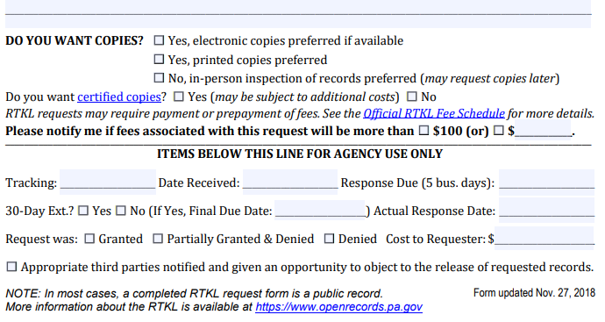
How to File a RTKL Request
OOR Standard
RTK Request
Form, part 2

Slide 14
How to File a RTKL Request
OOR Standard
RTK Request
Form, part 2

Slide 15
How to File a RTKL Request
OOR Standard
RTK Request
Form, part 2

Slide 16
Timeline of a RTKL Response
Every state & local agency must respond to RTK requests
Must respond in writing within 5 (agency) business days
  If no response received, request is deemed denied
  Allow additional 3 business days for postal mail before filing appeal
Agency can extend timeline by 30 calendar days
  Must be done in writing within the initial 5 business days
  Any other extension must be agreed to by requester & in writing
Track all dates & deadlines in case you need to appeal

Slide 17
Agency Response: Costs & Format
OOR fee schedule developed pursuant to RTKL
No charge for electronic records
  Redactions may necessitate printing electronic records
Up to $0.25/page for hard copies (8.5 x 11)
Requesters can photograph records they asked to inspect
Agencies do not have to create a record
Agencies required to provide records in medium requested (electronic vs. hard copy)

Slide 18
Common Exemptions Raised by Agencies
Exemptions raised most often during appeals to OOR in 2018
Noncriminal investigative, 708(b)(17)
Criminal investigative, 708(b)(16)
Internal, predecisional deliberations, 708(b)(10)
Personal identification information, 708(b)(6)
Public safety, 708(b)(2) & Personal security, 708(b)(1)

Slide 19
Requesting Police Recordings
RTKL does not apply to police recordings
Act 22 of 2017 covers police video & audio recordings
Requests must be submitted within 60 days of recording date
  Requests must be submitted via certified mail or in person
Agency has 30 days to respond, may deny for various reasons
Denials may be appealed within 30 days to court; $125 fee
Law enforcement agencies & DAs have fairly broad discretion to release a recording (with or without a written request)
More info on OOR website

Slide 20
Tip: Communicate with the Agency
Good communication can prevent and solve many issues
Good practice to let agency know you’re willing to talk
Requesters often submit broad requests to ensure they get all the records they want
  Understandable, but can be expensive & frustrating
  Requesters don’t want surprise bills
  Agencies don’t want unnecessary work
Many agencies willing to discuss requests
If agreement reached on revised request, put it in writing

Slide 21
Appealing a RTKL Denial
OOR appeal process designed to be simple
File appeals using online form at OOR website
  About 10 to 15 minutes to fill out
Only need to complete the form – can make argument later
No lawyer necessary
OOR assigns Appeals Officer to oversee case
Both sides can present evidence & argument
OOR has 30 days to issue Final Determination

Slide 22
Tip: Consider Requesting Mediation
RTKL authorizes OOR to establish informal mediation program
Goal: Mutually agreeable settlement
Voluntary & confidential
Either side can end mediation at any time
  If mediation ends, case moves to normal appeal process (new AO)
OOR has trained mediators
Can save time & expense

Slide 23
OOR Caseload
Thousands of RTK appeals filed every year
In 2018, OOR heard 2,229 appeals
  Three-year average: 2,255; Five-year average: 2,341
  That’s appeals, not requests
  No central database of # of requests
    LBFC Study (released 2018) estimated 109,000 requests received by state & local agencies, combined, in 2016
    Thus, approximately 2.1% of requests are appealed to OOR
    Our data indicates <10% of OOR decisions are appealed to court

Slide 24
OOR Resources
Website, Twitter, Email Lists & More
Web: https://openrecords.pa.gov/
Blog: https://openrecordspennsylvania.com/
Email lists: Daily Digest of FDs & General Updates
  https://www.openrecords.pa.gov/EmailSubscriptions.cfm
Twitter: @OpenRecordsPA
  Executive Director: @ErikOpenRecords
YouTube Channel
Open Records in PA Podcast: Apple Podcasts, Stitcher, etc.

