Slide 1

Dr. Logan Molyneux
Temple University
February 27, 2020
Erik Arneson, Executive Director
https://openrecords.pa.gov
@ErikOpenRecords
@OpenRecordsPA
earneson@pa.gov
(717) 346-9903

Slide 2
Accessing Government Records
What kind of records do you want?
Federal Government: Freedom of Information Act (FOIA)
Judicial Records: Common Law, PA Supreme Court Rule 509
State & Local Records: Right-to-Know Law
Of course, always search online first…

Slide 3
A Brief History of the RTKL
RTKL introduced 3/29/2007, signed 2/14/2008, eff. 1/1/2009
Senator Dominic Pileggi, new majority leader – SB 1
Then-existing RTK Act presumed gov’t records were not public
  Requester had to prove public nature & all appeals went to court
  In practice, basically limited to financial records
Act 3 of 2008 – complete rewrite, new RTKL
  Flipped presumption: now gov’t records presumed to be public
  Created independent Office of Open Records (free appeals)

Slide 4
What Records Should be Available?
Should this be available under the RTKL?
An agency’s budget for FY 2018-19

Slide 5
What Records Should be Available?
Should this be available under the RTKL?
An agency’s budget for FY 2018-19 – IT IS AVAILABLE
Financial records are the most public of all government records

Slide 6
What Records Should be Available?
Should this be available under the RTKL?
Video recording of a city council meeting

Slide 7
What Records Should be Available?
Should this be available under the RTKL?
Video recording of a city council meeting – IT IS AVAILABLE
Agency boards, such as city councils, can meet in private (“executive session”) for certain reasons specified in law

Slide 8
What Records Should be Available?
Should this be available under the RTKL?
Police detective’s interview notes

Slide 9
What Records Should be Available?
Should this be available under the RTKL?
Police detective’s interview notes – NOT AVAILABLE
RTKL includes an exemption for criminal investigative records

Slide 10
What Records Should be Available?
Should this be available under the RTKL?
County proposal to Amazon for HQ2

Slide 11
What Records Should be Available?
Should this be available under the RTKL?
County proposal to Amazon for HQ2 – IT IS AVAILABLE
Agencies cannot claim the RTKL’s “trade secrets” exemption

Slide 12
What Records Should be Available?
Should this be available under the RTKL?
Database of lead tests done by city w/ home addresses

Slide 13
What Records Should be Available?
Should this be available under the RTKL?
Database of lead tests done by city w/ home addresses
IT IS AVAILABLE, but with limits
Block-level data (e.g., “100 block of Pine Street”)

Slide 14
What Records Should be Available?
Should this be available under the RTKL?
Inappropriate emails sent by a gov’t employee to a co-worker on gov’t computer, during work hours

Slide 15
What Records Should be Available?
Should this be available under the RTKL?
Inappropriate emails sent by a gov’t employee to a co-worker on gov’t computer, during work hours – NOT AVAILABLE
Let’s discuss the RTKL’s definition of a “record”…

Slide 16
Fundamental Question: What is a “Record”?
A record is…
“information, regardless of physical form or characteristics, that documents a transaction or activity of an agency and that is created, received or retained pursuant to law or in connection with a transaction, business or activity of the agency”
PA Office of Attorney General v. Philadelphia Inquirer
  Personal communications, even if they violate agency policies, are not “records” under the RTKL

Slide 17
Right-to-Know Law Basics
All state & local government records presumed to be public
30 exceptions in the RTKL
  Fewer apply to financial records & aggregated data
Exceptions in other laws & regulations
  Other laws also make records expressly public (e.g., Coroner’s Act)
Attorney-client privilege & other privileges
  Only if recognized by PA courts; not “self-critical evaluation”
Records can be made non-public by court order

Slide 18
Records Take Many Shapes
The Right-to-Know Law…
Doesn’t distinguish between formats
  Paper, email, texts, social media, audio, video, etc.
Doesn’t distinguish between agency & personal devices
(or agency & personal email / social media accounts)
  Practical issues re: accessing personal devices & email
  Best practice: Agency business done on agency devices & email
Bottom line: Is it a record? And if so, is it a public record?

Slide 19
Records Take Many Shapes
More examples of records accessed via RTKL…
Settlement agreements with outgoing gov’t employees
  Confidentiality clauses do NOT trump the RTKL
$8 million paid by PSP to settle 18 sexual harassment lawsuits
A recommendation, never implemented, to install flashing lights at a RR crossing where a woman was subsequently killed
Documents showing a dramatic increase in towing referrals for one specific company after a directive from a local police chief

Slide 20
Records Take Many Shapes
One recent case involving public safety issues
2019-1265: Sought records related to surveillance cameras
  Purchase orders, source of funding
Allegheny County DA partially granted the request
  Redacted “information that could give rise to the location or operation of cameras” including vendor, camera model & location
Appeal filed on July 30, 2019; OOR decision on Sept. 19, 2019
  Agency cannot withhold vendor names
  Agency cannot withhold types of surveillance cameras purchased
  Agency can withhold specific locations of the cameras

Slide 21

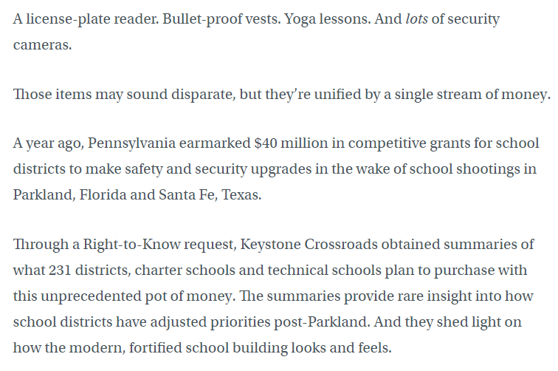

Records Take Many Shapes

Slide 22
Records Take Many Shapes
WHYY: How these Pa. schools fortified themselves…
$40 million state grant program for school security
231 districts, charter schools & technical schools won grants
  7 license-plate readers (at one district)
  Bullet-proof vests
  Night-vision cameras
  Airlock sensors for entrance doors
  Yoga training (no further explanation included in article)

Slide 23
Pennsylvania Universities & Colleges
RTKL applies differently to three types of universities & colleges
State System of Higher Education
  Lock Haven, Clarion, Slippery Rock, West Chester, etc.
  State agencies just like any other state agency
State-Related (Penn State, Temple, Pitt, Lincoln)
  Hybrid, covered by Chapter 15 of RTKL (Form 990 & top salaries)
Private
  Not covered by RTKL other than gov’t contracts

Slide 24

How to File a RTK Request
Submit your RTK request to the correct agency
State agencies: DEP, DOC, PennDOT, etc.
Local agencies: Cities, boroughs, townships, school districts
Address requests to Agency Open Records Officer (AORO)
AORO database available on OOR website

Slide 25
How to File a RTK Request
Basic steps include:
Use the appropriate form
  All agencies must accept OOR’s Standard RTKL Request Form
  Agencies may have their own form, you can choose to use that one
Be specific (but not too specific) when describing records
Make a note of request date
  Very important if you need to appeal

Slide 26
Writing a Good RTK Request
Specificity is a 3-part test: Pa. Dep’t of Educ. v. Post-Gazette
Subject Matter: Identify ‘transaction or activity’ of the agency
Scope: Identify discrete group of docs (e.g., type or recipient)
Timeframe: Identify a finite period of time
  This is the most fluid factor – failure to identify a finite timeframe will not automatically render a request overbroad & a short timeframe will not make an overbroad request specific
  Timeframe can be implied (e.g., “the ongoing Pine Street repaving”)

Slide 27
Specificity: Examples
Commonwealth Court cases on specificity:
Pa. Dep’t of Educ. v. Pittsburgh Post-Gazette
  Can not seek all emails of a public employee over 1 year
Dep’t of Envtl. Prot. v. Legere:
  Seeking 4 years of “Section 208” letters is allowed
  Agency’s organizational decisions not held against requester
Dep’t of Corr. v. St. Hilaire:
  “All records” for 5 years documenting injuries & deaths is allowed

Slide 28
Requesting Police Recordings
RTKL does not apply to police recordings
Act 22 of 2017 covers police video & audio recordings
Must request recording within 60 days of its creation
Agency has 30 days to respond, may deny for various reasons
Denials may be appealed within 30 days to court; $125 fee
Law enforcement agencies & DAs have fairly broad discretion to release a recording (with or without a written request).
More info on OOR website

Slide 29
Requesting Information In Databases
Information in databases subject to presumption of openness
Commonwealth Court has ruled, repeatedly, that agencies must provide non-exempt data from databases
Learn about the database software used by the agency
  If possible, learn capabilities of program/database – ask if unsure
  How do agency employees extract info from database
Terminology can be important – use agency jargon if possible
  Create, export, compile, format, CSV, TXT, comma-delimited…

Slide 30
Speaking of Databases…
Two useful resources:
Online Contract Database, http://contracts.patreasury.gov/
  State agency contracts of $5,000 or more
PennWATCH, http://pennwatch.pa.gov/
  State employee names, titles, salaries & compensation
  State agency employee counts
  Some very basic state budget data

Slide 31
How Much Does This Cost?
OOR fee schedule developed pursuant to RTKL
General rule: No charge for electronic records
  Redactions may necessitate printing electronic records
Up to $0.25/page for hard copies (8.5 x 11, b&w)
Requesters can photograph records
Agencies required to provide records in medium requested (electronic vs. hard copy), do not have to create a record

Slide 32
How Long Does This Take?
Relatively (compared to FOIA & other states) tight timeline
Agency must respond within 5 (agency) business days
  If no response received, request is deemed denied
Agency can extend timeline by 30 calendar days
  Any other extension must be agreed to by requester & in writing
Track all dates & deadlines in case you need to appeal

Slide 33
What If My Request is Denied?
Most denials can be appealed to the OOR
If request is denied, appeal can be filed within 15 business days
Most appeals filed with the OOR
  Not Attorney General, Auditor General, Treasurer, General Assembly
  Not Courts (requests & appeals governed by Rule 509)
  Denials from local agencies based on criminal investigatory records appealed to county DA (but PSP denials appealed to OOR)
Can also appeal redactions (which are denials) & fees
OOR offers a voluntary mediation program

Slide 34
Appealing a RTKL Denial
OOR appeal process designed to be simple
File appeals using online form at OOR website
  About 10 to 15 minutes to fill out
No lawyer necessary
OOR assigns Appeals Officer to oversee case
Both sides can present evidence & argument
OOR has 30 days to issue Final Determination

Slide 35
Overall Cost of the RTKL
Legislative Budget & Finance Committee:
Study released in 2018 (data covering calendar year 2016)
54% of agencies reported $500 or less annual cost
  92% of agencies reported $10,000 or less
Total cost (all agencies, 2016) ~ $5.7 million to $9.7 million
  Median cost = $500
  > 6,000 agencies, so avg. cost = $950 to $1,617 per agency

Slide 36
OOR Resources
Website, Twitter, Email Lists & More
Web: https://openrecords.pa.gov/
Blog: https://openrecordspennsylvania.com/
Email lists: Daily Digest of FDs & General Updates
  https://www.openrecords.pa.gov/EmailSubscriptions.cfm
Twitter: @OpenRecordsPA
  Executive Director: @ErikOpenRecords
YouTube Channel
Open Records in PA Podcast: Apple Podcasts, Stitcher, etc.

