Slide 1

All Things Right-to-Know Law,
2021 Edition
Pennsylvania State Association of Boroughs
June 7, 2021
Liz Wagenseller, Executive Director
https://openrecords.pa.gov
@LizOpenRecords
@OpenRecordsPA
ewagensell@pa.gov
(717) 346-9903

Slide 2
Presentation Overview
Right-to-Know Law Requests
The OOR and the Appeals Process
Tips and Best Practices
Recent Developments
Questions?

Slide 3
Right-to-Know Law Requests

Slide 4
Right-to-Know Law Basics
The very basics of the Right-to-Know Law
RTKL allows people to request state & local gov’t records
Agencies must respond within 5 business days
  Can sometimes extend deadline by 30 calendar days
  Requester can grant additional time – must be in writing
Can grant or deny request, or a combination of both
If any part denied, requester can appeal (<2.5% of cases)
OOR decides cases in 30 days (requester can grant more time)
Either side can appeal OOR decision to court (<10% of cases)

Slide 5
Receiving RTKL Requests
Not everything has to be a formal RTKL request
Use common sense
What will be most efficient? What will take the least time?
Post commonly requested records on website
Little (or no) reason to require RTKL request for simple records

Slide 6
Receiving RTKL Requests
The Agency Open Records Officer (AORO) is VITAL
Borough appoints AORO
AORO receives all requests
AORO serves as main point of contact for requesters
AORO contacts employees & contractors who may have records
AORO tracks deadlines for responses and appeals
AORO, when necessary, consults with agency head
AORO, when necessary, consults with agency solicitor

Slide 7
What are Records?
Any information, regardless of its physical form.
Paper
Emails
Phone records
Text messages
Blueprints
Audio recordings
Security camera footage
Social Media

Slide 8
Possession of a Record
You cannot use personal devices and accounts to hide the public’s business
Third Party (Contractor) Records
Copyrighted Records
Tax Collector Records v. Agency Reports
RTKL does not address records retention, although you should have a retention schedule

Slide 9
Responding to RTKL Requests
What agencies must do (part 1)
Conduct a good faith search for records
  Advise all custodians of potentially responsive records about the request – employees & contractors
  Obtain all potentially responsive records from those in possession
  Review responsive records & assess their public nature
  Search must be reasonably calculated to find all responsive records

Slide 10
Responding to RTKL Requests
What agencies must do (part 2)
Maintain all responsive records through all appeals
  RTKL authorizes courts to sanction for bad faith
Consider the constitutional right to privacy

Slide 11
Responding to RTKL Requests
What agencies are not required to do
Do not have to create a record that doesn’t exist
Do not have to conduct legal research
  “What law gives you the authority to do this thing I don’t like?”
Do not have to create electronic copies if only hard copies exist
But… it might make sense to do any or all of these
  Again: What is most efficient?

Slide 12
Requesting Information In Databases
Information in databases subject to presumption of openness
Commonwealth Court has ruled, repeatedly, that agencies must provide non-exempt data from databases

Slide 13
Payment Issues
Agency is only required to provide the record in the current medium
Cannot charge for electronic records
Must allow Requester to use their own equipment to make copies
Cannot charge for labor/redaction/legal review
Can only charge the actual cost/pass-through costs

Slide 14
The OOR and Appeals Process

Slide 15
Office of Open Records
Created by RTKL: Independent & quasi-judicial
Decide appeals filed by people denied access to records
Provide RTKL & Sunshine Act training
2020 = 2764 Appeals Reviewed
  (372 involved boroughs)
20 total staff
  Executive Director & Deputy Director
  13 Attorneys (incl. 11 Appeals Officers)
  Chief of Training & Outreach
  4 Administrative

Slide 16
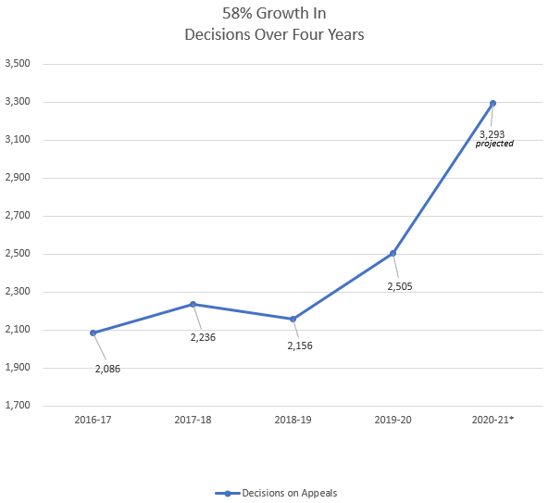
Growth in OOR Decisions

Slide 17
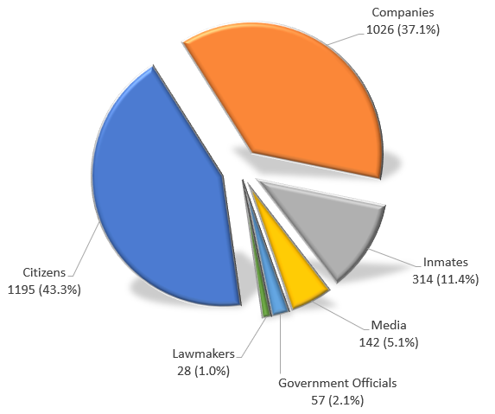
Most Appeals Come From Citizens

Slide 18
Appealing a RTKL Denial
OOR appeal process designed to be simple
Requester can file appeals w/ online form at OOR website
  About 10 to 15 minutes to fill out
No lawyer necessary
OOR assigns Appeals Officer to oversee case
Both sides can present evidence & argument
  Burden of proof is on the agency seeking to deny access
OOR has 30 days to issue Final Determination

Slide 19
OOR Mediation Program
RTKL authorizes OOR to establish informal mediation program
Goal: Mutually agreeable settlement
Voluntary & confidential
Either side can end mediation at any time
  If mediation ends, case moves to normal appeal process (new AO)
OOR has trained mediators
Can save time & expense

Slide 20
Training from the OOR
Training on the RTKL & Sunshine Act
OOR website filled with information
  https://www.openrecords.pa.gov
Weekly virtual trainings: basics, recent cases & more
  Details on OOR website
  May also request a custom virtual training

Slide 21
Tips and
Best Practices

Slide 22
Tip: Communicate with the Requester
Good communication can prevent and solve many issues
Requesters often submit broad requests to ensure they get all the records they want
  Understandable, but can be expensive & frustrating
  Requesters don’t want surprise bills
  Agencies don’t want unnecessary work
Many requesters willing to discuss requests
  Cannot require requester to provide reason for request
If agreement reached on revised request, put it in writing

Slide 23
Best Practices
Experience shows agencies handle RTKL requests best when:
AORO receives RTKL training
  Other staff may also benefit from training
Alternate AORO is available when AORO is out of office
AORO uses resource email account rather than personal email account
Update OOR when AORO changes to another individual
Agency work is done on agency devices & email accounts
A good record retention policy is in place … and followed.

Slide 24
Affidavits
Insufficient to say: The agency looked. They do not have any records.
Level of detail critical to meeting burden
Establish a nexus between the exemption and any redactions
  Who
  What
  Where
  When
  How
  Why

Slide 25
Affidavits
Who looked for records
Who did they talk to as part of search for records – custodian, officials, contractors, person with knowledge, etc.
Where did they look
When did they search
Why did they look there
What did they find or not find – mention retention policy
Where else could the records be - private devices
Why does the agency not have them if it should
What keywords were used as part of the search

Slide 26
Gregg Twp. v. Grove, 2018 Pa.Commw.Unpub. LEXIS 343; 2018 WL 3097074
Request was for footage from security cameras in building used for municipal offices
  Agency denied claiming release would threaten public safety and endanger safety of the building (b)(2) and (3)
Court held agency did not meet burden and video was public
  Why?
    Affidavit was silent as to what was depicted in video
    Affidavit referred generally to all the cameras but failed to explain why footage from one camera will jeopardize safety
    Affidavit did not explain how the cameras are used to enhance public safety – monitored some contemporaneously
    Affidavit did not address whether info could be redacted
    Affidavit had conclusory statements without explaining details about how security will be jeopardized

Slide 27
Recent Developments

Slide 28
RTK Requests During the Pandemic
The OOR remained operational through the pandemic.
The OOR issued indefinite stays (essentially a pause) for all appeals filed with the OOR from late March to early April of 2020; switched to 30 day stays in April.
In August of 2020, the OOR began issuing stays for appeals only as needed; otherwise, business as usual, which continues to this day.

Slide 29
Sunshine Law During the Pandemic
Act 15 of 2020 went into effect on April 20 and applies as long as an emergency declaration is in effect.
  Remote meetings are allowed; quorum may be fulfilled with remote participants.
  “To the extent practicable” local government agencies must provide advance notice of all remote meetings including date, time, technology, and how the public can participate.
  “To the extent practicable,” local government agencies must provide for public participation directly through the teleconferencing or videoconferencing system used to hold the meeting, via email and/or via postal mail.
  If an emergency meeting (i.e., a meeting called without public notice) related to COVID-19 takes places, the minutes of that emergency meeting must be made available within 20 days.
Even when in-person meetings resume, the virtual option of participating and viewing an agency meeting may continue.

Slide 30
Recent Court Cases of Interest
Finnerty vs. Department of Community and Economic Development (2021)
  Documents exchanged with an outside consultant are not exempted as “internal deliberations”
Uniontown Newspapers vs. Department of Corrections (2020)
  The DOC failed to disseminate documents that the OOR ordered be released; Commonwealth Court found that the DOC “acted in bad faith” and required the DOC to pay the newspaper $118,458 in legal fees

Slide 31
Pending Legislation of Note
SB 522 (Dush): Vexatious requestors
SB 312 (Brooks): Commercial requestors
SB 492 (Mastriano): commercial requesters, inmates, personal fin. Info. and PIAA
SB 554 (Stefano): Requires that agencies make their meeting agendas available to public at least 24 hours before meeting; once agenda finalized, may not take any official action on any item that is not listed on the notice, except in emergency situations or to consider matters that are de minimis in nature.

Slide 32
In Development at OOR
Electronic docketing system
  All steps of appeal process conducted on portal accessed via OOR website
Promulgation of regulations of appeals process
Review of agencies’ RTKL webpages
  Will publish report with best practices

Slide 33
OOR Resources
Website, Twitter, Email Lists & More
Web: https://openrecords.pa.gov/
Blog: https://openrecordspennsylvania.com/
Email lists: Daily Digest of FDs & General Updates
  https://www.openrecords.pa.gov/EmailSubscriptions.cfm
Twitter: @OpenRecordsPA
  Executive Director: @LizOpenRecords
Phone: (717) 346-9903
Email: openrecords@pa.gov

